Slide 1
Emerging from the Filter Bubble:
Helping Students Go from Confirmation Bias to Cross-check

Slide 2
History of Fake News
Rise of the Internet
Current Landscape
Media Response
What Can You Do?
Knowledge about the types of fake news
Insights into the origin of fake news
Skills and activities for recognizing and evaluating images, articles, and facts for veracity

Slide 3
Fake News Isn't New

Slide 4
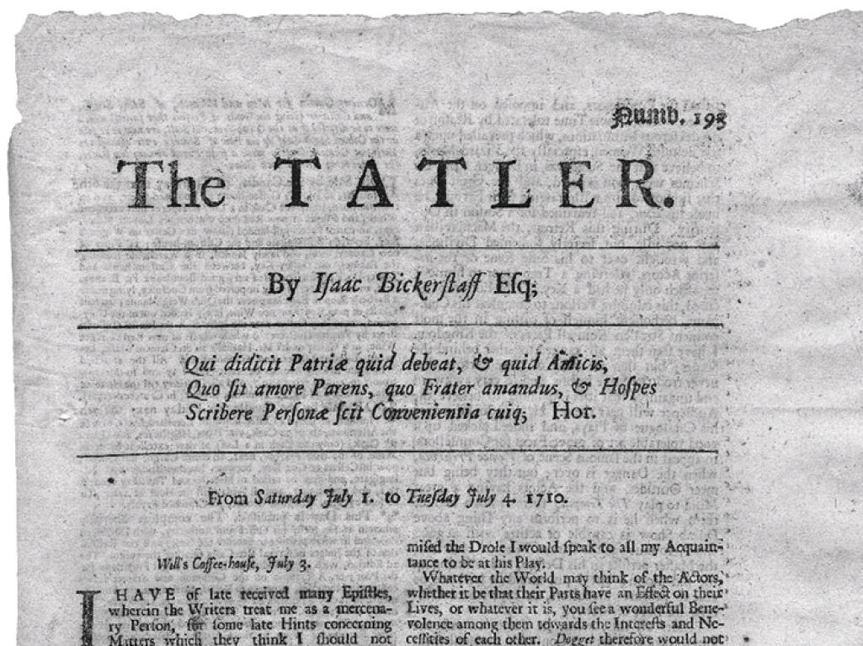

Slide 5
"principally intended for the use of politic persons, who are so public spirited as to neglect their own affairs to look into transactions of State. Now these gentlemen, for the most part, being men of strong zeal and weak intellects, it is both a charitable and necessary work to offer something, whereby such worthy and well-affected members of the commonwealth may be instructed, after their reading, what to think;"

Slide 6
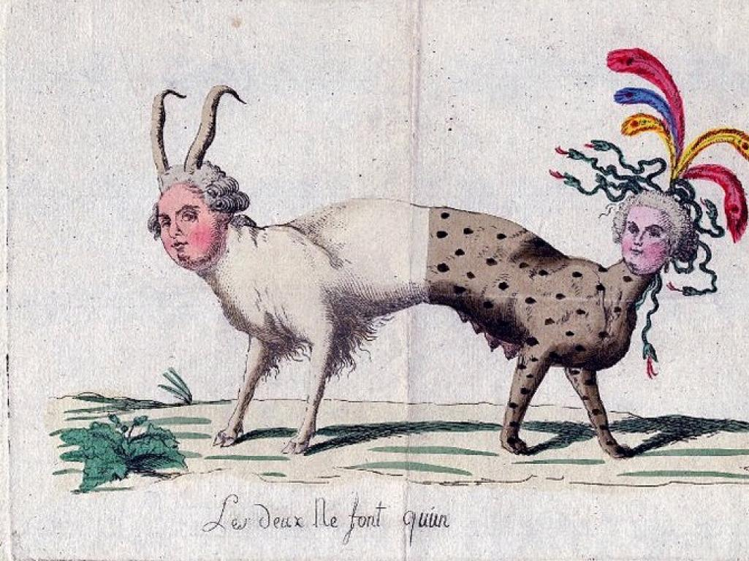
Notes:
"The two only make one" 1791 http://collection.waddesdon.org.uk/search.do?view=detail&page=1&id=42635&db=object

Slide 7
Fake News History Video

Slide 8
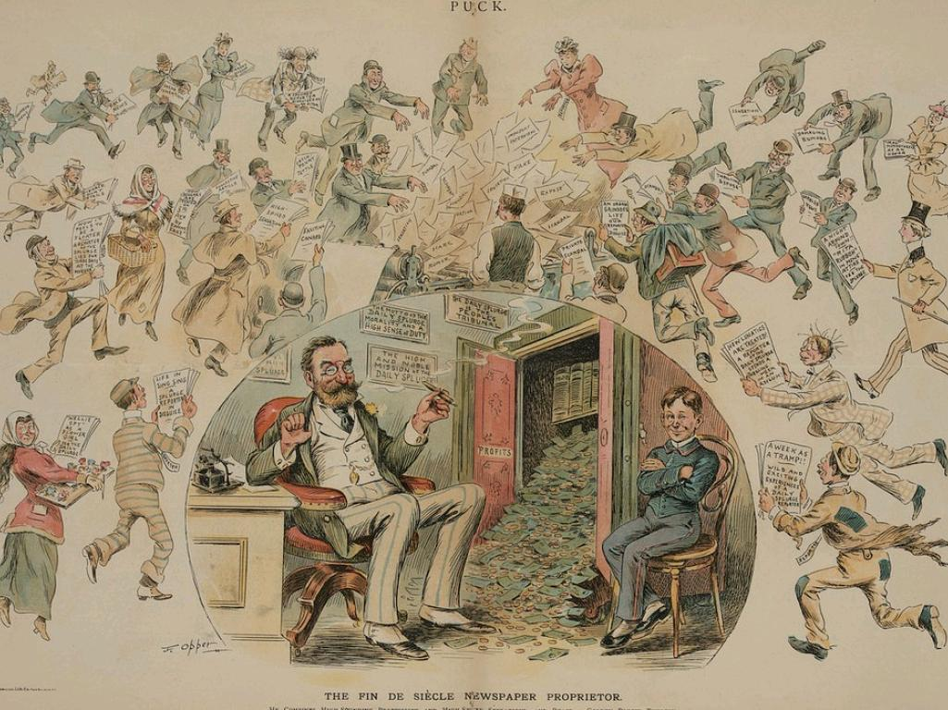
Notes:
1894, Fin De Siecle Newspaper Proprietor Joseph Pulitzer Source: https://www.loc.gov/resource/ppmsca.29087/

Slide 9
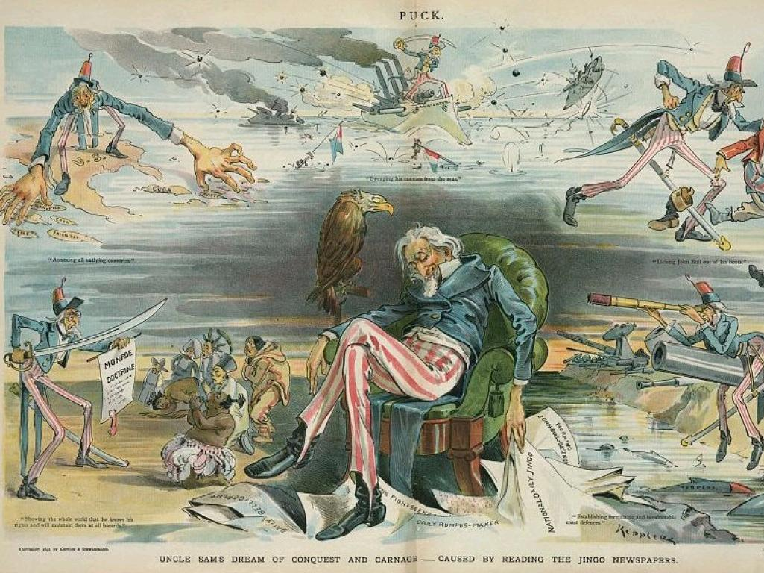
Notes:
1895 source: https://www.loc.gov/item/2012648579/

Slide 10
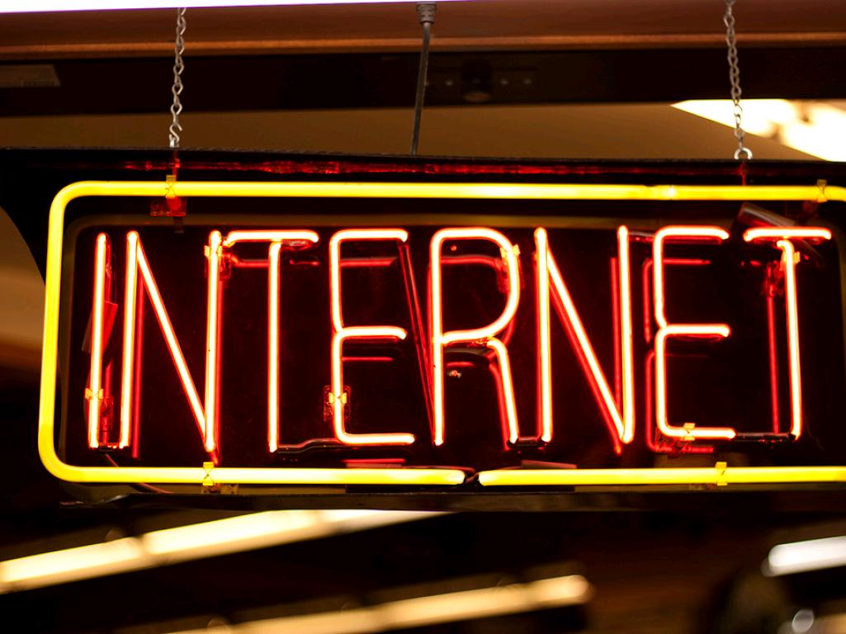
Rise of the
cc: DocBrownX - https://www.flickr.com/photos/40693555@N02

Slide 11
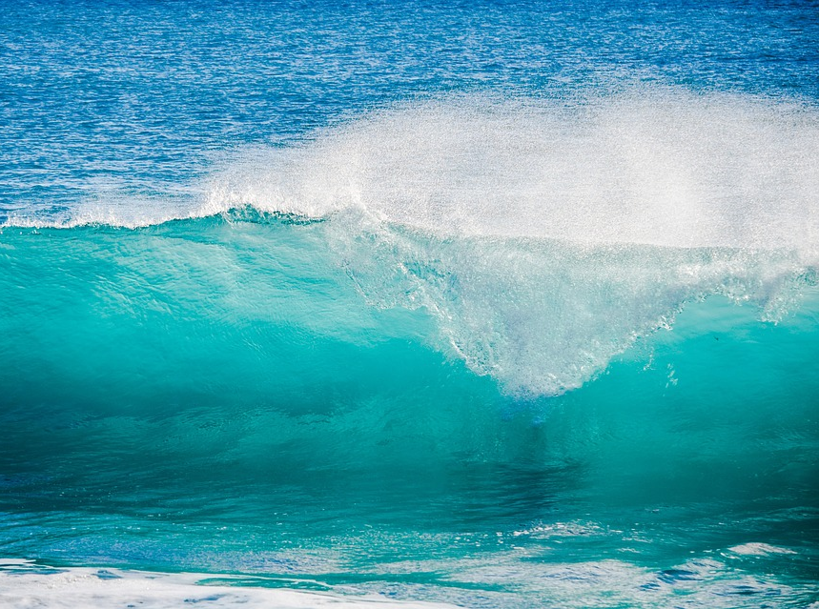
Information Inundation

Slide 12
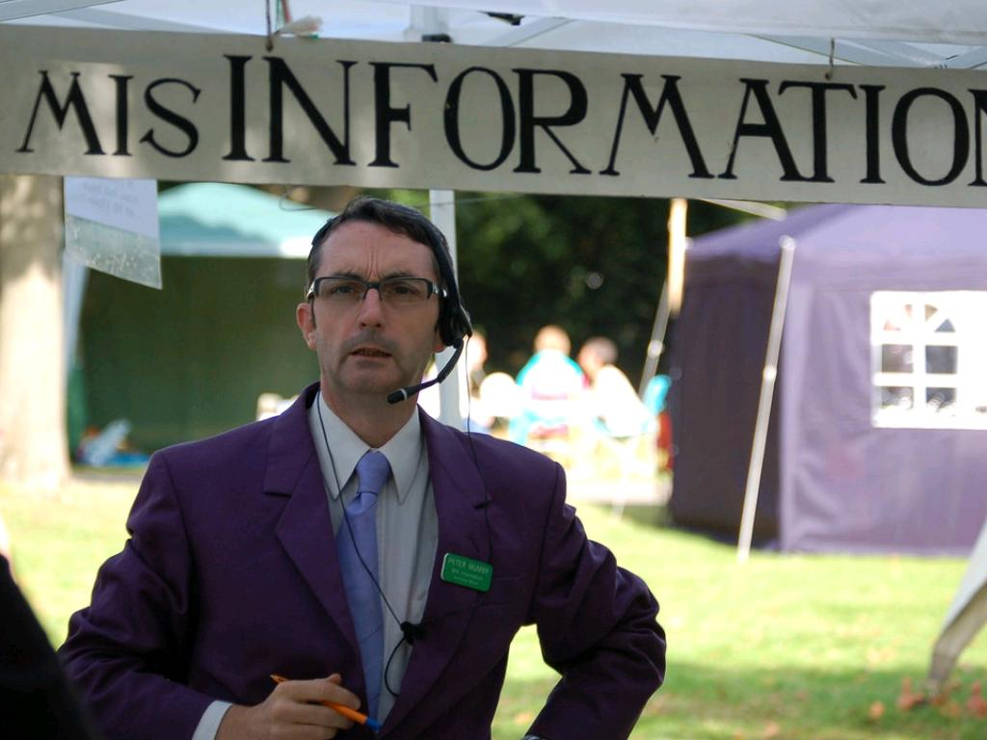
cc: jimjarmo - https://www.flickr.com/photos/10846528@N05

Slide 13
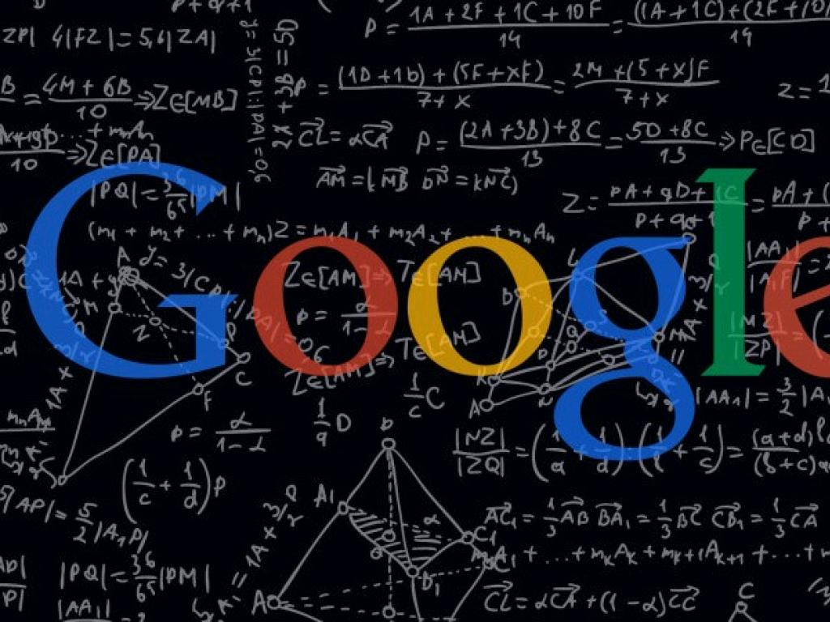

Slide 14
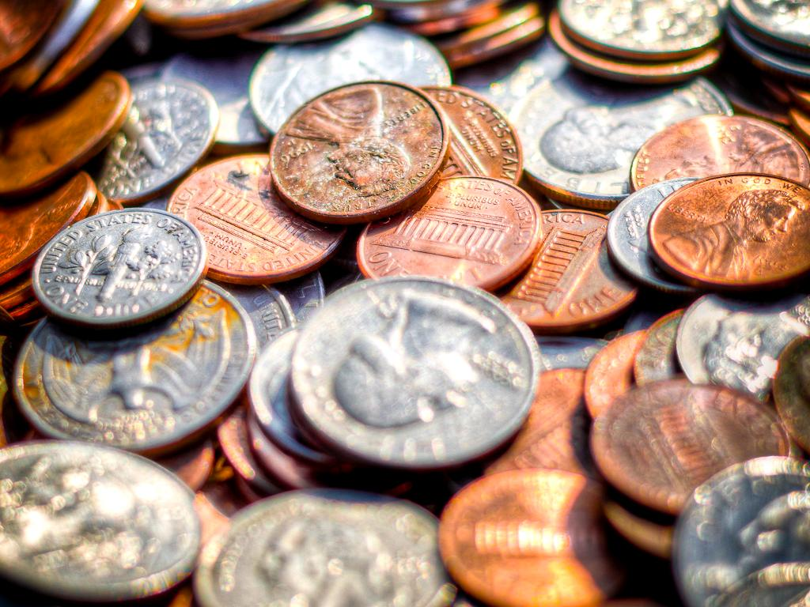
Clicks = Money
cc: Ian Aberle - https://www.flickr.com/photos/7305851@N07

Slide 15
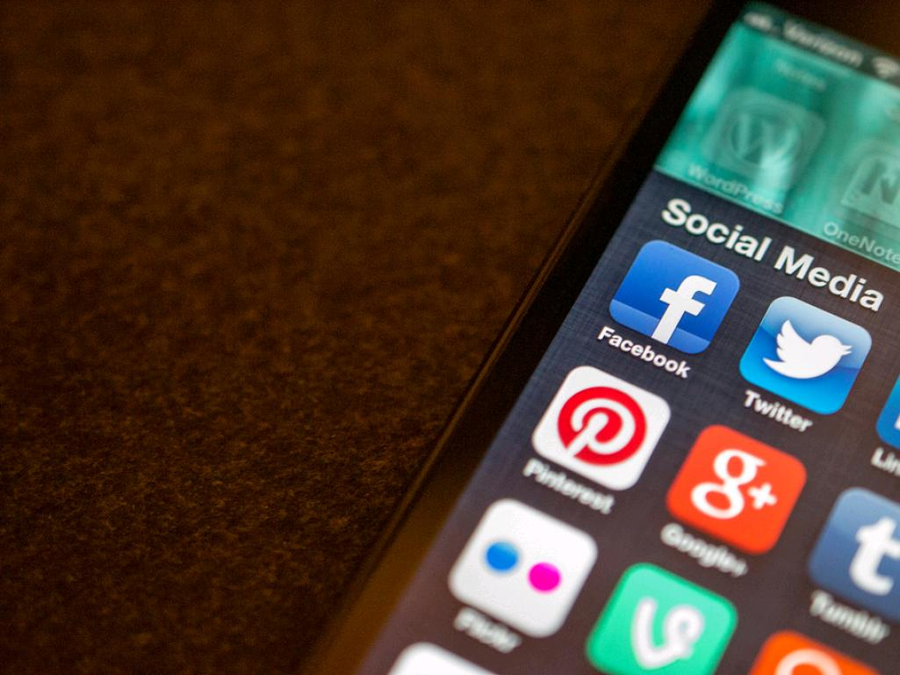
Social Media
cc: Jason A. Howie - https://www.flickr.com/photos/40493340@N00

Slide 16
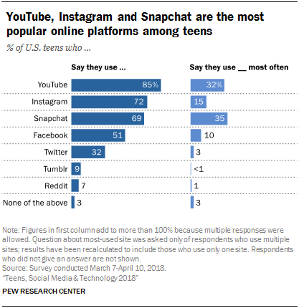
“YouTube, Instagram and Snapchat are the most popular online platforms among teens. Fully 95% of teens have access to a smartphone, and 45% say they are online ‘almost constantly’”
http://www.pewinternet.org/2018/05/31/teens-social-media-technology-2018/

Slide 17
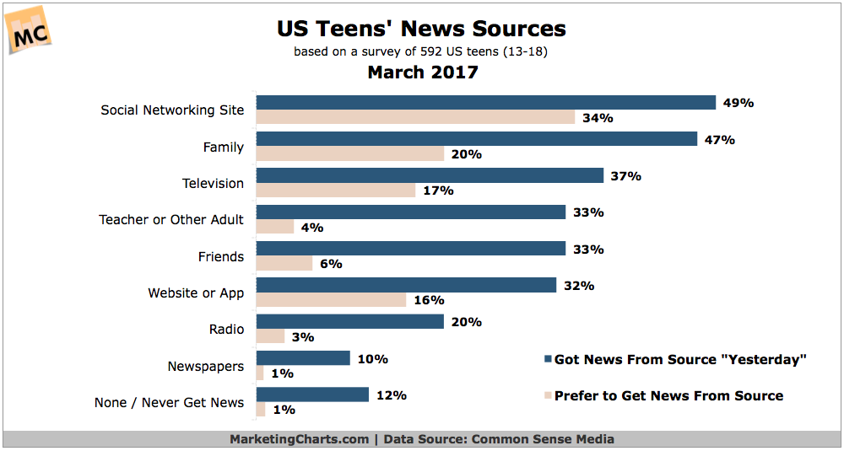
“More US teens say they get their news from social networking sites (49%) and family (47%) than from any other source, according to a study from Common Sense Media.”
https://www.marketingcharts.com/industries/media-and-entertainment-75562

Slide 18
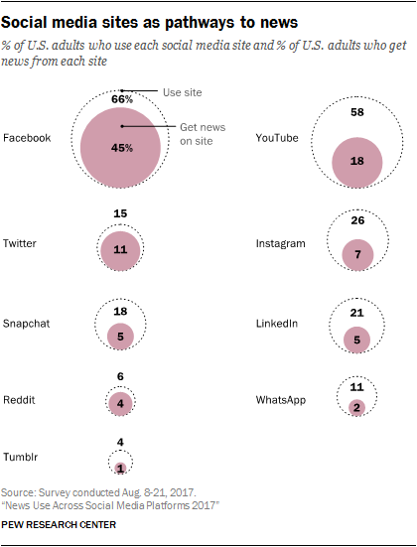
“Overall, Facebook outstrips all other social media sites as a source of news; YouTube now reaches second highest percentage”
http://www.journalism.org/2017/09/07/news-use-across-social-media-platforms-2017/

Slide 19
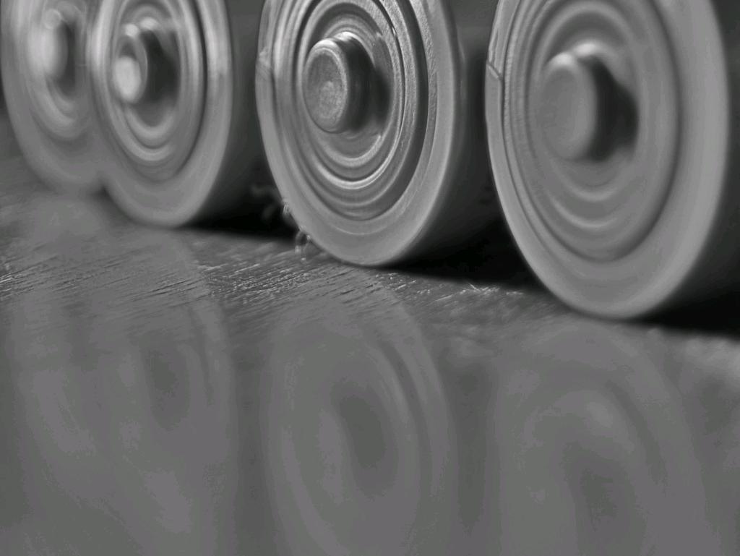
Polarized
cc: r.nial.bradshaw - https://www.flickr.com/photos/33227787@N05

Slide 20
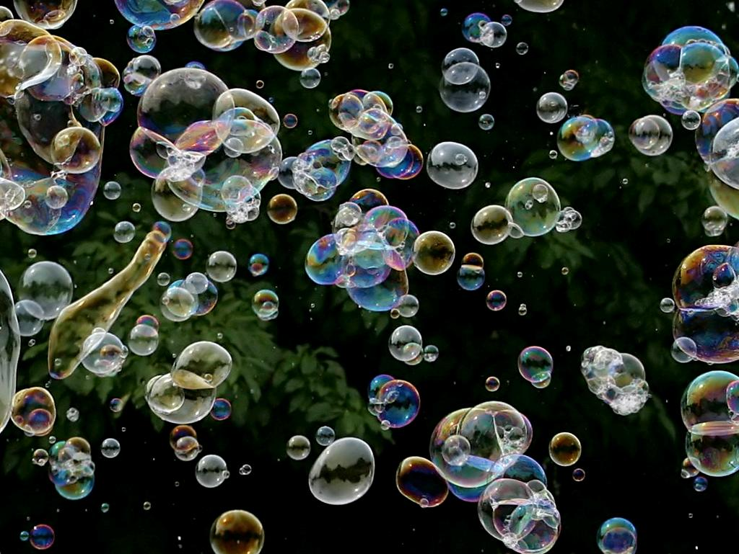
Your Bubble
cc: Glenn Loos-Austin - https://www.flickr.com/photos/15888330@N00

Slide 21
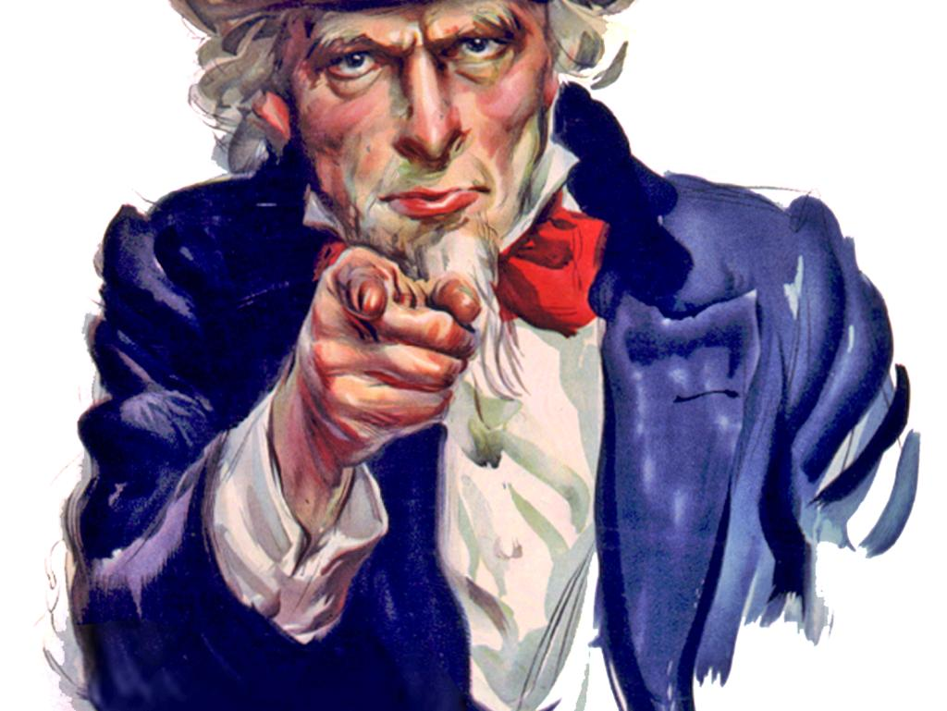
What Can You Do?
cc: DonkeyHotey - https://www.flickr.com/photos/47422005@N04

Slide 22
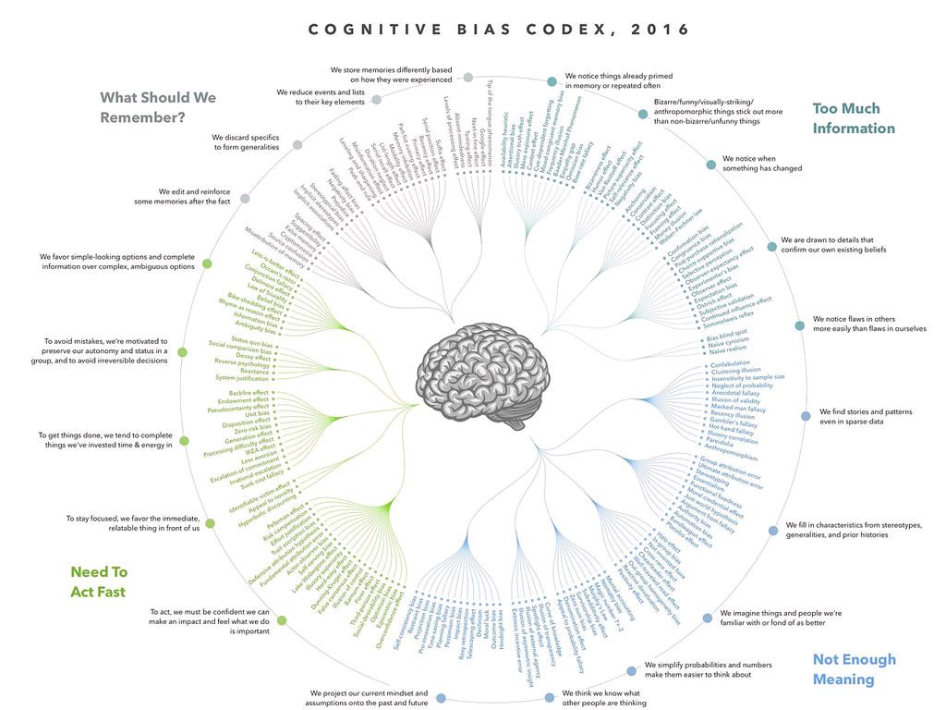
Be Aware of Cognitive Biases
cc: eric.delcroix - https://www.flickr.com/photos/24998164@N06

Slide 23
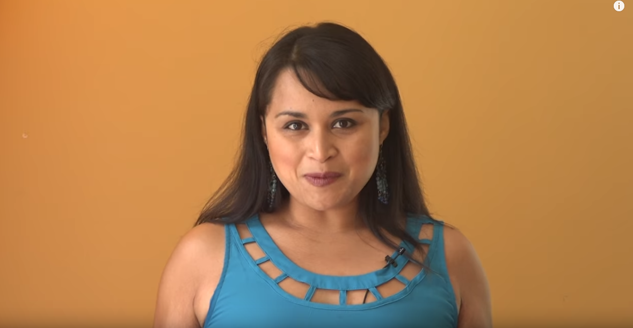
Confirmation Bias
5 Ways to Beat Confirmation Bias

Slide 24
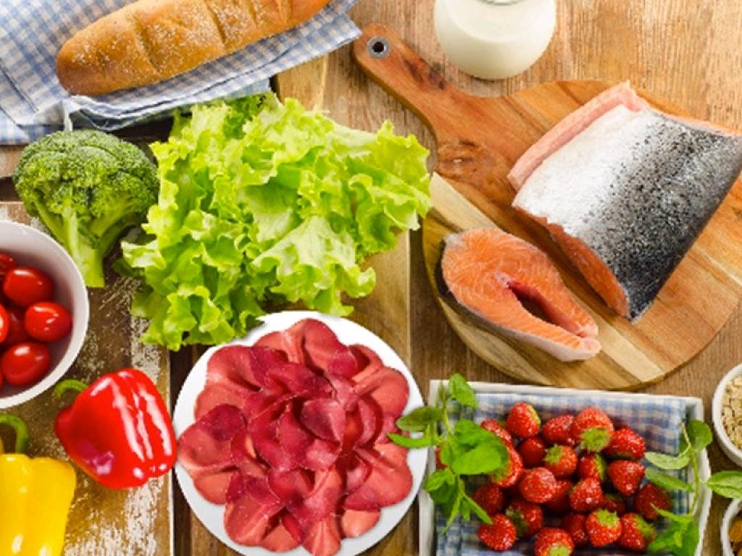
Varied Diet

Slide 25
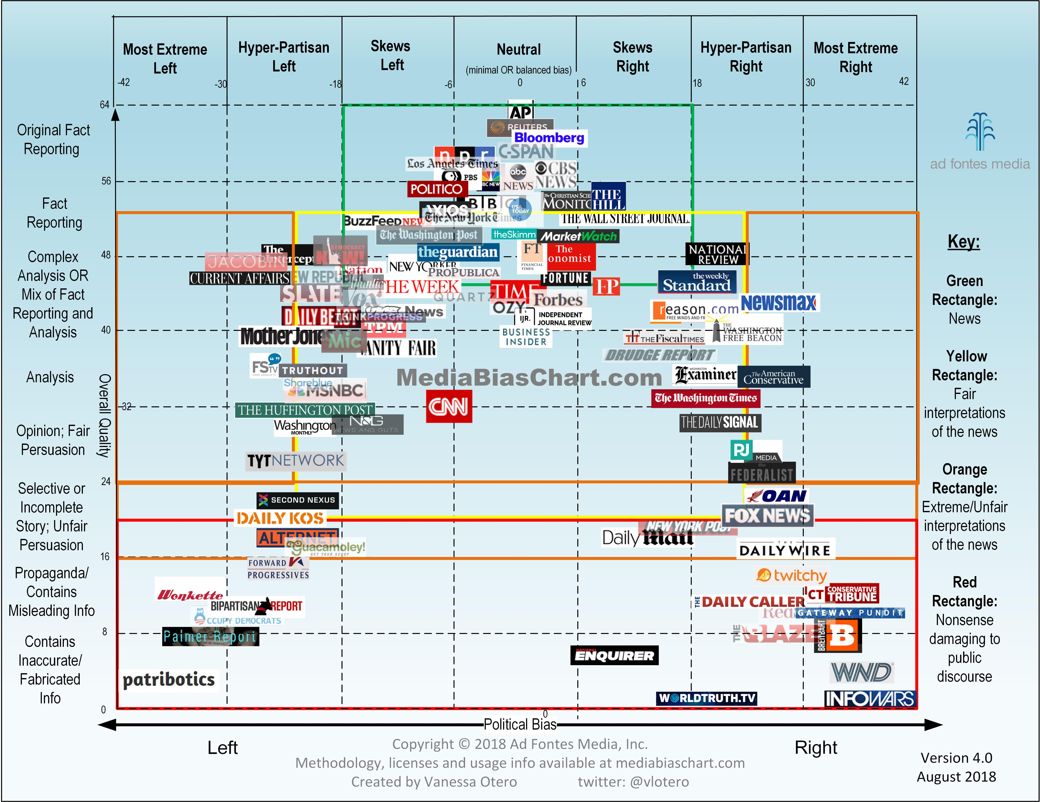
https://www.adfontesmedia.com/

Slide 26
YOU
Filter Bubble

Slide 27
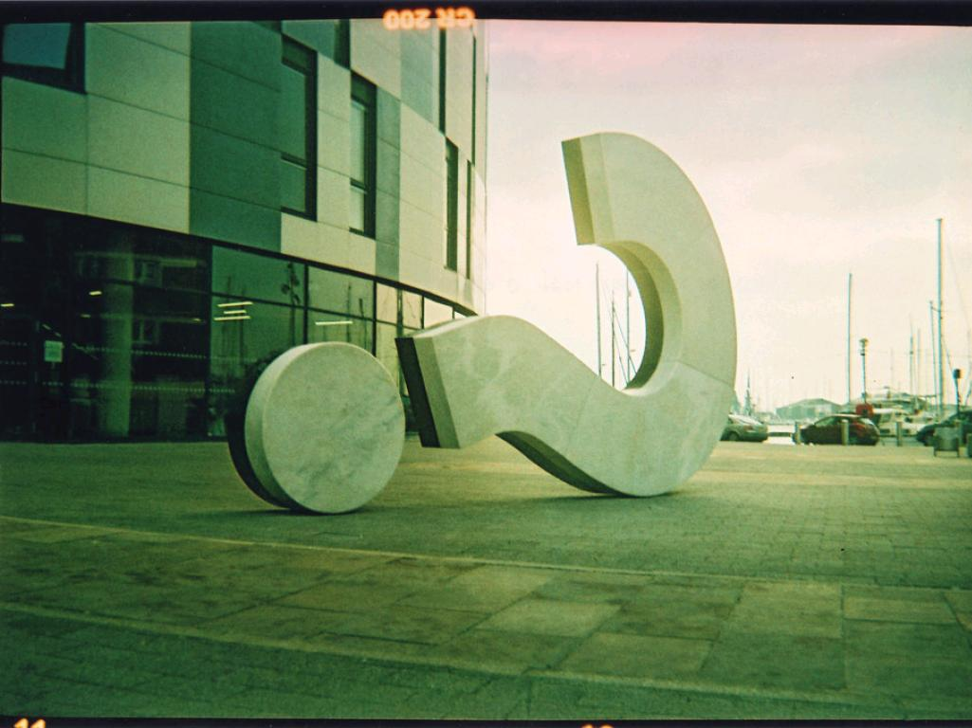
Ask Questions
cc: ed_needs_a_bicycle - https://www.flickr.com/photos/91029339@N00

Slide 28
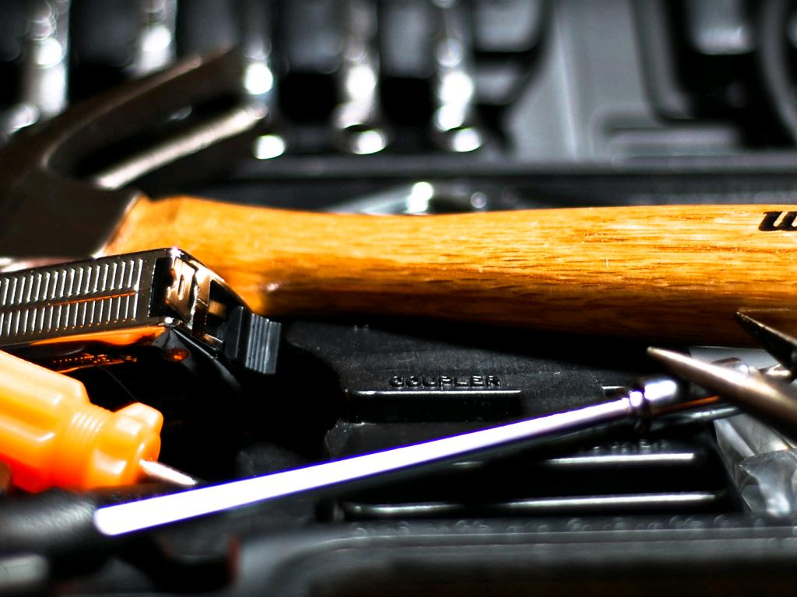
Your Toolkit
cc: RLHyde - https://www.flickr.com/photos/36655009@N05

Slide 29
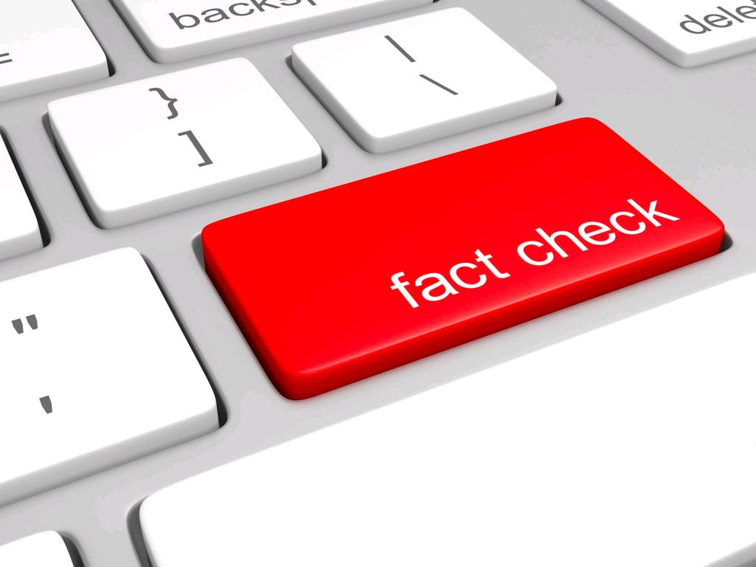
Fact Checking Sites

Slide 30
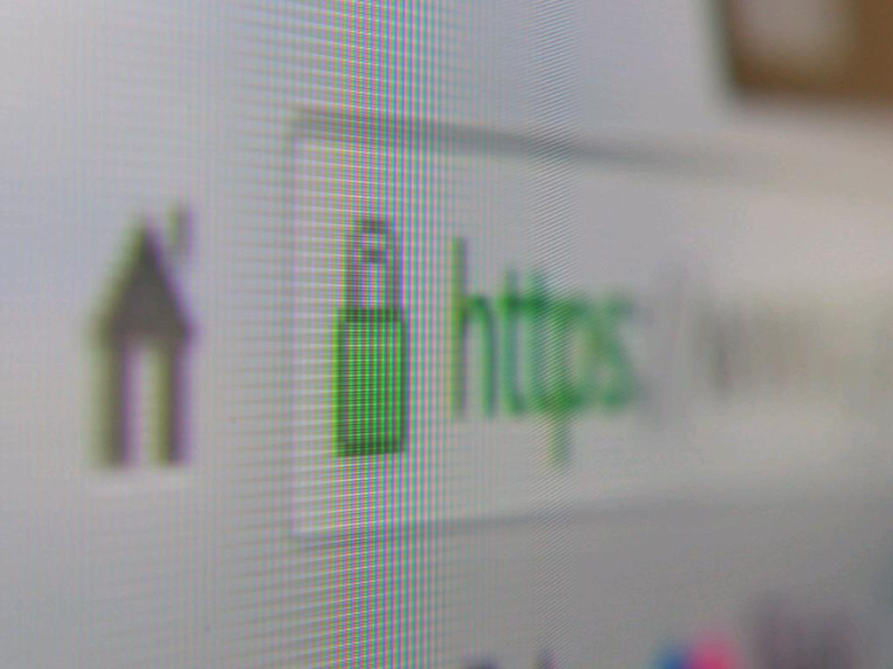
Browser Extensions
cc: Yu. Samoilov - https://www.flickr.com/photos/110751683@N02

Slide 31
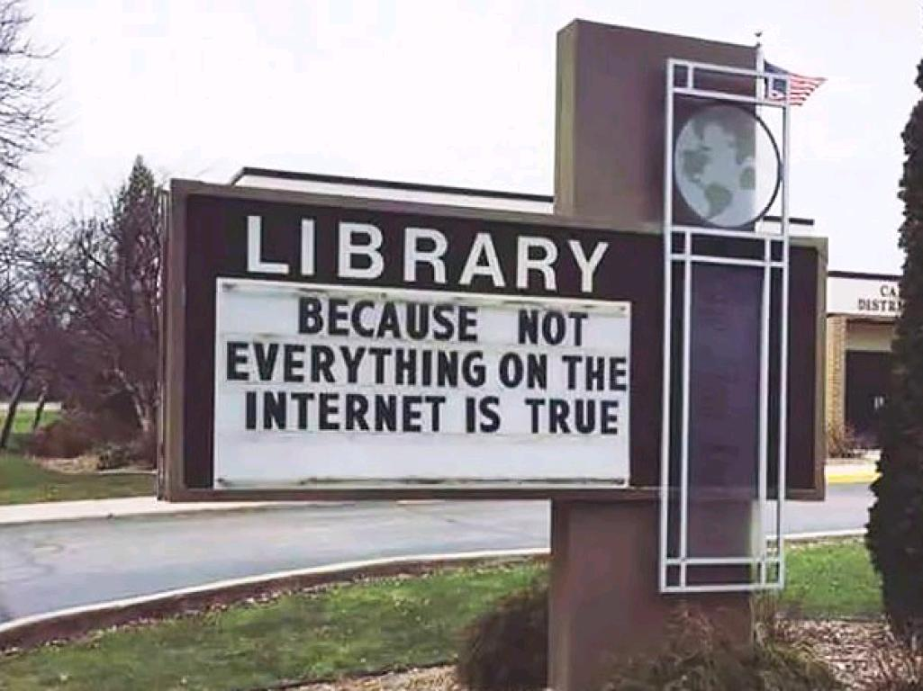

Slide 32
Diana Shull & Martha Stephenson - UW-Whitewater - libguides.uww.edu/fakenews

