Slide 1
Creating an Expense Report in Workday
Step-by-Step Instructions for Submitting Mileage Expenses

Slide 2
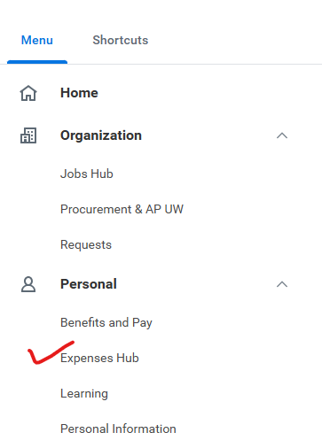
Access the Expenses Hub
From the Workday homepage, click Menu.
Select the Expenses Hub app.

Slide 3
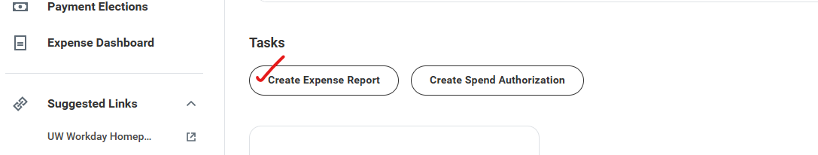
Create an Expense Report
Click Create and Expense Report
Enter and review data in all required fields
Click OK to continue

Slide 4
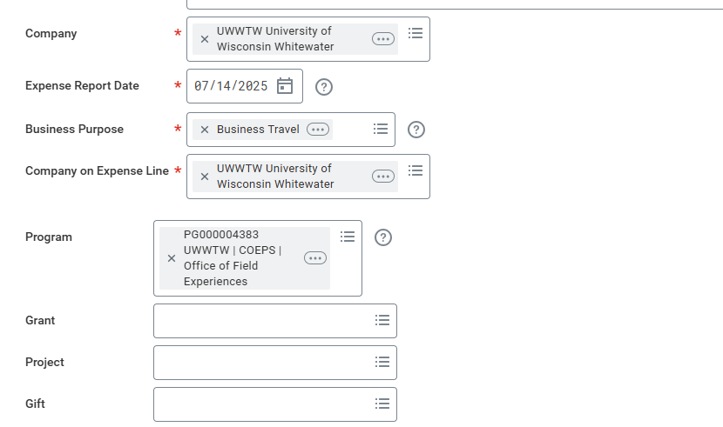
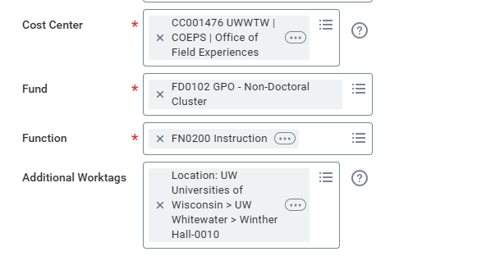
Funding String
Date of Travel
Funding String:
Program: PG 000004383
Cost Center: CC001476
Fund: FD0102
Function: FN0200

Slide 5

Add Attachments (If Needed)
Submit only necessary approvals or information, such as emails from the Dean.
Click Edit.
Select Choose Files or drag and drop to upload documents.
Click Save.
Travel Maps and Itineraries are not required!

Slide 6
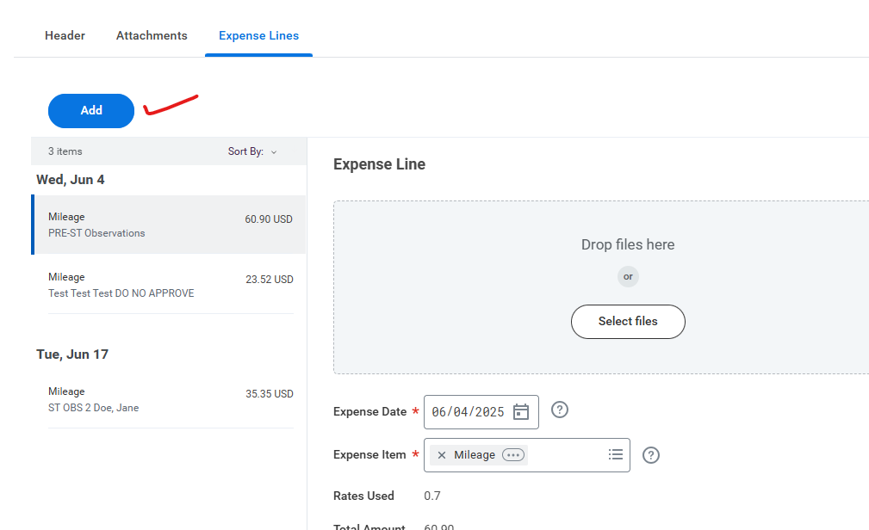
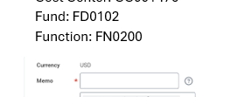
Adding Expense Lines
Click the Expense Lines tab.
Click Add to enter each expense item.
Enter the following information:
Expense Date: Travel date
Expense Item:
Choose from the list or type “Mileage”
Memo: Enter one of the following:
  ST Doe, John (for Student Teaching)
  PRE-ST Doe, Jane (for Pre-Student Teaching)
* Memo area serves as Itinerary
This is where you will attach your maps or itinerary if you choose, but are not required

Slide 7
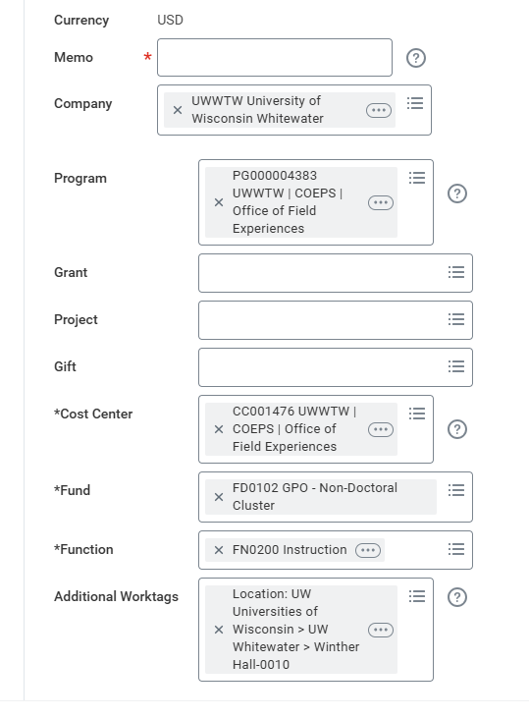
Verify Cost Information
Ensure the following fields are correctly entered:
Company: UWWTW
Program: PG000004383
Cost Center: CC001476
Fund: FD0102
Function: FN0200

Slide 8
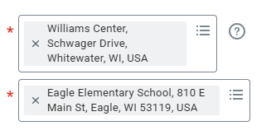
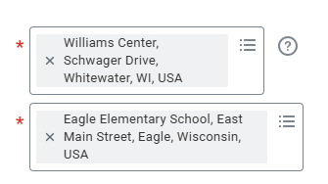
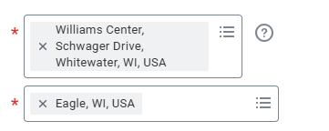
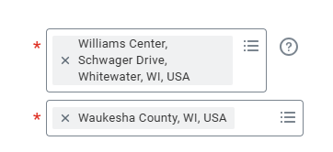
Enter Mileage Details
Origin Address:
  Your home address or
  Williams Center, Schwager Drive, Whitewater, WI, USA (if closer)
Destination Address (Enter in this order-Examples):
  School Name: Eagle Elementary School, Eagle, WI
  Street: 810 E Main St
  City: Eagle, WI
  County: Waukesha County, WI
Round Trip?: Check box if applicable

Slide 9
Add More Expense Lines
Mileage calculates automatically.
Click Add to enter additional expense lines.
Repeat steps for each travel date or location.
Enter an expense line for each destination:
1. Williams Center to Eagle Elementary
2. Eagle Elementary to Whitewater Middle School
3. Whitewater Middle School to Williams Center
DO NOT click Submit until all expense lines have been entered.

Slide 10
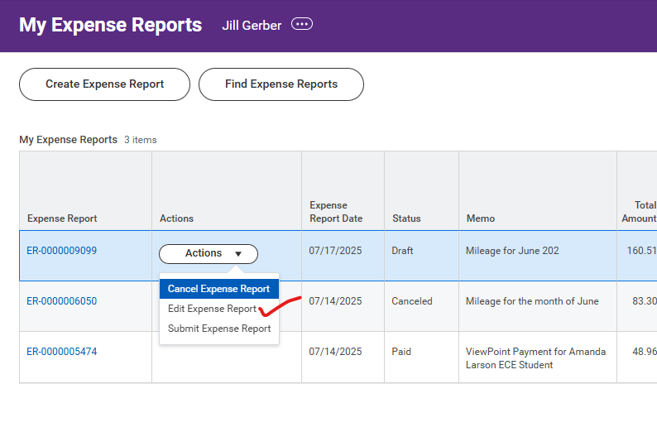
Final Step-Review and Submit
After all items are added, your list appears on the left panel.
Review for accuracy.
Click Submit to finalize the report or
Click Save for Later
Save for Later: allows you to Edit or
Continue to add expense lines.
The saved report will be listed in
“My Expense Reports”

Slide 11
Questions
Jill Gerber
Data and Special Programs Assistant
gerberj@uww.edu
262.472.1935

