Slide 1
Tips to Save You Time:
Find Info Fast
https://pixabay.com/vectors/telescope-vintage-retro-optical-2518988/

Slide 2
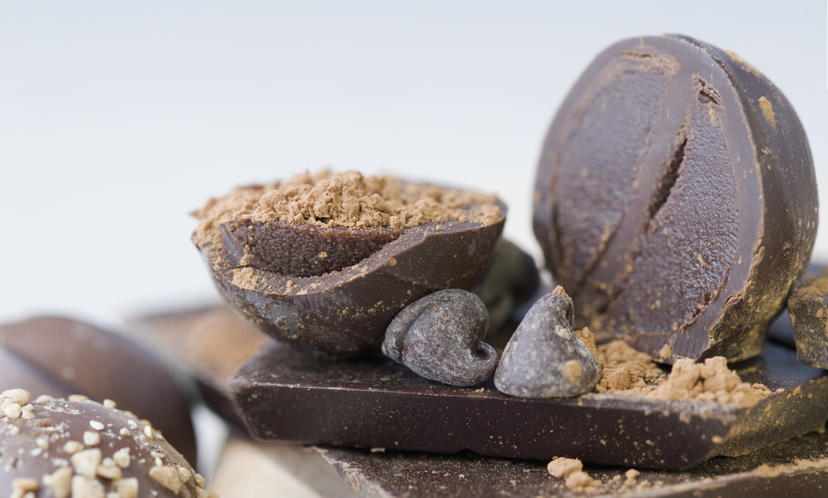
Statement, Issue, Question (What do you want to know?)
What are the health benefits of dark chocolate?

Slide 3
Health | Benefits | Dark chocolate
diet | lower blood pressure
nutrition | good mood
weight | fights free radicals
calories | reduce heart disease
B
R
A
I
N
S
T
O
R
M

Slide 4
Health | Benefits | Dark chocolate
diet | lower blood pressure | cacao
nutrition | good mood | cocoa
weight | fights free radicals | antioxidants
calories | reduce heart disease | flavonols
B
R
A
I
N
S
T
O
R
M

Slide 5
Health | Benefits | Dark chocolate | Good stuff
diet | lower blood pressure | cacao | antioxidants
nutrition | good mood | cocoa | flavonols
weight | fights free radicals | chocolate | flavonoids
calories | reduce heart disease
B
R
A
I
N
S
T
O
R
M

Slide 6
Keyword Tip #1: multiple terms
Use when have several different concepts
All concepts will be in the results
Narrows search (finds fewer, more useful results)
disease Finds=
heart disease diet Finds=

Slide 7
Keyword Tip #2: Phrases
Quotation Marks “ ”
Use when words often or always occur in a specific order, e.g., as a phrase
Words will be in the exact order entered in the results
Narrows search (finds fewer, more useful results)
heart disease diet Finds=
“heart disease” diet Finds=
BUT NOT “health”

Slide 8
Keyword Tip #3: Use Truncation
Truncation
Place symbol at end of root word
Use to find all endings for a root word
Broadens search (finds more results)
Be cautious of short root words!
diet* = diet OR diets OR dietary…
Caution! cat* = cat OR cats OR catatonic plus over 250 words unrelated to cats

Slide 9
Keyword Tip #4: Use NOT
NOT
Use to remove a term
Order matters, use it before the last term
The term after NOT will be omitted from the results
Narrows search (finds fewer, more useful results)
“heart disease” diet Finds=
“heart disease” diet NOT exercise Finds=

