Slide 1
Resilience: The path to hope and healing
Protective Factors that Make a Difference

Slide 2
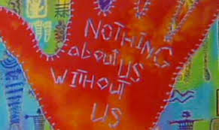
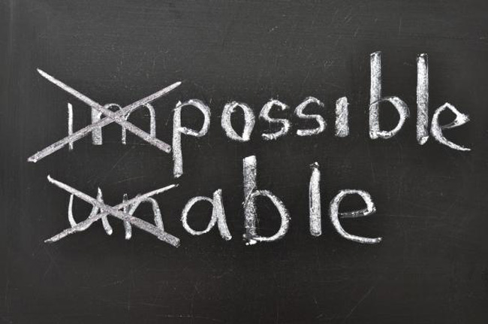
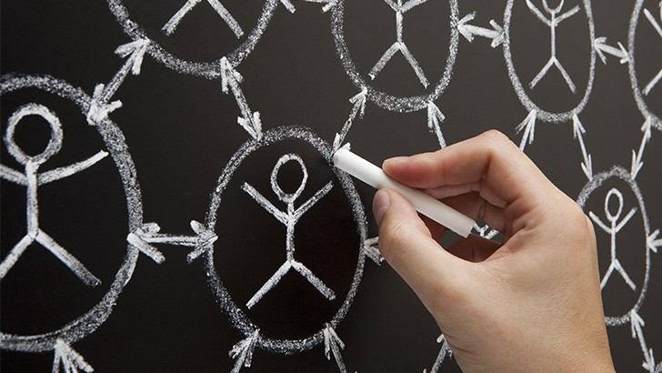
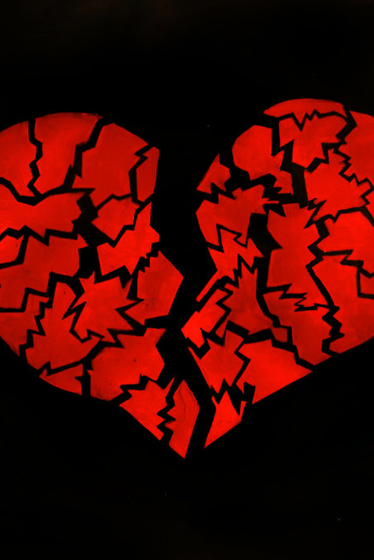
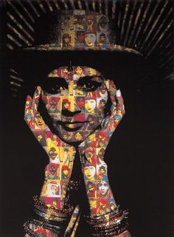
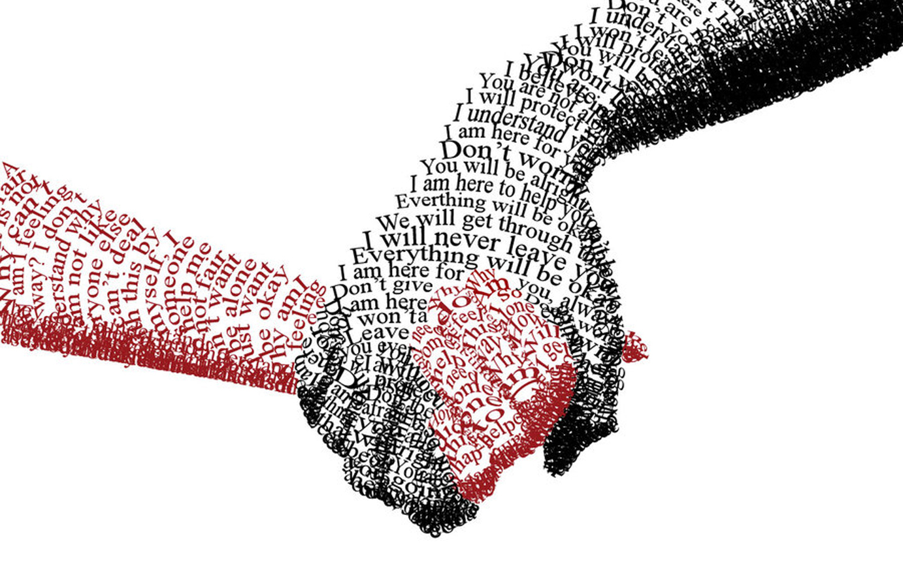
Resilience is the ability to overcome challenges of all kinds and to bounce
back stronger, wiser, and more personally powerful.

Slide 3
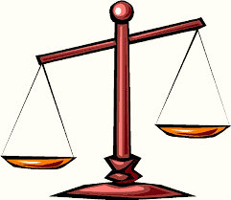
Addressing RESILIENCE at multiple levels:
Personal/
Interpersonal
Organizational/
Community
Systems
PROTECTIVE FACTORS
RISK
FACTORS

Slide 4
Your Influence
Caring Relationships/Community
Meaningful Participation
Positive High Expectations with Support
Mastery
Real Talk
Creative Expression
Service to Others
Cultural Identity

Slide 5
Caring Relationships
BUILDING COMMUNITY

Slide 6
Meaningful participation

Slide 7
Positive and High expectations …with support

Slide 8
Mastery

Slide 9
When ordinary conversations become extraordinary

Slide 10
Creative Expression
“If your heart is broken,
make art with the pieces”
-Shane Koyczan, Poet

Slide 11
Service to others
“We rise by lifting others.”
-Robert Ingersoll

Slide 12
Cultural identity
To Be Seen. Understood. Empowered.

Slide 13
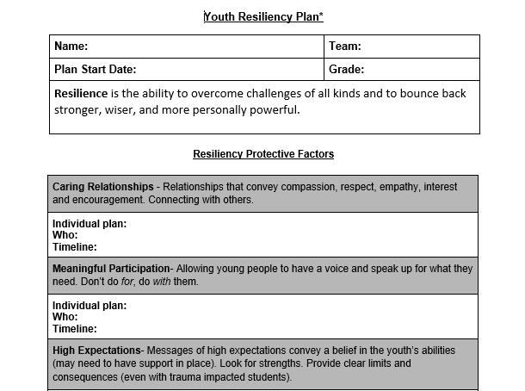

Slide 14
Families as Partners in building resilience
Don’t Forget the Families
The Search Institute (2012)

Slide 16
To Maximize Your Influence…
How will you promote resilience in youth?
How will you cultivate your own resilience?
How does building your own resilience impact your ability to build resilience in young people?

Slide 17
To Maximize Your Influence
One thing I learned or re-learned was…
One thing that surprised me was…
One thing that moved me…

Slide 18
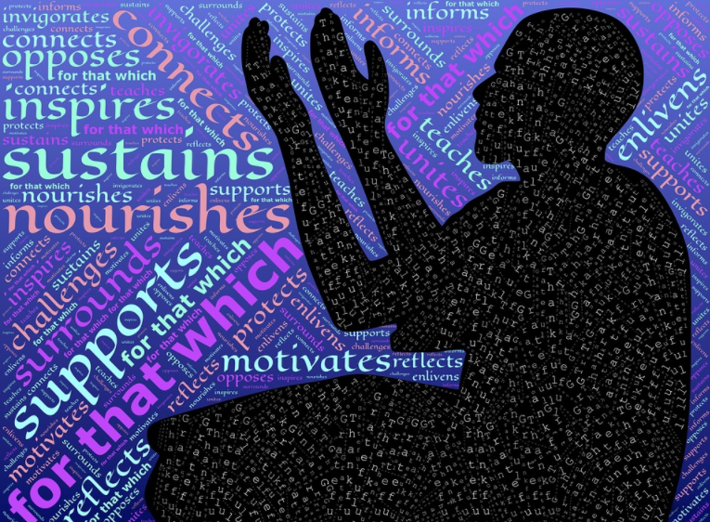
Thank you
Monica.Wightman@dpi.wi.gov
Funding for this conference was made possible by NITT-HT grant, CFDA 93.243 from SAMHSA. The views expressed in written conference materials or publications and by speakers and moderators do not necessarily reflect the official policies of the Department of Health and Human Services; nor does mention of trade names, commercial practices, or organizations imply endorsement by the U.S. Government.

