Slide 1
Duel: Co-Occurring Disorders Strategies for Recovery & Relapse Prevention
Gabrielle O’Neil

Slide 2
Who Am I?
Professional speaker
Artist, Poet, Musician
Aunt, Daughter, Sister

Slide 3
Friend, Explorer, Traveler
Athlete, Footballer

Slide 4
Defining the Terms
People who have substance abuse use disorders as well as mental health disorders are diagnosed as having co-occurring disorders or dual disorders
Addiction/Substance Abuse: When substance use interferes with functioning
Recovery: A return to a normal state of health, mind or strength; the action or process of regaining possession or control of something stolen or lost
Relapse: Re-occurrence of a prior condition; or in the context of substance abuse, the re-initiation of drug-seeking behaviors and the resumption of use after a period of abstinence
Notes:
AmericanAddictionCenters.org ADD: INFO GRAPHIC FROM SITE
Addictions.com

Slide 5
How I see things…
Everyone is different- different approaches/definitions
Recovery: A model for wellness and living that is conducive to current circumstances and my personal needs.
Relapse: Specific to drugs.

Slide 6
What comes first: the chicken or the egg?
ADDICTION
DISEASE
The fact or condition of being addicted to a particular substance, thing or activity
A disorder of structure or function in a human, animal, or plant, especially one that produces specific signs or symptoms or that affects a specific location and is not simply a direct result of physical injury

Slide 7
Addiction vs. Disease
Symptoms:
Can overlap
Are often interrelated
One can trigger symptoms in the other (can become cyclical)
Thus the Question…
There’s not a lot of research or data on recovery
Books
Creative Recovery
The Price of Greatness
Film: Recovery Boys (Netflix)

Slide 8
“So what’s your deal?”
My co-occurring disorders
Bipolar
PTSD
ADD
Substance addiction

Slide 9
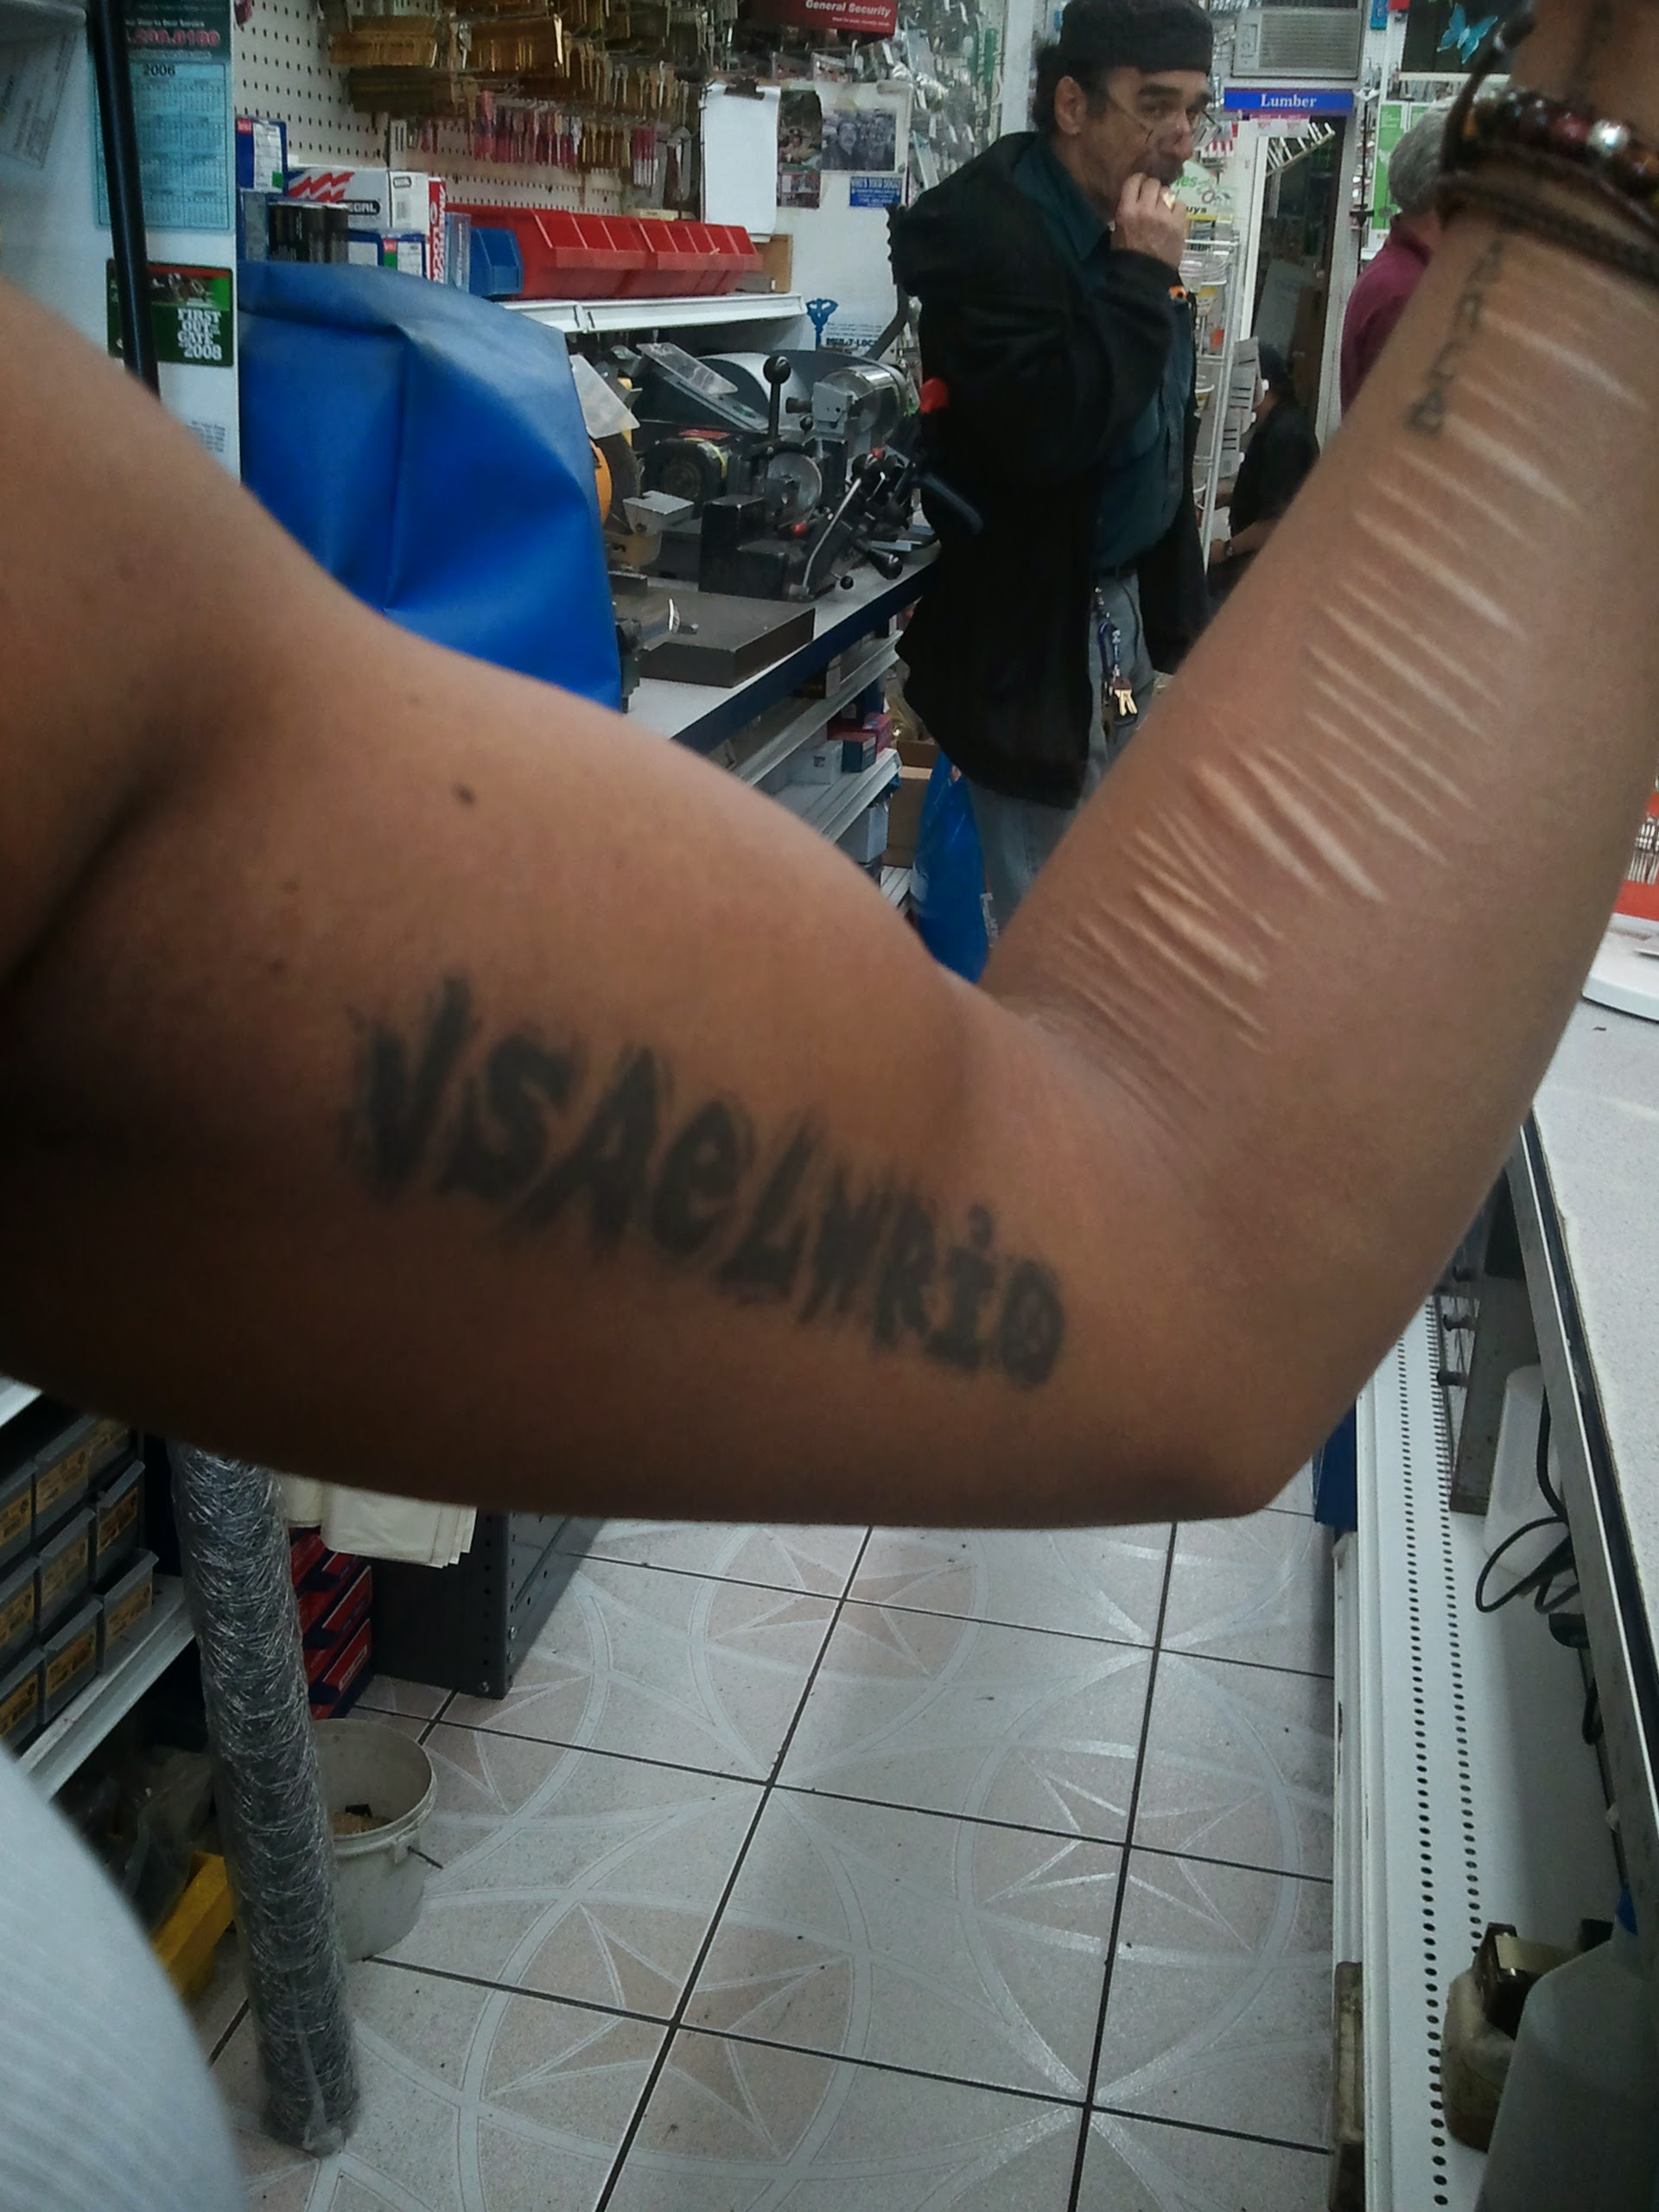
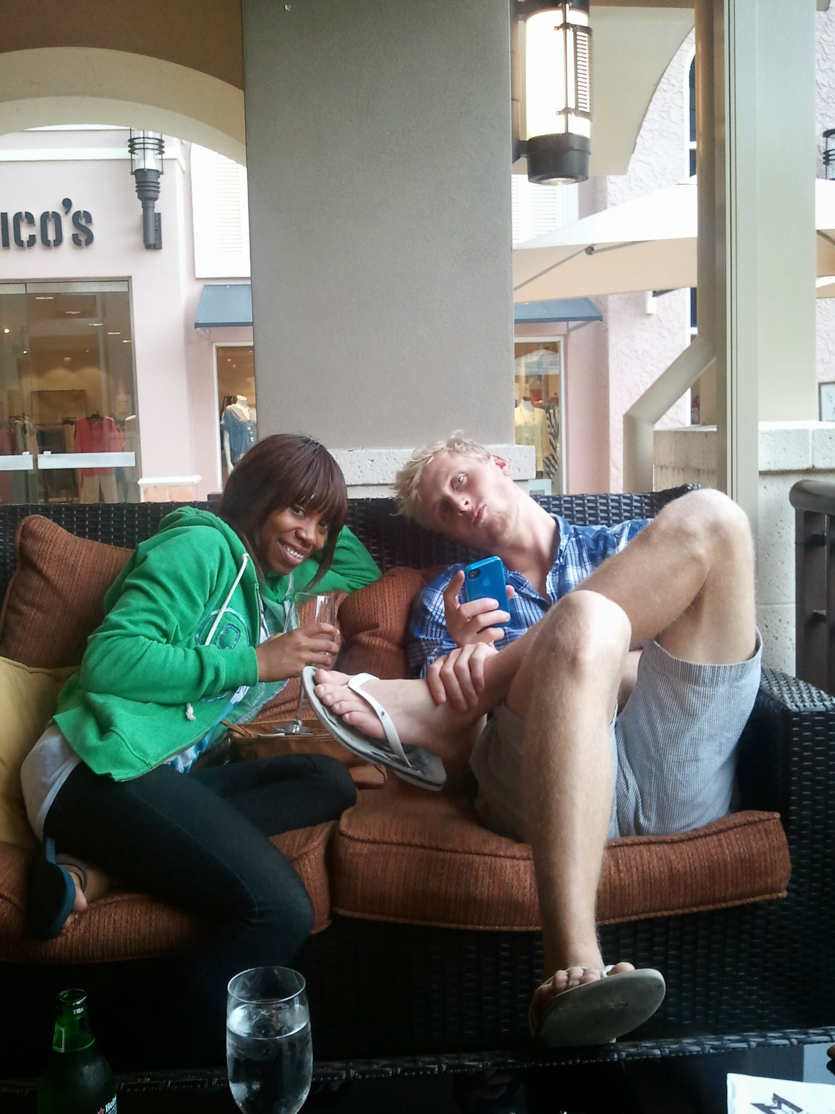
My Co-Occurring
Before going to a hospital in Florida
Self harm
Cocaine skinny, manic

Slide 10
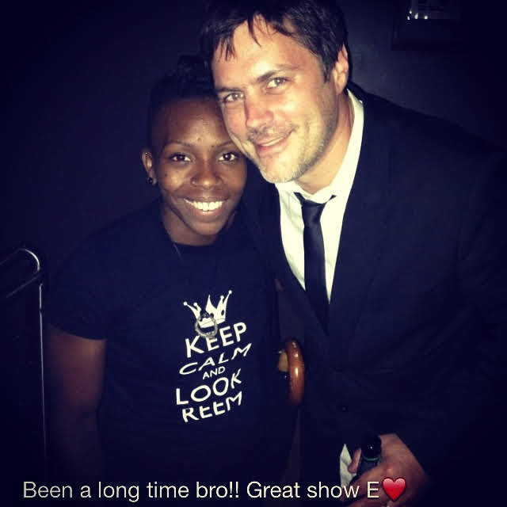
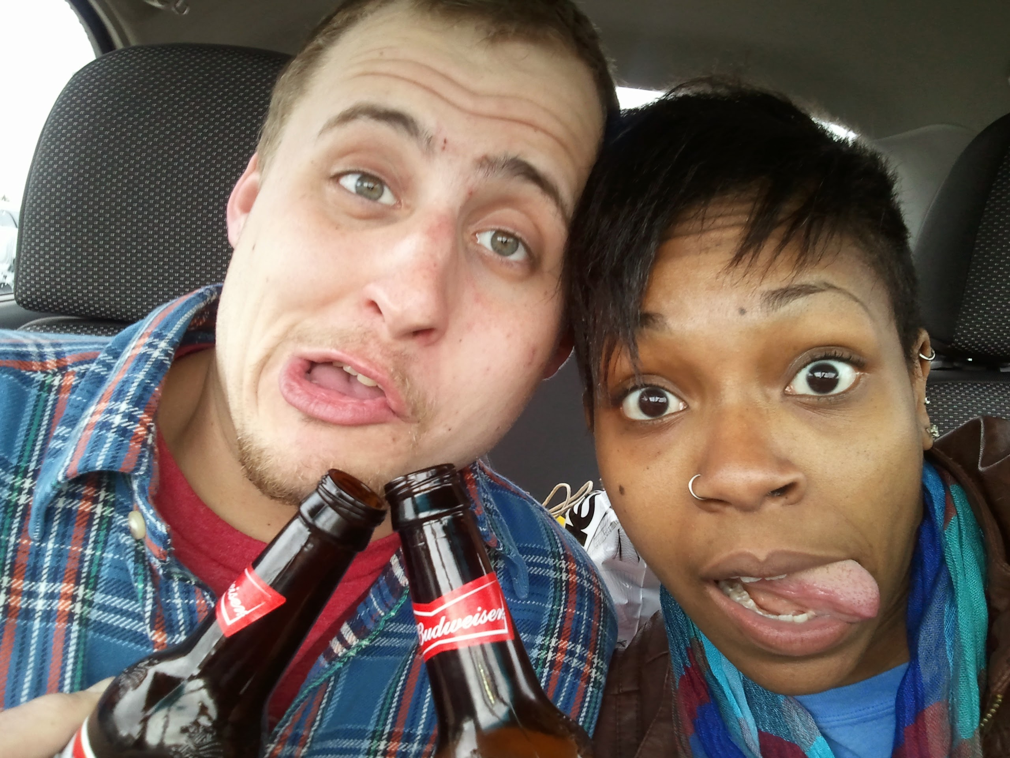
“Always a reason to party”
Drinking with my buddy in the hospital parking lot after the birth of one of his kids
My friend Ethan
Passed away a couple of years ago
“The beginning of the end”

Slide 11
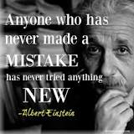
Failure is the only way to SUCCESS?

Slide 12
Know Your Particular Risk Factors
ACEs- Adverse Childhood Experiences
Gay/Coming out
Attempted suicide more than once
Dual diagnosis
Triggers (stress and anxiety, sleep deprivation, lack of proper nourishment, certain touches, specific relationships, places/memories etc.)

Slide 14
Strategies
Questions to Ask
Answers Reveal
What do I love?
What do I fear?
What do I want?
Desire, motivation/intention
Provides insight, highlights areas of resistance
A roadmap for an action plan, a framework, directs goals- inspires challenges
#reframe

Slide 15
Strategies
Know thyself
Self awareness, Self care
Identify your needs and triggers
Reach out
Ask for help
Have a plan
Practical
Healthy food
Quality sleep
Exercise
Sunshine
Being around people who are good for you
Having purpose
#reframe

Slide 16
Strategies
How to find hope?
What is the impetus for change?
Ask for what you need
Crowd sourcing
Wisdom of the community
Produce thoughts that create an environment capable of cultivating hope.
Knowing your triggers (self awreness/ self work)
Having a plan (action)
Be open to new things (adapt and evolve)
Be proactive
Stay ahead of relapse/ episodes. LIVE recovery.
#reframe

Slide 17
Gaining Ground
This is achieved by living a recovery plan, self awareness, being alert to when you are triggered or symptoms arise
How do I live my Recovery?

Slide 18
Holistic Recovery Plan
Mind, Body, Spirit: Address all three areas, they interrelate
Engaging the Mind
Reading, writing, puzzles, art, conversation, mindfulness
Engaging the Body
Exercise, prioritizing quality sleep and food, body positivity
Engaging the Spirit
Connecting to a greater purpose

Slide 19
A curious mind:

Slide 20
Questions & Answers
What are your thoughts?

Slide 21
Additional Items
More people than you think live with mental illness
Stigma is a silencer
Creative people have higher rates of mental illness
As do LGBTQ, people with ACEs, people with biological risk factors, trauma, toxic environment
Sobriety vs. Recovery
Recovery as a way of life
Addiction & Mental Illness
Doing the same thing, expecting different results = Definition of insanity
Do things differently, Change your patters
Brain Plasticity

Slide 22
Sources
Book: Creative Recovery & The Price of Greatness
SAMSA
Mentalhealthamerica.net
Lived Experience
National Institute Of Mental Health
Notes:
ADD SOURCES

Slide 23
Professional Information
Gabrielle O’Neil
www.gabrielletalks.com
thisisgabrielletalks@gmail.com
gabrielle@namiwaukesha.org
Notes:
ADD WEBSITE, ETC, INFORMATION

