Slide 1
Now Is The Time- Serving Young Adults with Mental Health and AODA Concerns
Sara Zwieg, Jefferson County
Joe Horsch, Outagamie County
Emily Enstad, Jefferson County
Brandie Veronikas, Jefferson County
August 10, 2018

Slide 2
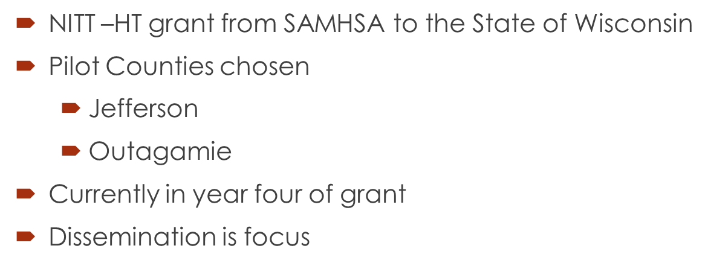
How Did We Get Here?

Slide 3
Who We Are
Sally Raschick, NITT Principle Investigator, DHS
Teresa Steinmetz, Children, Youth and Families Section Chief, DHS
Joe Horsch, YES Director, Outagamie County
Sara Zwieg, YES Director, Jefferson County
Emily Enstad, YES Service Facilitator, Jefferson County
Chris Richards, YES Service Facilitator, Jefferson County
Brandie Veronikas, Youth Coordinator, Jefferson County
Lois Miller, Parent Liaison, Jefferson County

Slide 4
Comprehensive Community Services Program
Comprehensive Community Services is the Program
Youth Empowered Solutions (YES) is the Philosophy
aka a different way of doing business when
working with youth/young adults (Y/YA)

Slide 5
Goals of the Now is the Time Grant
Provide age-appropriate, culturally-competent, and
evidence based behavioral health treatment.
Increase number of youth/young adults aged 16-25
receiving mental health and/or AODA services.
Increase awareness of providers, parents, youth, and
young adults on the mental health issues and needs of
Youth/Young Adults aged 16-25.
4. Develop and implement practice changes that will improve
Youth/Young Adult engagement as well as promote
successful transitions to adulthood.
5. To create opportunities for positive youth development and youth
leadership that engage and empower Youth/Young Adults.

Slide 6
Optimal Goal
Disseminate new philosophy and practices through a
YES! Framework that will assist the State of Wisconsin counties
and partners to have knowledge and tools to engage
and support youth and young adults with a successful
transition into adulthood.

Slide 7
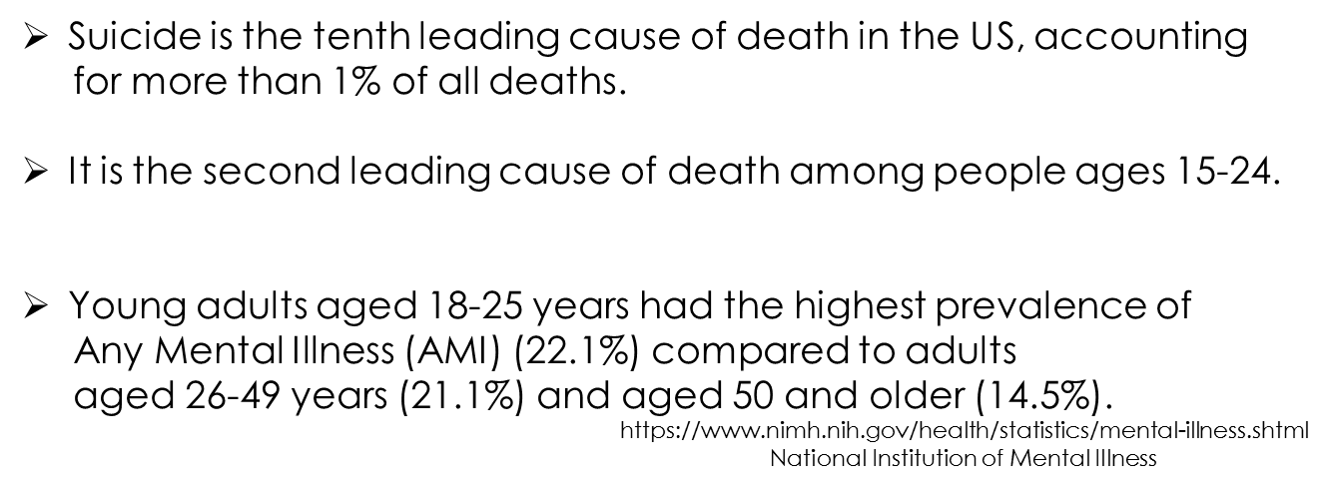
Why Do We Need To Do Something Different
http://www.mentalhealthamerica.net/suicide

Slide 8
"This Is Who I Am"
(Mental Health Stigma Reduction) –
YouTube
https://www.youtube.com/watch?v=Xew-rFIVk4U&feature=youtu.be

Slide 9
Youth/Young Adults Have Different Needs
Than Other Populations
We have three systems of care with various needs
Children
Y/YA
ADULT

Slide 10
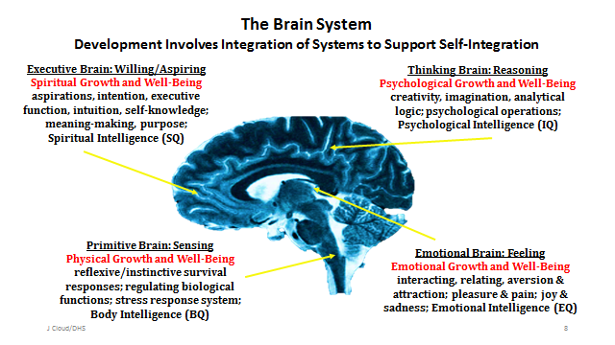
BRAIN SYSTEM

Slide 11
ENGAGE, EQUIP, EMPOWER

Slide 12
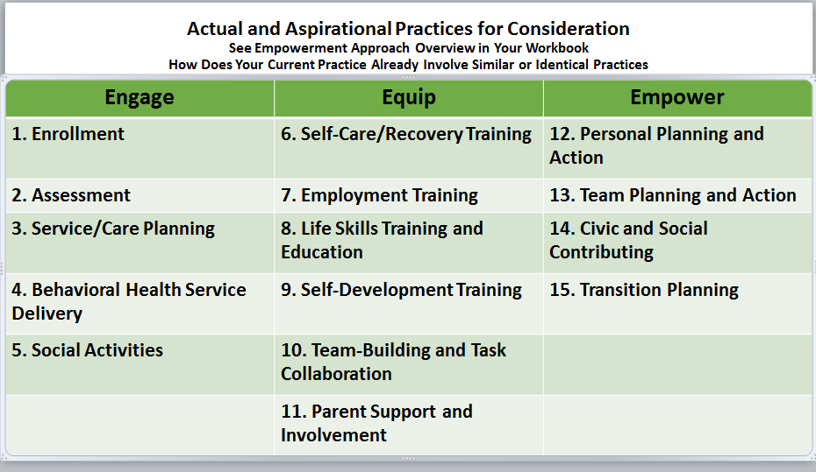
ENGAGE, EQUIP, EMPOWER

Slide 13
ENGAGE
Ask permission
Choices
Use of Technology
Language
Sparks
Youth Voice
Services
Build Rapport
Motivational
Interviewing
Partner
Acceptance
Compassion
Evocation
Do not focus initial contact
on consumer Trauma
Partner
Psychoeducation
Small and Obtainable Goals
Strengths
Create Experiences
Ask how the
process of engagement was
past services

Slide 14
ENGAGE
Communication Strategies
Texting
Use agency texting policy
Emails
Facebook/Instagram/Snapchat/Twitter

Slide 15
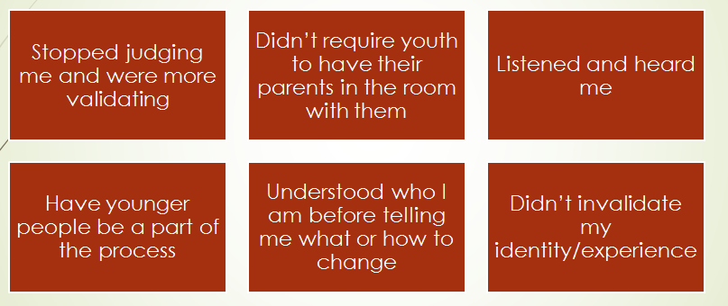
Solicit their thoughts and ideas
What Do You Wish Providers Did Differently?

Slide 16
BARRIERS
What are the barriers to seeking support?
Insurance- underinsured or not insured
Transportation
Knowing who to trust
Stigma
Judgment
What and where are the resources
Trans-Exclusive; Queer Exclusive
Time
Money
Past providers who invalidate me and don’t understand youth/young adult needs

Slide 17
EQUIP
Youth Group
Process
Employment
Youth Coordinator
Independent Living Skills
Peer Support
Skill Building
Housing
Budgeting
Support Educational
Goals
Wellness Skills
Dialectical Behavioral Therapy
In vivo teaching
Trauma Informed Cognitive
Behavioral Therapy

Slide 18
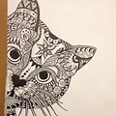
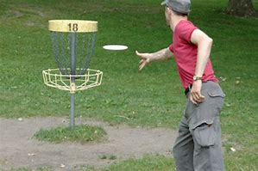
EQUIP
Create Experiences To Promote Executive Functioning

Slide 19
EQUIP
HOW PEER SUPPORTS AND YOUTH COORDINATORS MAKE A DIFFERENCE IN THE LIVES OF YOUTH/YOUNG ADULTS
Unique/Powerful Connection
Model and Provide Leadership
Ensure Youth Voice/Groups
Bridge Services

Slide 20
EQUIP

Slide 21
EQUIP
Transition to Independence - TIP Model
http://www.tipstars.org/OverviewofTIPModel.aspx

Slide 22
EMPOWER

Slide 23
Balance of Relationships

Slide 24
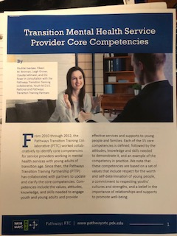
Transition Mental Health Service
Provider Core Competencies
15 Core Competencies to working with youth/young adults
https://www.pathwaysrtc.pdx.edu/pdf/projPTTP-core-competencies-2018.pdf

Slide 26
OUR CONTACT INFORMATION
Sally Raschick, NITT Principal Investigator
Sally.raschick@dhswisconsin.gov
Sara Zwieg, LCSW Jefferson County
saraz@jeffersoncountywi.gov
Judy VanRyzin, LCSW Outagamie County
judy.vanryzin@outagamie.org
Joe Horsch, Grant Coordinator, Outagamie County
Joseph.horsch@outagamie.org

