Slide 1
The Brain as an Historical Organ How Early Experiences and Relationships Impact Current Functioning Michelle Maikoetter Child Trauma Academy Fellow
Notes:
Change logo out

Slide 2
“To increase awareness and understanding of the unique needs of youth and young adults… with a mental health diagnosis or need.”

Slide 3
Why are we here,
really?

Slide 4
I used to want to save the world. To end war and bring peace to mankind.
And now I know, that only love can truly save the world. So I stay, I fight, and I give, for the world I know can be.
This is my mission now.
Forever.

Slide 5
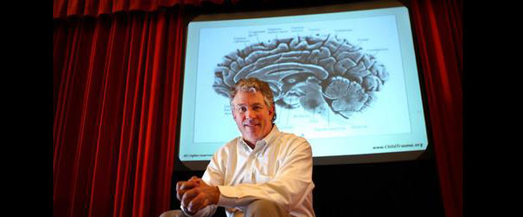
One of my heroes

Slide 6
What is Bruce Perry’s Neurosequential Model or NM©?s Six Healthy Development
Understanding how relationships
and
experiences
affect brain development

Slide 7
“The human brain is the organ responsible for everything we do. It allows us to love, laugh, walk, talk, create or hate.
For each of us, our brain’s functioning is a reflection of our experiences.”
-BP

Slide 8
Our approach moves us from the certainty that behavior is simple willful defiance to being curious as to what need is behind the behavior.

Slide 9
Curious about what?

Slide 10
Everything.

Slide 11
Curious about relationships. . .

Slide 12
and experiences . . .

Slide 13
And also
Neurodevelopment

Slide 14
“…in order to understand trauma, we have to understand memory. In order to appreciate how children heal, we need to understand how they learn to love, how they cope with challenge, how stress affects them.”
-BP

Slide 15
Where do we start?
At the very beginning.

Slide 16
Beginning at conception.

Slide 17
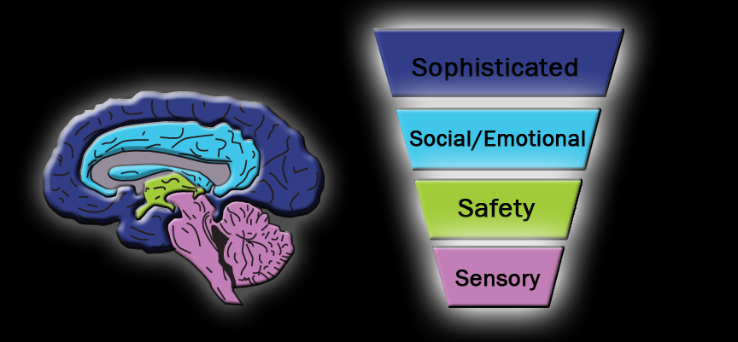
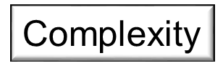
Why? Why? Because we Because we know:
Experience affects brain development..
Adapted from the work of Dr. Bruce Perry, MD, PhD © 2006-2010

Slide 18
Adapted from the work of Dr. Bruce Perry, MD, PhD © 2006-2010
Adapted from the work of Dr. Bruce Perry, MD, PhD © 2006-2010

Slide 19
Six Risk Factors to Healthy Development
1. Difficult pregnancy
2. Difficult birth
3. Abuse
4. Neglect
5. Trauma
6. Combination
Information taken from: Dr. Karyn Purvis

Slide 20
The Brain
Organized in a hierarchical fashion, primitive to sophisticated
bottom to the top
from inside out
all incoming sensory input enters the lower parts of the brain first
ma
6. Combination
Notes:
Bruce Perry notation

Slide 21
First things first.
Your brain’s # 1 directive is . . .

Slide 22
Singing Alien video
Notes:
survivor video?

Slide 23
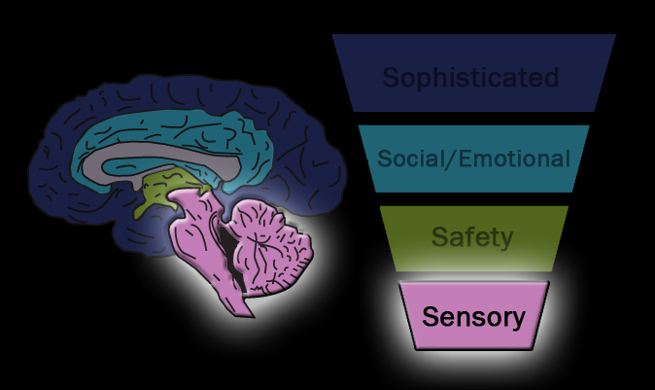
Adapted from the work of Dr. Bruce Perry, MD, PhD © 2006-2010

Slide 24
DJ’s QUILT
My quilt is soft.
To touch it is like floating on a forever.
I love my quilt because it keeps me sane.
My quilt is like a cup of cocoa on a cold day.
My quilt is the harmony to my music.
Taken from: Reasonable People by Ralph James Savarese Pg. 281

Slide 25
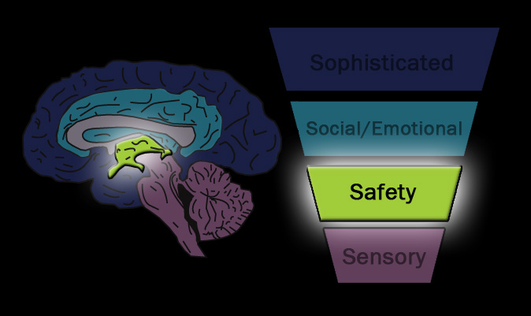
Adapted from the work of Dr. Bruce Perry, MD, PhD © 2006-2010

Slide 26
Meet Jewel (and Riley)

Slide 27
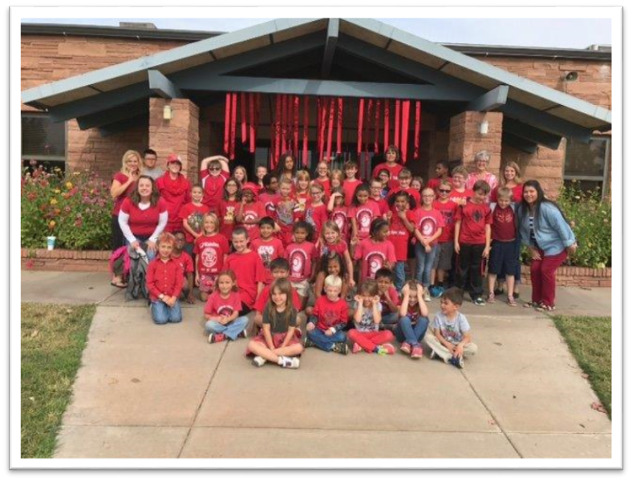

Slide 28
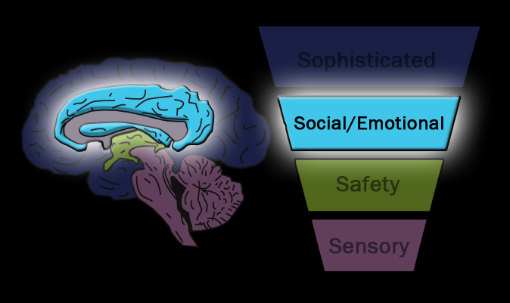
Adapted from the work of Dr. Bruce Perry, MD, PhD © 2006-2010

Slide 29
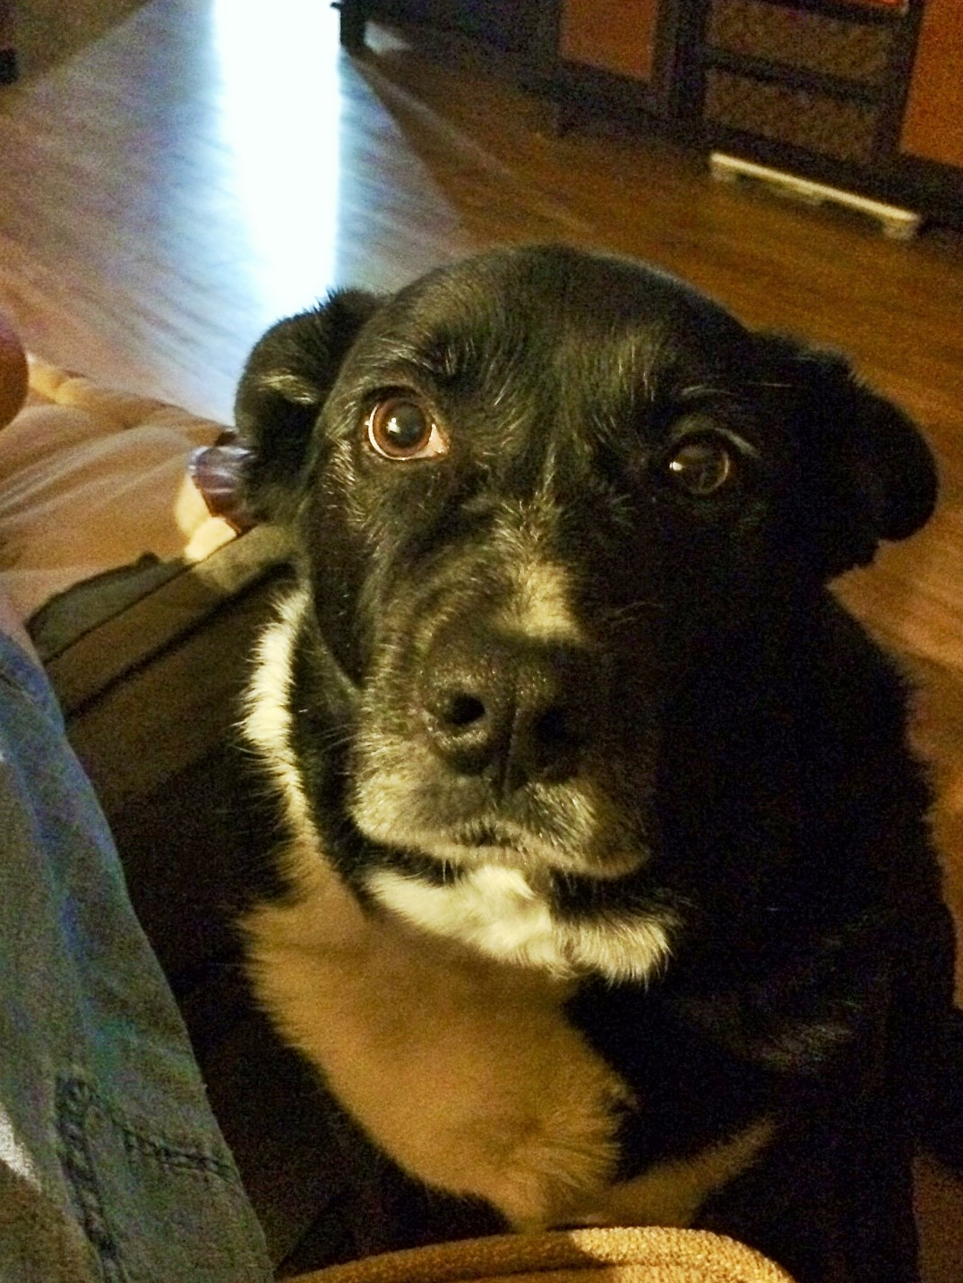
Now Meet Madie. . .

Slide 30
Katelyn and the Cupcake

Slide 31
What about the adolescent brain?

Slide 32
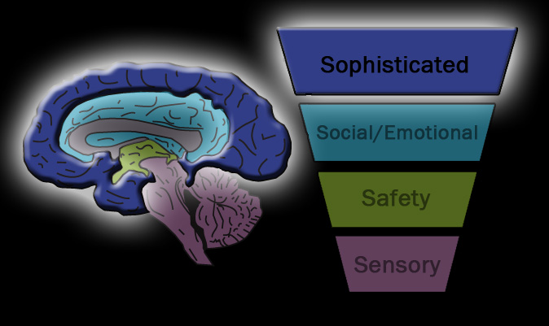
Adapted from the work of Dr. Bruce Perry, MD, PhD © 2006-2010

Slide 33
Experiences – good and bad
Timing
Intensity
Duration

Slide 34
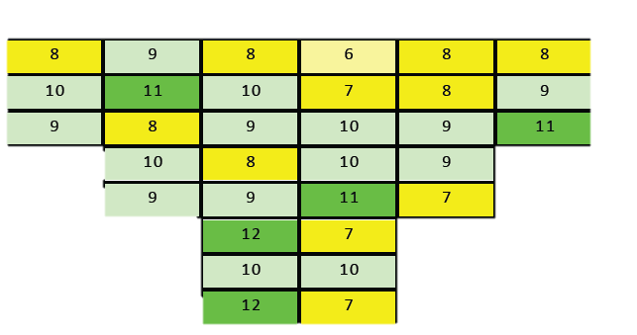
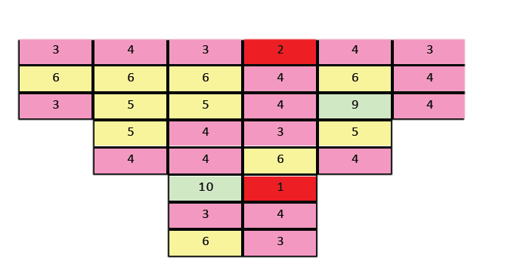
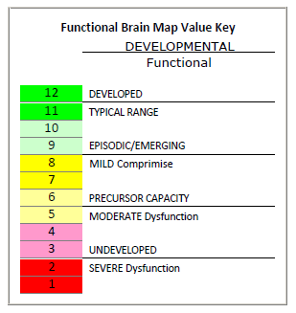
The Tale of Two Different Brains
Typical
9 year old
Atypical
9 year old
Adapted from the work of Dr. Bruce Perry, MD, PhD © 2006-2010

Slide 36
One of the most important outcomes of early developmental insults:
The brain learns the world is unsafe,
and gets stuck in a state of surviving.

Slide 38
Experiences – good and bad
Timing
Intensity
Duration

Slide 39
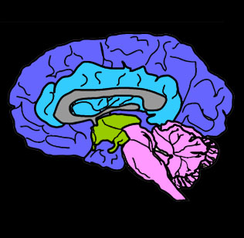
Arousal Continuum
CALM
ALERT
ALARM
FEAR
TERROR
Adapted from the work of Dr. Bruce Perry, MD, PhD © 2006-2010
Upside down triangle representation of brain and arousal continuum – DR. BRUCE PERRY

Slide 40
Stress (fear/shame) makes us
STooPID

Slide 41
Our brains are pattern seeking
and
meaning making
machines

Slide 42
Why?
The brain must anticipate and make associations based on past experiences
in order to survive.

Slide 43
It
constantly and continuously
tags incoming information as
Positive
Negative
Or
Neutral
Based on your past experiences.

Slide 44
This is the basis of ALL learning – passive and active.

Slide 45
Can you read this?
7H15 M3554G3 53RV35 7O PR0V3 H0W 0UR M1ND5 C4N D0 4M4Z1NG 7H1NG5! 1MPR3551V3 7H1NG5! 1N 7H3 B3G1NN1NG 17 WA5 H4RD BU7 N0W, 0N 7H15 LIN3 Y0UR M1ND 1S R34D1NG 17 4U70M471C4LLY W17H 0U7 3V3N 7H1NK1NG 4B0U7 17, B3 PROUD!

Slide 47
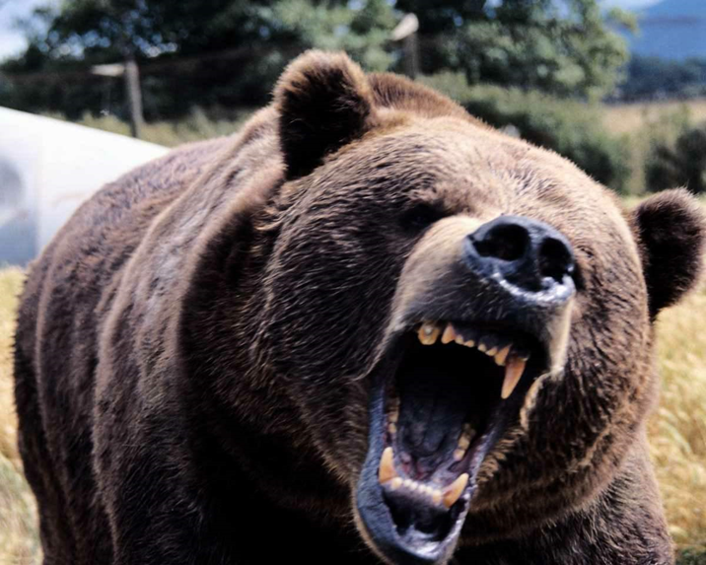
Fight
Flight
Freeze

Slide 48
OR?
FLOCK- to gather, congregate

Slide 49
Why would one
system be
activated
over the other?

Slide 50
So . . .What is Threat?
It depends.

Slide 51
With trauma
Similar = Same

Slide 52
Our brains take notice of
And
Novelty (n.)
innovation, newness, uniqueness, originality, freshness
Why?

Slide 53
New experiences signal opportunity OR danger novelty provides challenges to our stress response system

Slide 54
What our brain tags as threatening depends on our past experiences . . .

Slide 55
and what it thinks is the most important to our survival.

Slide 56
Especially early
experiences with
caregivers

Slide 57
If the world is dangerous, but we are lovable and loved, things will be okay.
Louis Cozolino
Cozolino, 2014, p. 219.

Slide 58
And our default is ALWAYS…
And

Slide 59
And
Suspicion
(it’s known as the negativity bias)

Slide 60
Why?

Slide 61
Attachment and BELONGING
Ability for one heart to emotionally connect to another
Based on our relationships with our first caregivers –sets the foundation for all future ones
For the most part, we love the way we have been loved and parent the way we were parented
We can only give what we have been given

Slide 62
Adapted from the work of Dr. Bruce Perry, MD, PhD © 2006-2010

Slide 63
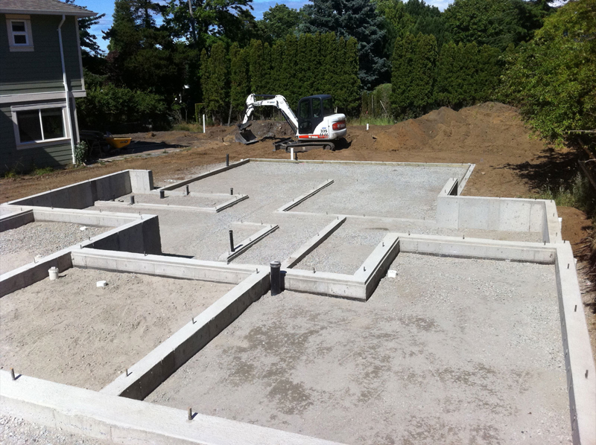

Slide 64
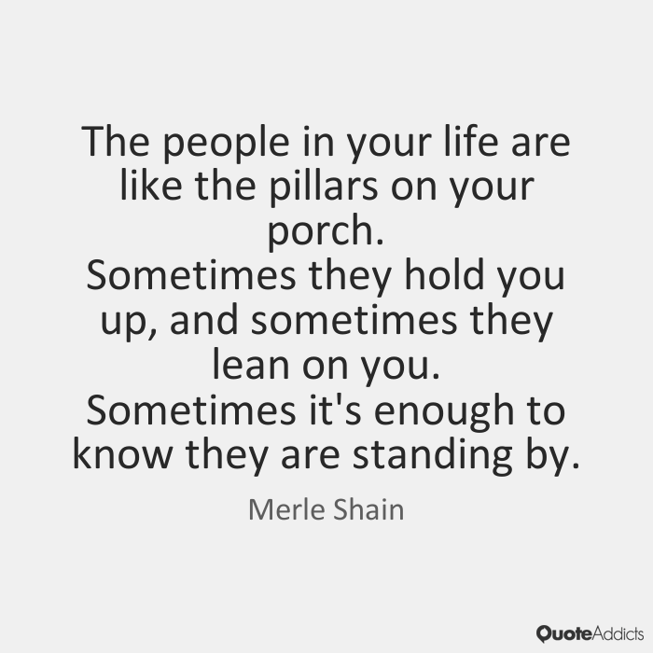

Slide 65
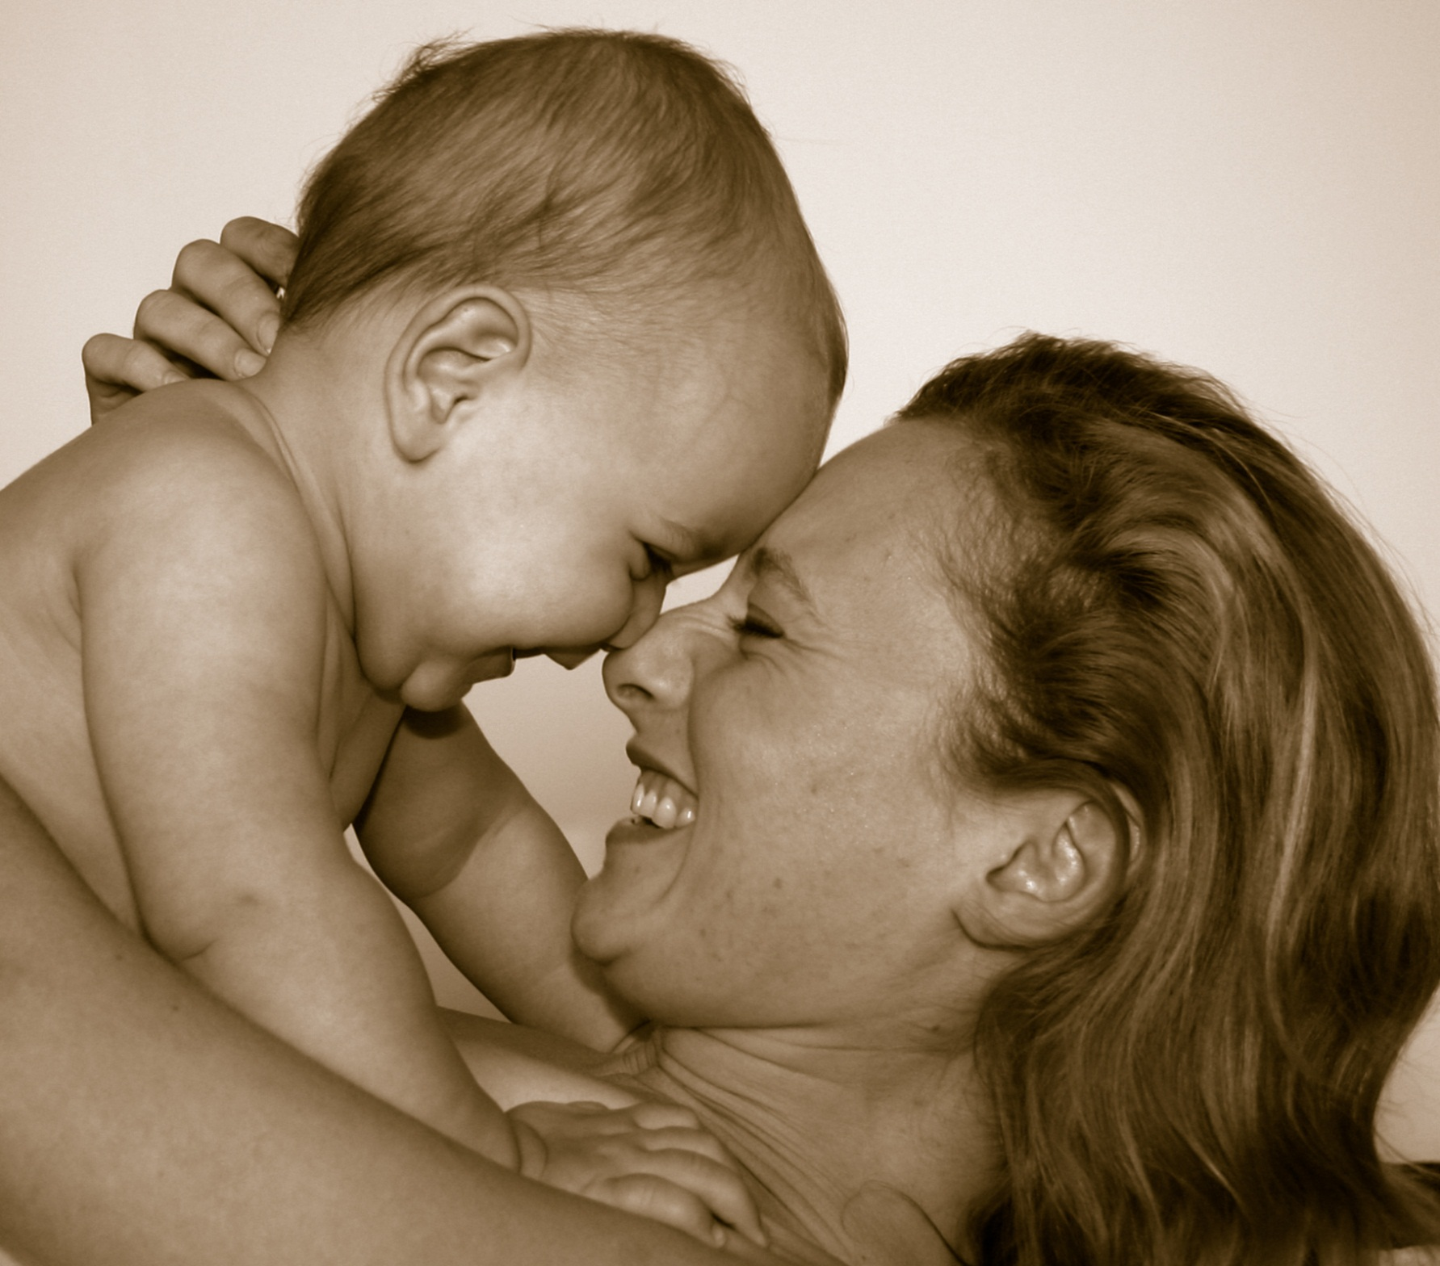

Slide 66
So if this is your early caregiving . . .
What could your template be?
I am . . .
Others are . . .
The world is . . .
So I must . . .
Information taken from: Brendtro & du Toit, 2005

Slide 67
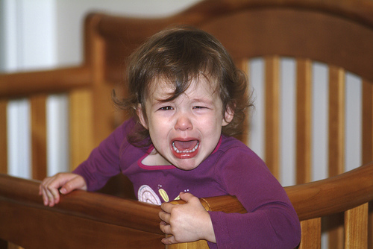

Slide 68
So if this is your early caregiving . . .
What could your template be?
I am . . .
Others are . . .
The world is . . .
So I must . . .
Information taken from: Brendtro & du Toit, 2005

Slide 69
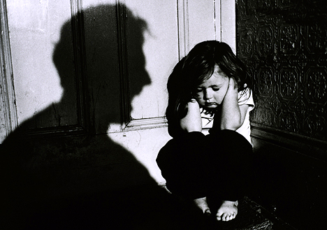

Slide 70
So if this is your early caregiving . . .
What could your template be?
I am . . .
Others are . . .
The world is . . .
So I must . . .
Information taken from: Brendtro & du Toit, 2005

Slide 71
Case Study –
How do you see Brooke?
Therapy vs therapeutic

Slide 72
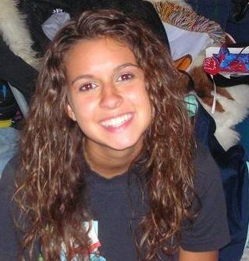
Meet Brooke
Presenting issues:
Chronic, long-term underachievement in school and
General lack of motivation in any area of her life
Parents are unable to provide adequate supervision

Slide 73
Placement Goals
Learn to respect and follow rules
Be respectful and empathetic in her communications with others
Develop her personal integrity to live by her values and do the right thing
Improve her honesty
Accept responsibility for her behavior/ choices

Slide 74
Without looking at neurodevelopment and relational health
Make home uncomfortable so school seems rewarding
Remove all extracurricular activities
Isolate her from peers
Make all rewarding activities contingent upon improving grades

Slide 75
Six Risk Factors to Brooke’s Healthy Development
1. Difficult pregnancy
2. Difficult birth
3. Abuse
4. Neglect
5. Trauma
6. Combination
Information taken from: Dr. Karyn Purvis

Slide 76
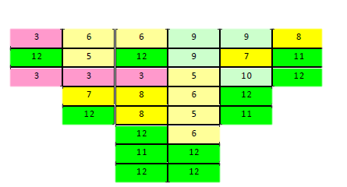
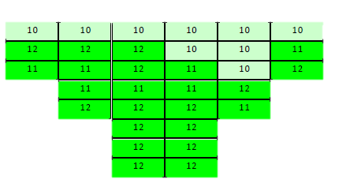
NMT Metric of Brooke
Original map – 6/2012
Client 14 years, 7 months
Age Typical 14-16 years
Adapted from the work of Dr. Bruce Perry, MD, PhD © 2006-2010

Slide 77
Looking at neurodevelopment and relational health
Family contact – Safety/Belonging
EAP sessions – Belonging/Achievement/Power/Adv
Acceptance - Belonging
Mentoring - Purpose
Peer exercise - Belonging
Monitoring sleep habits – Health hygiene
Involvement in extracurricular/outside activities-
Belonging/achievement/power/adventure
EMDR - Safety
Psycho-education

Slide 78
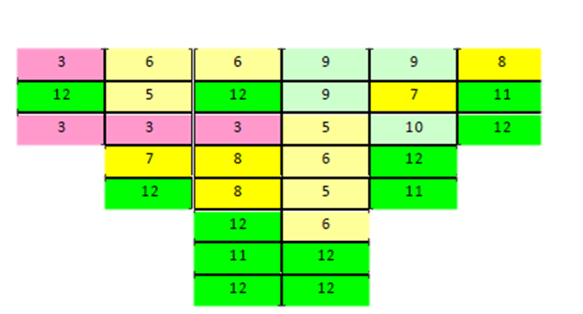
NMT Metric for Brooke after 7 months
Age Typical
14-16 years
Adapted from the work of Dr. Bruce Perry, MD, PhD © 2006-2010

Slide 79
What will help/work?
Consistent (routine, structure, limits)
Predictable
A sense of control
And. . .

Slide 80
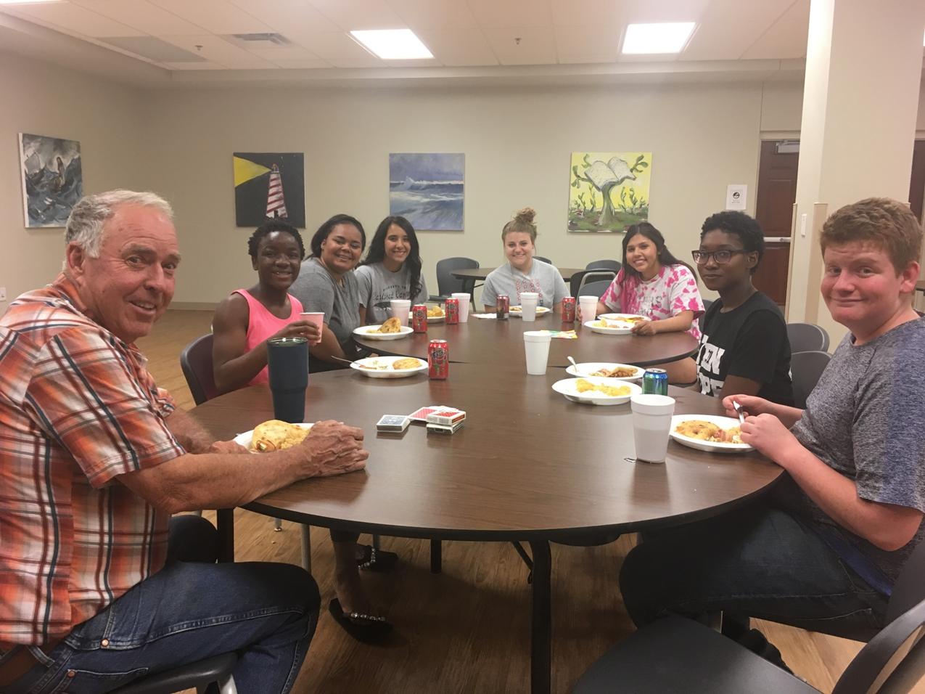
STABLE RELATIONSHIPS
With
SUPPORTIVE PEOPLE
Love and belonging

Slide 81
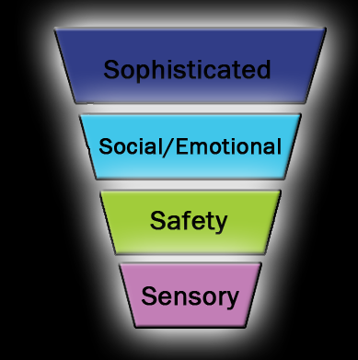
What will help? Sequence of Engagement
Problem solving
Collaborate/create solutions together
Positive self - talk
Reason
Side by Side, 1:1
Empathize
Identify/clarify feelings
Noticement
Relate
Regulate
Rhythmic
Repetitive
Patterned activity
Regulate
Sensory aware
Noise & Voice
modulation
Reflect/listen
Reassure
Adapted from the work of Dr. Bruce Perry, MD, PhD © 2006-2010

Slide 82
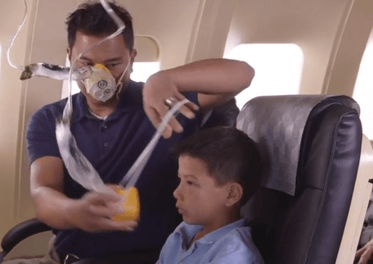
Take care of you TOO:
Take your time off
and BE OFF
Exercise
Sleep
Eat good food
Laugh
Talk to the people who lift you up
and encourage you

Slide 83
Ask for help
Find your
support group
Find your
cheerleaders
Continue your spiritual development

Slide 84
“ “We get sicker in isolation, we heal in community.”
Notes:
Change logo out

Slide 85
michellemaikoetter@calfarley.org Y’all come see us!
www.cflearning.org

