Slide 1

How to be a safe, supportive person for young people
Wisconsin Initiative for Stigma Elimination: Statewide collaboration of
organizations and individuals offering consultation, resources, support and evidence-based programs for stigma reduction
Notes:
This is designed as an approximately 1.5 hour training/discussion. We are happy to consult with you about how to decrease the training time to best suit your needs

Slide 2

Safe Person Campaign
Safe Person Decal
http://safeperson.org/
Notes:
Objective: Introduce Safe Person Decal and where more can be ordered, a way to indicate your intention that you want to be supportive of others.
What can we do to indicate we want people to talk with us who are struggling? We created the Safe Person Decal to indicate that you intend to be a safe person in whom to confide. These decals were created in partnership with youth. Note that the decal says we “seek to listen and support.” That means, we will try our best to be a supportive, compassionate person when people confide in us. But, let’s face it, we are all human and may sometimes fall short!
In the last year, we have given out over 30,000 decals! And, we would love to give out even more. After today’s presentation, you can go to “safeperson.org” and place an order for additional decals (note: if there is time, go to safeperson.org and show the website and where decals can be ordered). These can be given to individuals at your school/organization. Or, they can be given away at events as a resource. We have fielded requests for 1 decal, as well as requests for 500! Generally, there is not a fee for the decals, unless a large order requires substantial shipping costs. We’d love to have these displayed all across the state in each school and youth serving organization – help us reach our goal!
Note. Have someone pass out decals here

Slide 3
Safe Person & Seven Promises
By displaying this decal, I promise to:
Acknowledge that reaching out
for support is a strength.
2. Listen and react non-judgmentally.
3. Respond in a calm and reassuring manner.
4. Reflect back the feelings, strengths, and ideas I hear when listening.
5. Ask how I can be helpful and respond as I am able.
6. Do what I can to connect to other supports if asked.
7. Maintain confidentiality and communicate if exceptions exist.
Notes:
Let’s look a little bit more closely at what displaying the decal means. In partnership with youth, these 7 promises were developed to go along with the decal. We are going to go through each of these 1 by 1 and do activities that help us delve deeper into each of the 7 promises.

Slide 4
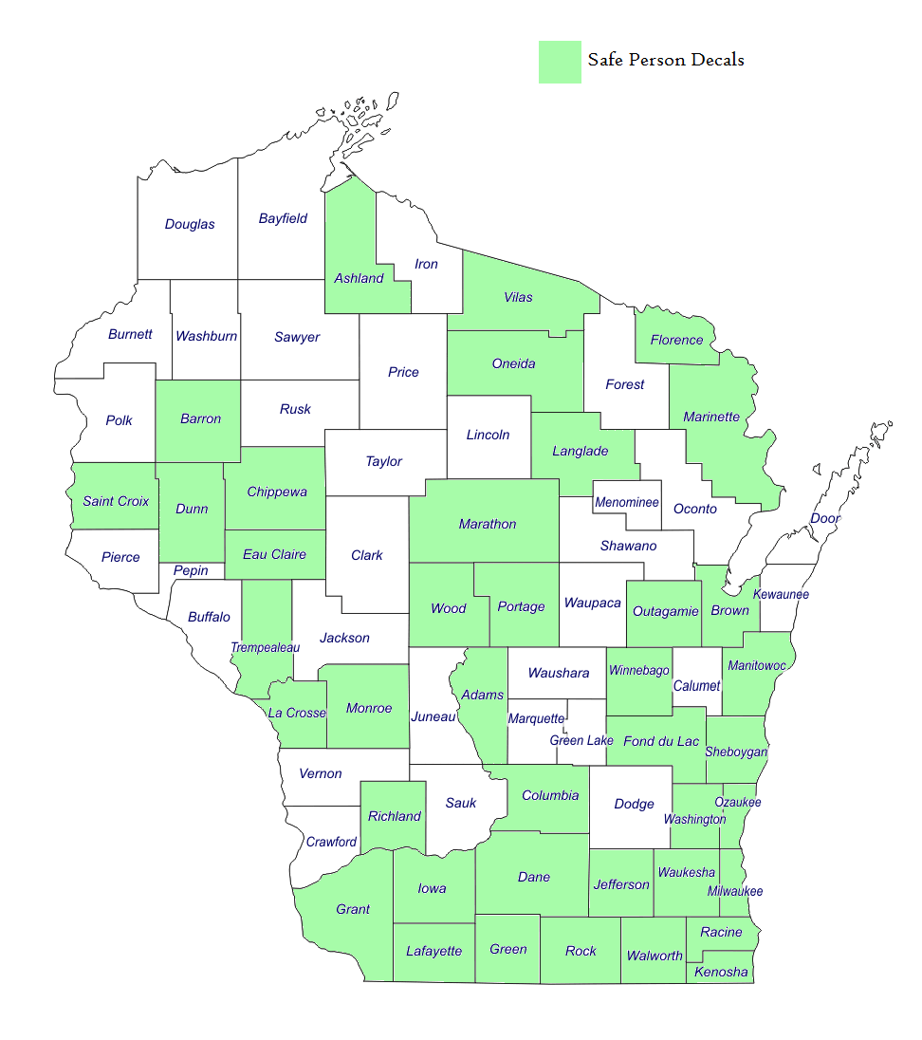

Slide 5
3 ways you might incorporate decals into school setting in a meaningful way
Display decals and inform students of their meaning/intent
Conduct short conversation with students or youth group about benefits of talking to others and supporting their peers
  Normalize
  Benefits of reaching out
  Reach out to peers/friends
Conduct mini-training with faculty/staff on the 7 Promises

Slide 6

1 in 4
47% in our lifetime
anxiety
schizophrenia
depression
trauma
Drug and alcohol abuse
eating disorders
They are us!
Notes:
Objective: Express how common mental health challenges are and how they affect us all
(if in a large group). How many of you know someone with a mental health challenge, whether diagnosed or not? I’m not asking about your personal experience, but stand up if you know someone with a mental health challenge. Depression. Anxiety. Self-harm. Eating Disorders. ADHD. The list goes on and on. Stay standing. And, now stand up if you know someone who has a substance abuse problem with drugs, alcohol or prescription medication. Stay standing. Stand up if you know someone who has experienced trauma, perhaps physical, sexual, or emotional abuse.
Note. By now, nearly all should be standing. Be patient, people may be hesitant to stand initially. With young people, ask instead if they know other young people – friends, siblings, cousins, teammates, etc.- who experience these challenges. Emphasize that you are not asking about them personally, but rather people they know. Once the majority are standing, have them look around and before sitting back down, ask if they are surprised.
1 in 4 in any given year will experience mental illness or substance use disorders. The CDC data is that 47% of people will have a diagnosable mental illness in their lifetime. It this is not about your personal experience of mental health challenges, it may be in the future or you may relate to it as a family member or friend. That means that nearly all of us have someone close to us who experiences a mental health challenge and many of us know several people. So how can we best hope to be sources of support for people we care about?

Slide 7

What are additional challenges that are difficult to talk about?
Notes:
Objective: Communicate that there are lots of aspects of our identities/experiences/needs that are difficult to share with others, not just mental health difficulties.
Mental health can be hard to open up about to people because of how people might react or our concerns about what they will think about us. What are some other challenges that can be difficult to discuss with people in our life?
Note: If the group is struggling to name other things that are difficult to talk about, perhaps give some ideas. Or, share something personal about yourself that has been hard to talk about at times. The point is to generate a list of things that can be scary/awkward/uncomfortable to talk about with others. Generate a long list, or depending on group size, have everyone list one thing. Write on whiteboard, chalkboard, large white paper all the ideas and emphasize then how it is all the more important that we do our best to “make the way” for people to be comfortable talking with us.
Note. If you know the group you are working with all shares a key connection that could be difficult to talk about (e.g., all participants are LGBTQI), then make this discussion more relevant to that particular group.

Slide 8
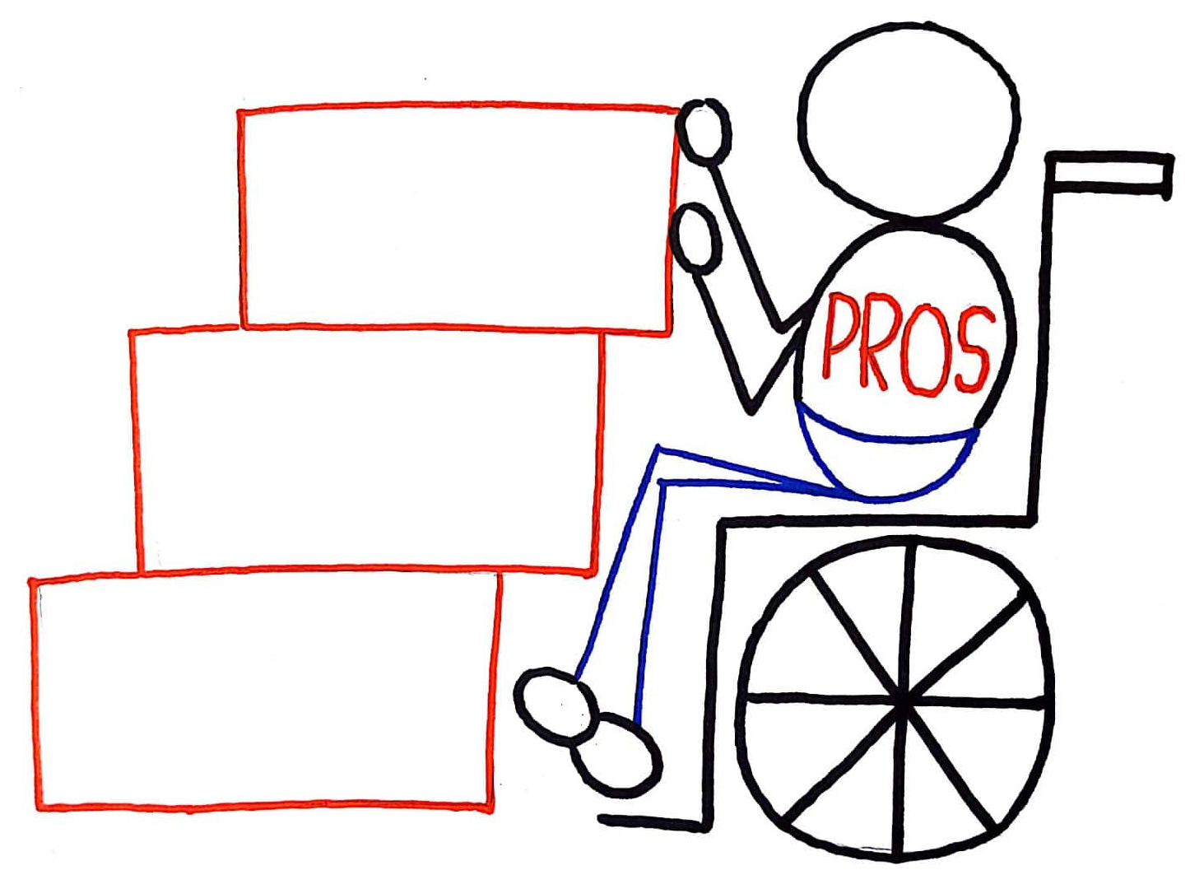


What are the benefits to opening up to people about our challenges?
Notes:
Objective: Help people understand the benefits of opening up to people about your challenges – to lay the foundation for how we can help people to do so
Generate a list of the positive benefits of sharing your problems/challenges/difficulties with people. Write on whiteboard, chalkboard, or large white paper. To root this conversation a bit more, perhaps make it more explicitly relevant to the group you are working with. For example, if you are framing the conversation about mental health concerns, generate a list of benefits related to talking about mental health concerns. If you are talking about anti-bullying, generate a list of benefits about talking about your experience with bullying. If you are talking to a group of LGBTQI people, talk about discussing sexuality and/or gender expression/identity. While pros will be varied, they will generally cover 4 themes: 1) I can get help/support for myself or find people like myself; 2) I can be genuine/honest/authentic with people (e.g., not keep secrets and connect better with people); 3) I may be able to help others; and 4) I can be an advocate to increase understanding/acceptance, hope and inclusion for others
note. If people are having a difficult time starting, perhaps watch the videos to start the conversation. The videos are people who are popular social media stars. The first video is 2.45 minutes and the second is 1.56 minutes.

Slide 9

What are we talking about?
Seizetheawkward.org
Notes:
Objective: Convey that having difficult conversations can be awkward and that these feelings are normal!
[play video, it is 1.19 minutes long]. Like the people in the video, there are lots of things that are scary/awkward/uncomfortable to talk about with other people. Today, we’re going to talk about some ways that we can make difficult conversations go as well as possible so that we can best support people we care about.

Slide 10
Safe Person & Seven Promises
By displaying this decal, I promise to:
Acknowledge that reaching out
for support is a strength.
2. Listen and react non-judgmentally.
3. Respond in a calm and reassuring manner.
4. Reflect back the feelings, strengths, and ideas I hear when listening.
5. Ask how I can be helpful and respond as I am able.
6. Do what I can to connect to other supports if asked.
7. Maintain confidentiality and communicate if exceptions exist.
Notes:
Let’s look a little bit more closely at what displaying the decal means. In partnership with youth, these 7 promises were developed to go along with the decal. We are going to go through each of these 1 by 1 and do activities that help us delve deeper into each of the 7 promises.

Slide 11
1: Acknowledge that reaching out for support is a strength.
Discuss as a group: What might someone be thinking or feeling about themselves when they reach out for support? Share some examples from the group of times when they might have felt uneasy about seeking help and someone helped them to feel more at ease.
Notes:
The first promise is to recognize how difficult it is to reach out for support. People who do so are incredibly brave! To be a safe person, you want to recognize that reaching out takes strength! When someone starts to open up to you welcome the person by recognizing the strength it takes to speak up. They may feel nervous or unsure, so reassure them that this is a positive step. Express your own gratitude for their trust in you as someone who can offer support.
Now, as a group, let’s discuss this a bit more……[see activity on slide]

Slide 12
2. Listen and react non-judgmentally.
Discuss in pairs: Think of a time when someone respond to you in a way that led you to believe that they judged your feelings to be wrong? What did they do that made you think they were negatively judging you for your feelings? List things to avoid doing if you want to appear non-judgmental. Write your ideas on posted chart paper. If yours is a repeat idea of another pair, simply place a checkmark by it.
OR
Discuss as a group: What are examples of ways someone may show full attention that may not fit into the experiences/expectations of another group?
Notes:
The second promise is to seek to listen and react non-judgmentally. Listen without bias by recognizing that the person’s feelings are legitimate, even if you’re struggling to understand their perspective. Give their vulnerability your full attention and care in culturally appropriate ways.
For this one, decide which of the activities listed above seems most appropriate given the make-up and size of the group and the time that you have left for the training. [choose activity on slide]

Slide 13
3. Respond in a calm and reassuring manner.
Discuss as a group: What can you do to deal with your emotional reactions in the moment and later?
AND
Discuss in pairs: Think of three scenarios and identify what would be realistic reassurance in each.
Notes:
We also want to do our best to respond in a calm and reassuring manner. There are 2 parts to this one – keeping yourself calm and then responding in a way that is reassuring. You may have an emotional reaction to what you’re hearing. Remind yourself that your feelings can be addressed afterwards. Wait until the person is done speaking before you respond. When you do, offer realistic reassurance. Exhibit acceptance, empathy, and respect. [then conduct activities/discussion on slide. If you are short on time, just do the group conversation].
Note. If there is time and you wish to show examples of the Promises in Action, you may show this video skit: https://www.youtube.com/watch?time_continue=78&v=4w5NYzYhn6g, which shows students from Hamilton and Sussex High schools role playing the promises. Promise 1, 2, and 3 is shown in skit 1, which takes place up until minute 1.18 of the video.

Slide 14
4. Reflect back the feelings, strengths, and ideas I hear when listening.
In pairs, each person share a current challenge you are facing. When sharing, the other person in the pair will practice repeating/rephrasing, stating the examples of strength/resilience they hear, and point out what next steps they heard the person thinking about taking- without giving advice. Take turn so both can share and listen.
Notes:
The fourth promise continues the theme of listening by suggesting we reflect back the feelings, strengths and ideas we hear. For this one, Repeat or rephrase what you heard in order to check for understanding. Call attention to concrete examples of their resilience and strength. Listen for action they believe would be helpful and are ready to take. [allow time to conduct activity]

Slide 15
5. Ask how I can be helpful and respond as I am able.
In pairs, role play one of three different scenarios.
  Scenario 1: One person shares a current challenge and the second person is able to provide support that is requested
  Scenario 2: One person shares a current challenge and the second person cannot respond as requested, so work together to find a compromise.
  Scenario 3: One person shares a current challenge and the second person does not understand how to best be helpful, so asks for clarification
Notes:
For this one, Ask how you can help. If the person asks for your input, make suitable suggestions. Follow through if they accept your offer. If you aren’t able to help in a way they propose, let them know, and work together to find a compromise. [do activity on slide]

Slide 16

6. Do what I can to connect to other supports if asked.
In groups of three or four, give two examples of a time when someone in the group was given advice when they did not want it. Discuss what that was like. How did it feel to get the advice? How did the conversation go? Discuss what would have happened had the person asked permission to give advice first.
Notes:
Ask if the person would like to hear about other supports before you offer. If they accept, connect them to outside resources that may offer further assistance. But, the key here is to do so “if asked.” Let’s watch this short video to learn more about the importance of waiting until asked to provide help/advice (video is 2.34 minutes). So, as Hannah indicated, we’re inclined to want to offer advice/fix people’s problems and help ease the suffering of people we care about. But, that tendency may not actually be as helpful as we intend. [do activity listed on slide].

Slide 17
7. Maintain confidentiality and communicate if exceptions exist.
In a group of two- four, write a 30-60 second skit to demonstrate a conversation where you both promise to keep the content a secret and how you might discuss exceptions in language that feels natural to the group. Be prepared to share your skit. Have fun and use humor if you would like
Notes:
Lastly, As a rule, maintain confidentiality. If you feel you’re the sole source of the person’s support, ask if there is someone you could engage in supporting them as a team. Inform them that, while you respect their rights, their safety is your top priority, and you will take action to ensure it if necessary. If your professional ethics require you to take such steps, inform them early in the conversation. [Here, ask about situations in which people may be inclined to break confidentiality; ensure that one thing listed is ‘if someone is thinking of suicide.’].
note. On this one, someone may ask what you should do if you feel that someone is at risk of suicide or hurting themselves. Best practice suggests that rather than avoid the topic, you should ask outright about their thoughts/intentions. For example, “Sometimes when people are in a dark place, they think about hurting themselves. Do you have thoughts about ending your life?” While this can be difficult and you may be concerned that the person will get angry, would you rather have someone who is angry, or someone left alone with these thoughts with the possibility they might act on them?

Slide 18
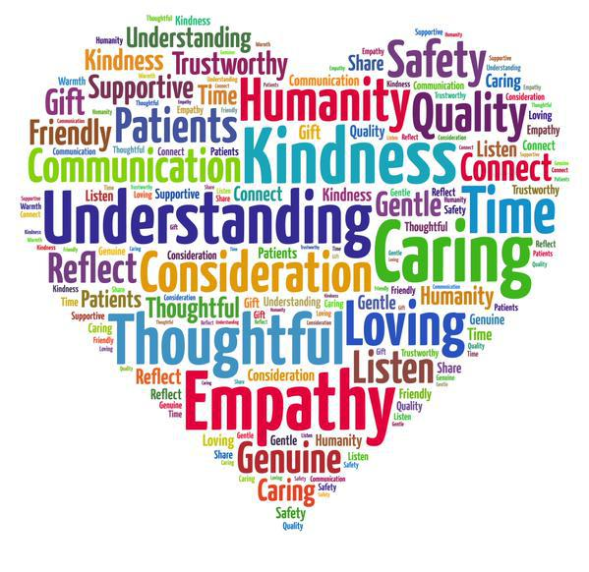
Compassion in Action
At what times or under what circumstances do you find it most difficult to be present with and show compassion to others?
  What can you do about it?
Are there certain people with whom you are less likely to abide by the 7 promises?
  What can you do about it?
Notes:
Objective: To notice that there are times we may struggle to offer support to others/abide by 7 promises and think of ways to limit these interactions.
The 7 promises say “we seek” to listen and support. Despite great intentions, there are likely times we may well come up short. Let’s take a few minutes to recognize those times in ourselves and discuss if there are things we might do to lessen these instances. [have group discussion from the slide]

Slide 19
Script for explaining decals to students?

Slide 20
Safe Person & Seven Promises
Distribution
Display stickers
Make goal to give out X stickers to others
Give sticker to people you think deserve them and epitomize 7 promises in action
Give sticker as a ‘thank you’ to someone who supported you
Other ideas?
Notes:
Objective: Discuss ways that participants can help with safe person distribution.

Slide 21
Thank you!
Order decals at Safeperson.org
For additional trainings contact Wise@WiseWisconsin.org
Get in touch: Sarah.Reed@RogersHospital.org

