Slide 1
YES! Youth Empowered Solutions
Sally Raschick
Dondieneita Fleary-Simmons
August 2019

Slide 2
Presentation Format
Welcome and introductions
YES! project overview
Evaluation summary
Panel discussion: YES! framework in practice
Question and answers

Slide 3
Welcome and Introductions
Sally Raschick, Wisconsin Department of Health Services
Robin Moskowitz, UW Population Health Institute
Janae Goodrich, UW Population Health Institute

Slide 4
Welcome and Introductions
Panel:
Dondieneita Fleary-Simmons, Department of Health Services (moderator)
Joe Horsch with young adult leaders from Outagamie County
Sara Zwieg with young adult leaders from Jefferson County

Slide 5
Learning Objectives
Identify practices that promote youth and young-adult engagement
Identify practices that promote partnership
Identify strategies for enhancing youth voice in plans
Identify strategies for promoting youth leadership

Slide 6
Now Is The Time: Grant Overview
Purpose and goals of the grant
Activities
Key lessons learned

Slide 7
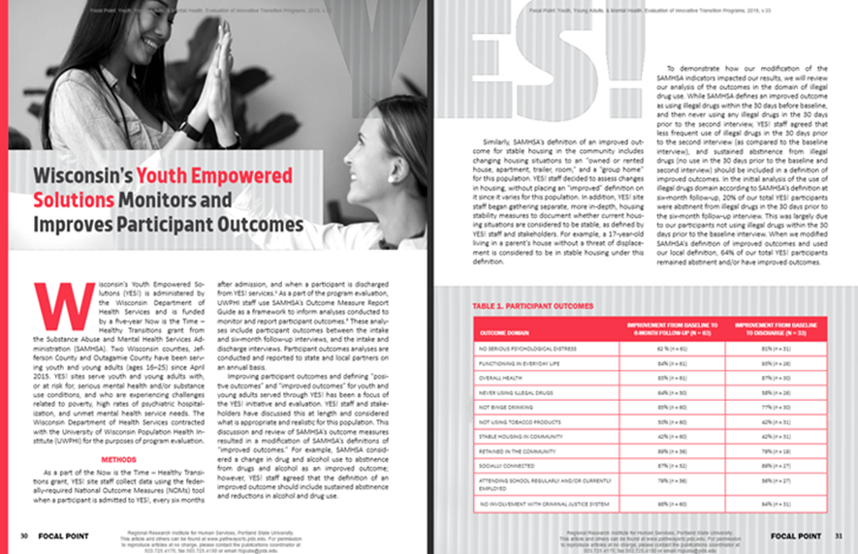
Evaluation Summary

Slide 8
Panel Discussion: YES! Framework In Practice

Slide 9
Engaging and Building Trust with Youth and Young Adults
Ensures accessibility
Creates a welcoming environment
Encourages a warm hand-off
Prepares staff to recognize developmental tasks
Understands and offers resources
Develops plan to engage
Builds relationships
Supports through eligibility process
Honors capacity and readiness to engage
Responds to immediate needs

Slide 10
Partnering with Youth and Young Adults
Continues the welcoming process
Explains the process
Builds rapport and trust
Attends to pacing
Focus on youth’s goals
Assesses through relationship
Offers options to youth
Tolerates reasonable Risks
Facilitates youth-led plans
Supports experiential Learning
Invites youth to lead activities
Includes youth voice in leadership

Slide 11
Question and Answer Time

