Slide 1
Ethics and Boundaries: Utilizing the Evidence-Based Practice Process in the Helping Professions ​
Presented By:
Kristen Prock, PhD, LCSW
Katherine Drechsler, DSW, LCSW-SA
Sarah Hessenauer, PhD, LCSW
University of Wisconsin-Whitewater

Slide 3
Introduction of Presenters
Katherine Drechsler
Kristen Prock
Sarah Hessenauer

Slide 4
Social Work Department
Bachelor of Social Work
Established 1974
150 graduates per year
350 declared majors
Master of Social Work
Established 2018
48 students
Minor Social and Human Services
130 students

Slide 5
Guidelines for the Training
Required to to attend all 4 hours. There will be two scheduled breaks.
WebEx Overview
Camera’s can be off unless we are breaking out into groups
We will all be gracious to those working from home
Use the mute when not talking
Use chat features to post comments and ask questions
Use of break-out rooms for small discussion
Using Poll Everywhere
Explanation of Breakout Sessions
Have a pen and paper available to take notes and participate in activities
Complete Evaluation

Slide 6
Training Overview
What Brings Us Here Today
Review of National Association of Social Work (NASW) Code of Ethics
Review of Wisconsin Administrative Code Marriage and Family Therapy, Counseling, and Social Worker Chapter 20 Conduct (MPSW 20)
Discussion of Ethics Violations
Overview of evidence-based practice process
Review the evidence-based practices widely used in the helping profession and in the state of Wisconsin
Reviewed professional standards that guide using evidence-based practices
Ethical and Value Dilemmas
Ethical Dilemma Decision Making Model
Applied Ethical Decision-Making Scenarios Related to Evidence-Based Practices
Implementation Science, Implementation of Evidence-Based Treatments, and Fidelity
Misconceptions, Criticisms, and Responses to using Evidence-Based Practices

Slide 7
Introductions of Attendees: Poll Activity
What populations do you work with?
How many years of practice do you have in the helping profession?

Slide 8
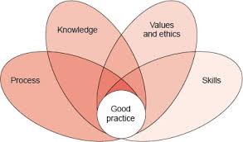
What Brings Us Here Today?
Foundations of Good Practice

Slide 9
Values and Ethics
VALUES
Refers to our beliefs about how things ought to be, about what is important and what is right and wrong. As individuals, our values originate and are shaped by our upbringing, faith, community, education, experiences, and the people who play influential roles throughout our lives. We all hold certain values more closely than others. Some remain constant and firm, whereas others evolve over our lifetime or exist as preferences rather than as fixed directives.
As with individuals, the profession of social work has values that stem from the origins of the discipline. These underlying values distinguish social work from other fields, and they guide our practice as social workers. A challenge social workers have is reconciling our own personal values with those of the profession.
ETHICS
Refer to the embodiment of values into guidelines for behavior.

Slide 10
Values and Ethics (continued)
CODE OF ETHICS go one step further to describe these behaviors in the form of standards or “shared reference points” that apply to all people who prescribe to a particular code.
NATIONAL ASSOCIATION OF SOCIAL WORKERS CODE OF ETHICS sets forth these values, principles, and standards to guide social workers’ conduct.
MPSW 20 Wisconsin Administrative Code Marriage and Family Therapy, Counseling, and Social Worker Chapter 20 Conduct.

Slide 11
National Association of Social Work Code of Ethics
Preamble
Purpose
Ethical Principles
Ethical Standards

Slide 12
NASW Code of Ethics (revised June 1, 2021)
Protects clients, families, and social workers
Holds the profession accountable
Summarizes principles & core values of a profession
Provides guidance for practice
Socializes new practitioners (important when talking about generational differences)

Slide 13
Self-Care
Professional self-care is paramount for competent and ethical social work practice. Professional demands, challenging workplace climates, and exposure to trauma warrant that social workers maintain personal and professional health, safety, and integrity. Social work organizations, agencies, and educational institutions are encouraged to promote organizational policies, practices, and materials to support social workers’ self-care.
***2021 Revision of NASW Code of Ethics
NASW Code of Ethics
Purpose

Slide 14
NASW Code of Ethics: Ethical Principals
Value: Service
Ethical Principle: Social workers’ primary goal is to help people in need and address social problems.
Value: Social Justice
Ethical Principle: Social workers challenge injustice.
Value: Dignity and Worth of the Person
Ethical Principle: Social Workers respect the inherent dignity and worth of the person.
Value: Importance of Human Relationships
Ethical Principle: Social workers recognize the central importance of human relationships.

Slide 15
Ethical Principles (continued)
Value: Integrity
Ethical Principle: Social workers behave in a trustworthy manner.
Social workers are continually aware of the profession’s mission, values, ethical principles, and ethical standards and practice in a manner consistent with them. Social workers should take measures to care for themselves professionally and personally. Social workers act honestly and responsibly and promote ethical practices on the part of the organizations with which they are affiliated.
***(2021 Revision of NASW Code of Ethics)
Value: Competence
Ethical Principle: Social workers practice within their areas of competence and develop and enhance their professional expertise.

Slide 16
NASW Code of Ethics: Ethical Standards
1. Social Worker’s Ethical Responsibilities to Clients
2. Social Worker’s Ethical Responsibilities to Colleagues
3. Social Worker’s Ethical Responsibilities in Practice Settings
4. Social Worker’s Ethical Responsibilities as Professionals
5. Social Worker’s Ethical Responsibilities to the Social Work Profession
6. Social Worker’s Ethical Responsibilities to the Broader Society

Slide 17
NASW Code of Ethics: Updated Cultural Competence
1.05 Cultural Competence
(a) Social workers should demonstrate understanding of culture and its function in human behavior and society, recognizing the strengths that exist in all cultures.
(b) Social workers should demonstrate knowledge that guides practice with clients of various cultures and be able to demonstrate skills in the provision of culturally informed services that empower marginalized individuals and groups. Social workers must take action against oppression, racism, discrimination, and inequities, and acknowledge personal privilege.
(c) Social workers should demonstrate awareness and cultural humility by engaging in critical self-reflection (understanding their own bias and engaging in self-correction); recognizing clients as experts of their own culture; committing to life-long learning; and holding institutions accountable for advancing cultural humility.
(d) Social workers should obtain education about and demonstrate understanding of the nature of social diversity and oppression with respect to race, ethnicity, national origin, color, sex, sexual orientation, gender identity or expression, age, marital status, political belief, religion, immigration status, and mental or physical ability.
(e) Social workers who provide electronic social work services should be aware of cultural and socioeconomic differences among clients’ use of and access to electronic technology and seek to prevent such potential barriers. Social workers should assess cultural, environmental, economic, mental or physical ability, linguistic, and other issues that may affect the delivery or use of these services.
*** (2021 Revisions of the NASW Code of Ethics)

Slide 18
NASW Code of Ethics: Technology
Not yet written into the Code of Conduct in Wisconsin
Social workers should discuss with clients the social workers’ policies concerning the use of technology in the provision of professional services.
Social workers should obtain clients' informed consent before making audio or video recordings of them or permitting observation of services to clients by a third party.
Social workers should obtain client consent before conducting an electronic search on the client. Exceptions may arise when the search is for purposes of protecting the client or other people from serious, foreseeable, and imminent harm, or for other compelling professional reasons.
Social workers who use technology in the provision of social work services should ensure that they have the necessary knowledge and skills to provide such services in a competent manner. This includes an understanding of the special communication challenges when using technology and the ability to implement strategies to address these challenges.

Slide 19
NASW Code of Ethics: Technology (Continued)
In the event of unauthorized access to client records or information, including any unauthorized access to the social worker’s electronic communication or storage systems, social workers should inform clients of such disclosures, consistent with applicable laws and professional standards.
Social workers should develop and inform clients about their policies, consistent with prevailing social work ethical standards, on the use of electronic technology, including Internet-based search engines, to gather information about clients.
Social workers should avoid searching or gathering client information electronically unless there are compelling professional reasons, and when appropriate, with the client’s informed consent.
Social workers should avoid posting any identifying or confidential information about clients on professional websites or other forms of social media.
Dual relationships over electronic communications.

Slide 20
NASW Code of Ethics: Technology (Continued)
Social workers who provide electronic social work services should be aware of cultural and socioeconomic differences among clients and how they may use electronic technology. Social workers should assess cultural, environmental, economic, mental or physical ability, linguistic, and other issues that may affect the delivery or use of these services.
Social workers should avoid communication with clients using technology (such as social networking sites, online chat, e-mail, text messages, telephone, and video) for personal or non-work-related purposes.
Social workers should take reasonable steps to protect the confidentiality of electronic communications, including information provided to clients or third parties. Social workers should use applicable safeguards (such as encryption, firewalls, and passwords) when using electronic communications such as e-mail, online posts, online chat sessions, mobile communication, and text messages.
Social workers should develop and disclose policies and procedures for notifying clients of any breach of confidential information in a timely manner.

Slide 21
Importance of Boundaries
These are a few of the major boundaries that may have implications for your practice and behavior.
Client Relationships. Make sure you are treating each client the same (not meaning extra energy but providing similar services).
Supervision and Consultation. Find ways to communicate with your supervisors and colleagues (as appropriate).
Dual Relationships. You should not hold more than one type of relationship with a client, for example, they cannot work for you, be a family member or receive extra private support from you, as well as be one of your clients.
Working Within Your Competence. It is important that you understand the limitations of your role and of your personal capabilities, and when to refer to other professionals or to seek further support and advice for yourself and your clients.
Looking After Self. It is your responsibility to ensure that you are in a fit state to do the job that you are required to do. Take lunch breaks. Stand and stretch. Take vacations.

Slide 22
Chapter MPSW 20: Conduct (April 26, 1993)
MPSW 20.01 Definition. “Gross negligence" in the practice of social work, or marriage and family therapy, or professional counseling means the performance of professional services that does not comply with an accepted standard of practice that has a significant relationship to the protection of the health, safety or welfare of a patient, client, or the public, and that is performed in a manner indicating that the person performing the services knew or should have known, but acted with indifference to or disregard of, the accepted standard of practice.
MPSW 20.02 Unprofessional conduct. Unprofessional conduct related to the practice under a credential issued under ch. 457, Stats., includes, but is not limited to, engaging in, attempting to engage in, or aiding or abetting the following conduct: violating laws, operating outside of scope or training, breaking confidentiality, avoiding dual relationships.

Slide 23
Break Time!
Be back in 10 minutes.

Slide 24
Violations in Wisconsin: Poll Activity
What do you think is the most prevalent violation in Wisconsin?

Slide 25
State of Wisconsin Violations (Social Work and Counseling)
Sexual harassment of co-worker
Relationship with supervisor
Recommended “swapping” medication
Lack of timely case notes
Relationship with co-worker
Relationship with client
Lied to supervisor and had co-worker cover
Proper documentation missing
Sexual text messages with clients (both a minor and a minor parent-separate cases)
Broke agency rules (giving minor rights not earned)
Theft from a client
Theft from agency
Used social work title inappropriately in dealing with a family member
Improper records (did not update as stated)
Signing off on CEU’s when did not complete

Slide 26
Overview of Evidence-Based Practice
Materials adapted from:
Cannata, E. (2020). Current trends in family intervention: Evidence-based and promising models of in-home treatment in Connecticut (7th ed). Plainville, CT: Wheeler Clinic.

Slide 27
Evidence-Based Practice: Poll Activity
When you hear the phrase “Evidence-Base Practice,” what two words or thoughts come to mind?

Slide 28
Breakout Session: Advising Marvin
Break out into 3 groups
Identify a spokesperson for group
Review Vignette 1 and Discuss
Review Vignette 2 and Discuss
Discuss Differences Between Medical and Mental Health Conditions

Slide 29
Vignette 1
Your best friend Marvin (who is a single father), who you are very close to, calls you to inform you that his seven year old son Benjamin was just diagnosed with brain cancer. He is very confused by all of the information that has been presented, and wants your advice about what will be the best course of medical action for his son.
What do you advise Marvin to do? Be specific about action steps/specific resources, etc., and how your group reached your decisions.

Slide 30
Vignette 2
Your best friend Marvin (who is a single father), who you are very close to, calls you to inform you that his son Benjamin was just diagnosed with Obsessive Compulsive Disorder. He is very confused by all of the information that has been presented, and wants your advice about what will be the best course of intervention for his son.
What do you advise Marvin to do? Be specific about action steps/specific resources, etc., and how your group reached your decisions.

Slide 31
Discussion of Marvin: Large Group Share
Were there any identified differences between the medical and mental health vignettes?
What are the implications of these difference?

Slide 32
Definitions of EBP
Organizations representing different healthcare professions have developed their own definitions and standards for Evidence-Based Practice

Slide 33
Evidence Based Practice
Definition of Evidence Based Practice
Originally coined in the medical field, “Evidence-Based Medicine” was defined as “…the conscientious, explicit and judicious use of current evidence in making decisions about the care of individual patients…” (Sackett et al., 1997)
EBP is a process in which the practitioner combines well-researched interventions with clinical experience, ethics, client preferences, and culture to guide and inform the delivery of treatments and services.
Evidence-Based Practices, Evidence-Based Treatments, Evidence-Based Interventions, and Evidence-Informed Interventions are phrases often used interchangeably. Here, for consistency, we will use the term evidence-based treatments (EBT).
These are interventions that, when consistently applied, consistently produce improved client outcomes. Some states, government agencies, and payers have endorsed certain specific evidence-based treatments such as cognitive behavioral therapy for anxiety disorders and community assertive treatment for individuals with severe mental illness and thus expect that practitioners are prepared to provide these services.

Slide 34
Towards a Definition of EBP in Social Work
Social work Code of Ethics (NASW, 1996) calling for social workers to “fully utilize evaluation and research evidence in their professional practice” (p.12)
EBP: “…the conscientious, judicious and explicit use of the best available scientific evidence in professional decision making” (e.g. Howard, McMillen, & Pollio, 2003)
“…evidence derived from randomized controlled outcome studies and meta-analysis of outcome studies…” (p. 149, Social Work Dictionary, Barker 2003)

Slide 35
Definition from the NASW
“In social work, most agree that EBP is a process involving creating an answerable question based on a client or organizational need, locating the best available evidence to answer the question, evaluating the quality of the evidence as well as its applicability, applying the evidence, and evaluating the effectiveness and efficiency of the solution. EBP is a process in which the practitioner combines well-researched interventions with clinical experience, ethics, client preferences, and culture to guide and inform the delivery of treatments and services” (NASW).
www.socialworkers.org/research/naswResearch/0108EvidenceBased/default.asp

Slide 36
Definition of EBP in Psychology
The American Psychological Association (APA) Task Force (2005) agreed on the following definition:
“Evidence-Based practice in psychology (EBPP) is the integration of the best available research with clinical expertise in the context of patient characteristics , culture, and preferences.”
“The purpose of EBPP is then to promote effective psychological practice and enhance public health by applying empirically supported principles of psychological assessment, case formulation, therapeutic relationship, and intervention.”
APA Presidential Task Force, 2005, appointed by APA President Ronald Levant.

Slide 37
EBP in Marriage and Family Therapy
MFT originally founded upon empirical foundations
But in the early decades of the family therapy “movement” , more of a following around influential and charismatic leaders (Sprenkle, 2002 in Patterson, Miller, Carnes & Wilson, 2004)
In the models that are presented in this course, family therapy is at the core of each of the models, with an emphasis on the empirical support for working with youth in a family context is more effective than working with youth individually
“‘EBP’ refers to the process of using research to make clinical decisions that best meet the needs of each client.” (Patterson, Miller, Carnes & Wilson, 2004)

Slide 38
Definitions of EBP
The most widely cited definition of Evidence- Based Practice is that of the Institute of Medicine (2001) adapted from Sackett et al., 2000:
“Evidence-based practice is the integration of best research evidence with clinical expertise and patient values.”

Slide 39
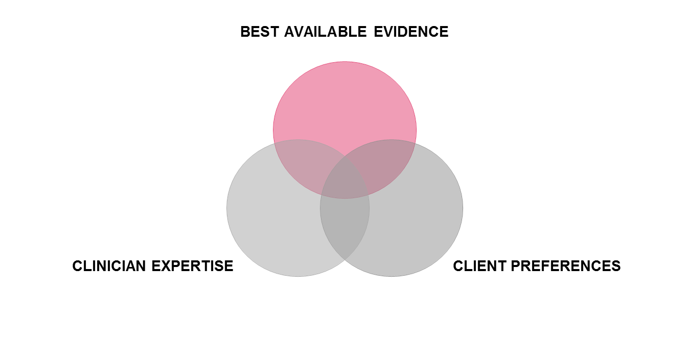
Shared Conceptualization of EBP for Behavioral Health

Slide 40
Evidence-Based Practice vs. Evidence-Based Practices
Evidence-Based Practice (EBP) as a process
Requires specific skill set to draw from existing research to inform clinical intervention
Evidence-Based Practices (EBPs)
Specific models of intervention with clear guidelines for implementation and rigorous research basis of support, a.k.a.:
“Evidence-Based Treatments” (EBTs),
“Evidence-Based Psychotherapies” (EBPT)
“Empirically Supported Treatment” (EST)
“Empirically Supported Intervention (ESI)

Slide 41
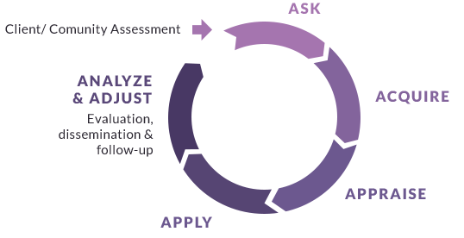
Steps of EBP Process Skill Set
The Five Steps (or Six A’s) of EBP Process:
Ask
Acquire
Appraise
Apply
Analyze & Adjust
Spring, B. & Hitchcock, K. (2009) Evidence-based practice in psychology. In I.B. Weiner & W.E. Craighead (Eds.) Corsini’s Encyclopedia of Psychology, 4th edition (pp. 603-607). New York: Wiley

Slide 42
Steps of EBP Process
1. ASK
Knowing how to formulate a client-oriented, objectively answerable question that is relevant to the health/behavioral health status of the individual or target population
Defining the context of the question: community, population and/or individual treatment need
Understanding what is most important to the client or population
Fine tuning the parameters of the questions
Know the best type of evidence to answer the question(s) at hand

Slide 43
Steps of EBP Process
2. ACQUIRE
Having the skill set to access the best available evidence to answer the question
Know where and how to find the best possible data
Familiarity with websites

Slide 44
Steps of EBP Process
3. APPRAISE
Having the skills to critically evaluate available evidence or to know how to access/recognize valid systematic appraisals by others
How do you know what is quality?
Assess validity, impact, and applicability of research
Identify gaps or inadequacies

Slide 45
Steps of EBP Process
4. APPLY
Use the best available empirical evidence to guide and support the intervention
Provider should synthesize the appraisal of evidence for the client to help them make an informed decision
Consumers/clients need to be viewed as partners in decision making

Slide 46
Steps of EBP Process
5. ANALYZE & ADJUST
Is whatever intervention that has been applied working and/or does it need some adjustment??

Slide 47
Hierarchies
of
Evidence

Slide 48
What Qualifies as Best Available Research?
What works? With whom? Are gains sustained? What is the evidence of applicability in the “real world”?
Formal definitions and standards for “model” or “well established” treatments and for “promising” treatments
What is your best evidence that something works?
Knowledge of the research
Clinical experience (outcome data?)

Slide 49
Hierarchies of Evidence (APA Task Force, 2005)
In decreasing order of strength:
Comparative treatment trials
Placebo-controlled trials
No-treatment control trials
Quantified clinical observations
Strongly positive clinical consensus
Mixed clinical consensus
Strongly negative clinical consensus
Evidence of Harmful Effects

Slide 50
California Evidence-Based Clearinghouse for Child Welfare Scientific Rating Scale
Provides criteria for assessing the evidence:
1. Well-Supported by Research Evidence
2. Supported by Research Evidence
3. Promising Research Evidence
4. Evidence Fails to Demonstrate Effect
5. Concerning Practice
NR. Not able to be Rated on the CEBC Scientific Rating Scale
https://www.cebc4cw.org/ratings/scientific-rating-scale/

Slide 51
Distinction between Evidence-Based Practice and Evidence-Based Practices
Have already met a defined set of research standards
Have clearly defined intervention parameters (i.e., a treatment manual)
Require training in the specific model with its specified set of tools
Also referred to as “EBTs” (Evidence-Based Treatments)

Slide 52
Evidence-Based and Promising Practice Treatments
Treatment models that target clinically meaningful populations, syndromes or situations
Clinical interventions that have an underlying conceptual framework and well defined treatment protocols (i.e. manualized)
Treatment Models that have a demonstrated research basis of support

Slide 53
Benefits of Evidence-Based Practice
Decrease symptoms
Increase rates of recovery (across a variety of measures)
Increase rates of client engagement
Increased retention rates and higher completion of services
Shows higher rates of service satisfaction compared to “service as usual”

Slide 54
Demand Across the Healthcare System: A Call to Action
Accountability
Demonstrating that what we do works
Improved Client Care
Identifying what interventions are most effective for achieving specified outcomes
Increasing client confidence in treatment
Consistency
Helping clients know what to expect from treatment
Shaping clinical practice through well-defined guidelines for therapists to follow

Slide 55
Break Time!
Be back in 10 minutes.

Slide 56
Making the Connection
Connecting the Mission of the Ethics of our Professions to the importance of using Evidence-Based Practice

Slide 57
Breakout Session: Connecting the Code of Ethics & EBP
Break out into 3 groups
Identify a spokesperson for group
Review the Code of Ethics
Identify where the NASW Code of Ethics supports using Evidence-Based Practices in Ethical Principles and Ethical Standards

Slide 58
Discussion of NASW Code of Ethics & EBP: Large Group Share
Where did you find EBP in Ethical Principals?
Where did you find EBP in Ethical Standards?
What are the key take-aways from your group?

Slide 59
NASW Code of Ethics & Evidence-Based Practice
Ethical Principles
Value: Service
Ethical Principle: Social workers’ primary goal is to help people in need and to address social problems. Social workers elevate service to others above self-interest. Social workers draw on their knowledge, values, and skills to help people in need and to address social problems. Social workers are encouraged to volunteer some portion of their professional skills with no expectation of significant financial return (pro bono service).
Value: Competence
Ethical Principle: Social workers practice within their areas of competence and develop and enhance their professional expertise. Social workers continually strive to increase their professional knowledge and skills and to apply them in practice. Social workers should aspire to contribute to the knowledge base of the profession.

Slide 60
NASW Code of Ethics & Evidence-Based Practice (continued)
Ethical Standard: Social Workers’ Ethical Responsibilities to Clients
1.04 Competence
Social workers should provide services and represent themselves as competent only within the boundaries of their education, training, license, certification, consultation received, supervised experience, or other relevant professional experience.
Social workers should provide services in substantive areas or use intervention techniques or approaches that are new to them only after engaging in appropriate study, training, consultation, and supervision from people who are competent in those interventions or techniques.
When generally recognized standards do not exist with respect to an emerging area of practice, social workers should exercise careful judgment and take responsible steps (including appropriate education, research, training, consultation, and supervision) to ensure the competence of their work and to protect clients from harm.

Slide 61
NASW Code of Ethics & Evidence-Based Practice (continued)
Ethical Standard: Social Workers’ Ethical Responsibilities to Clients
1.05 Cultural Competence
Social workers should demonstrate understanding of culture and its function in human behavior and society, recognizing the strengths that exist in all cultures.
Social workers should demonstrate knowledge that guides practice with clients of various cultures and be able to demonstrate skills in the provision of culturally informed services that empower marginalized individuals and groups. Social workers must take action against oppression, racism, discrimination, and inequities, and acknowledge personal privilege.
Social workers should demonstrate awareness and cultural humility by engaging in critical self-reflection (understanding their own bias and engaging in self-correction); recognizing clients as experts of their own culture; committing to life-long learning; and holding institutions accountable for advancing cultural humility.
Social workers should obtain education about and demonstrate understanding of the nature of social diversity and oppression with respect to race, ethnicity, national origin, color, sex, sexual orientation, gender identity or expression, age, marital status, political belief, religion, immigration status, and mental or physical ability.

Slide 62
NASW Code of Ethics & Evidence-Based Practice (continued)
Ethical Standard: Social Workers’ Ethical Responsibilities as Professionals
4.01 Competence
Social workers should accept responsibility or employment only on the basis of existing competence or the intention to acquire the necessary competence.
Social workers should strive to become and remain proficient in professional practice and the performance of professional functions. Social workers should critically examine and keep current with emerging knowledge relevant to social work. Social workers should routinely review the professional literature and participate in continuing education relevant to social work practice and social work ethics.
Social workers should base practice on recognized knowledge, including empirically based knowledge, relevant to social work and social work ethics.

Slide 63
NASW Code of Ethics & Evidence-Based Practice (continued)
Ethical Standard: Social Workers’ Ethical Responsibilities to the Profession
5.01 Integrity of the Profession
Social workers should work toward the maintenance and promotion of high standards of practice.
Social workers should uphold and advance the values, ethics, knowledge, and mission of the profession. Social workers should protect, enhance, and improve the integrity of the profession through appropriate study and research, active discussion, and responsible criticism of the profession.
Social workers should contribute time and professional expertise to activities that promote respect for the value, integrity, and competence of the social work profession. These activities may include teaching, research, consultation, service, legislative testimony, presentations in the community, and participation in their professional organizations.
Social workers should contribute to the knowledge base of social work and share with colleagues their knowledge related to practice, research, and ethics. Social workers should seek to contribute to the profession's literature and to share their knowledge at professional meetings and conferences.
(e) Social workers should act to prevent the unauthorized and unqualified practice of social work.

Slide 64
NASW Code of Ethics & Evidence-Based Practice (continued)
Ethical Standard: Social Workers’ Ethical Responsibilities to the Profession
5.02 Evaluation and Research
Social workers should monitor and evaluate policies, the implementation of programs, and practice interventions.
Social workers should promote and facilitate evaluation and research to contribute to the development of knowledge.
Social workers should critically examine and keep current with emerging knowledge relevant to social work and fully use evaluation and research evidence in their professional practice.

Slide 65
Evidence-Based Practices in Wisconsin

Slide 66
What Evidence-Based Practices are you Using?
A recent study estimated that 1-3% of publicly-funded behavioral health treatment agencies were implementing EBPs.
What EBPs do you know about? OR In which EBPs have you attended training?

Slide 67
How would you define an ethical dilemma?
How would you define a value dilemma?

Slide 68
Definitions: Ethical vs. Value Dilemma
Ethical Dilemma
Barksy (2019) defines an ethical issue as “any situations involving an ethical question-a question of right or wrong behavior-to be decided”
Value Dilemma
When the social worker has differing or conflicting morals or values from the client or when assisting a client who is dealing with an internal struggle related to the client’s own morals or values.

Slide 69
How Did You Make a Decision about the Dilemma?
Think of an example you have had with an ethical dilemma
or
Think of an example you have had with a value dilemma
What steps did you take to make a decision about the dilemma?

Slide 70
Reamer Ethical Dilemma Problem-Solving Model
Identify the ethical issues, including the social work values and ethics that conflict.
Identify the individuals, groups, and organizations that are likely to be affected by the ethical decision.
Tentatively identify all possible courses of action and the participants involved in each, along with possible benefits and risks for each.
Thoroughly examine the reasons in favor of and opposed to each possible course of action, considering relevant:
ethical theories, principles, and guidelines;
codes of ethics and legal principles;
social work practice theory and principles; and
personal values (including religious, cultural, and ethnic values and political ideology).
Consult with colleagues and appropriate experts (such as agency staff, supervisors, agency administrators, attorneys, ethics scholars, and ethics committees).
Make the decision and document the decision-making process.
Monitor, evaluate, and document the decision.

Slide 71
Practice Ethical Dilemma Problem Solving Model: Case Scenario One
As a practitioner you are accountable to services with the client. You are working with a client who is not making progress. The client is vocal about not making progress. You discuss the client during supervision. Your supervisor does not give you much direction. You do some reading on what you should do to support the client. Research indicates that the best intervention is an evidence-based treatment (for example DBT) that you have had two days of training. What decision should you make about the treatment for your client?

Slide 72
Discussion: Ethical Dilemma Case One
What is the ethical issue(s)?
Who is likely to be affected by the ethical decision?
What are the tentative courses of action---who will benefit and what are the risks?
Examine your reasoning---how did you consider:
ethical theories, principles, and guidelines;
codes of ethics and legal principles;
social work practice theory and principles; and
personal values (religious, cultural, and ethnic values and political ideology).
Who will you consult with?
How will you document the decision-making process?
How will you continue to monitor, evaluate, and continue to document the decision?

Slide 73
Practice Ethical Dilemma Problem Solving Model: Case Scenario Two
You recently attended an ethics and boundaries training that reviewed the ethical responsibility to use evidence-based practices in the helping professions, and are very passionate about wanting to provide evidence-based treatments in your work. You bring up your thoughts as a part of a clinical team meeting, and quickly become frustrated because it seems that although your direct supervisor supports your desire to use evidence-based treatments, your organization does not appear to, and has no money and little interest in moving towards an EBP model.

Slide 74
Discussion: Ethical Dilemma Case Two
What is the ethical issue(s)?
Who is likely to be affected by the ethical decision?
What are the tentative courses of action---who will benefit and what are the risks?
Examine your reasoning---how did you consider:
ethical theories, principles, and guidelines;
codes of ethics and legal principles;
social work practice theory and principles; and
personal values (religious, cultural, and ethnic values and political ideology).
Who will you consult with?
How will you document the decision-making process?
How will you continue to monitor, evaluate, and continue to document the decision?

Slide 75
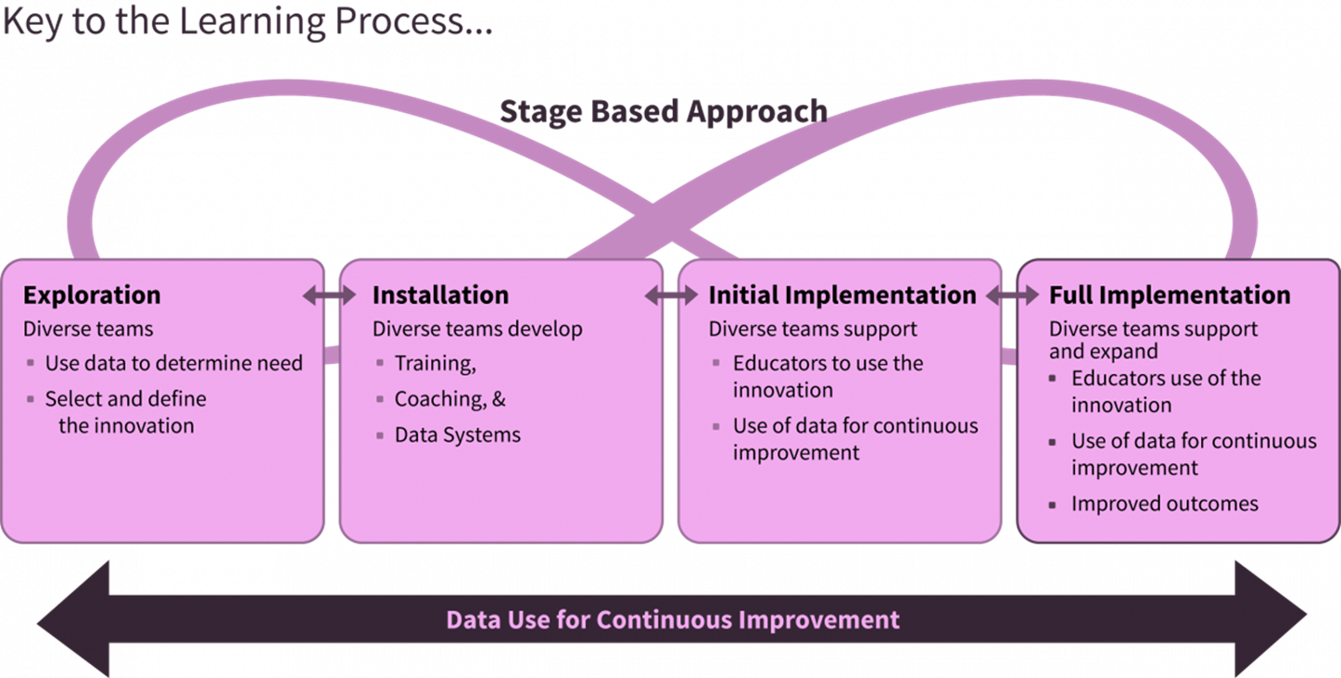
Implementation Science (Fixsen et al., 2005)

Slide 76
Research about Implementation
Dissemination of research and knowledge
Training alone
INSUFFICENT TO EFFECTIVELY CHANGE PRACTICE

Slide 77
Ensuring Fidelity
Pre-service training
Additional training as needed
Ongoing supervision/consultation
By model experts
Continuous Feedback Loops
Training
With focus on adherent model implementation
Tracking outcomes
Using data:
Adherence monitoring

Slide 78
Misconceptions about EBTs
“EBTs are too rigid – don’t take in to account client diversity”
All of the models to be presented emphasize the need for careful assessment of the unique combination of variables contributing to the presenting problem(s)

Slide 79
Misconceptions about EBTs
“EBTs ignore client values and preferences”
All of the models to be presented emphasize the fundamental principle that families must be full partners in defining the problem, determining the treatment goals and assessing how the intervention is working

Slide 80
Misconceptions about EBTs
“EBTs are too much of a ‘cookbook’ approach to very complex issues”
While the structure of each of the models to be presented gives a sequence of steps and/or tools to follow systematically in delivering the services according to the model, the actual “ingredients” (i.e. the goals, objectives and specific interventions of the treatment plan) are based on highly individualized assessment and treatment planning which are facilitated by the clinical expertise of the practitioner.

Slide 81
Misconceptions about EBTs
“EBTs do not take in to account, or allow for, clinical expertise (experience and judgment)”
All of the EBTs that will be reviewed in this course negate this criticism. The experience and knowledge base of the therapist are drawn upon every step of the way – e.g. in formulating the hypotheses about what is going on, in delivering the intervention and engaging clients in that process.
Emerging evidence that training in EBTs helps develop clinician skills for assessment and focused treatment plan development more generally (Baker-Ericzén, Jenkins, Park & Garland, 2015)

Slide 82
Misconceptions About Implementation of EBP
I completed the EBT training so that must mean I’m implementing the EBT.
Self-reported use of EBT is a valid and reliable way of assessing EBT fidelity.

Slide 83
Responses to Common Criticisms of EBTs
A related criticism posits that evidence-based treatments are not culturally competent since they typically are researched within controlled settings with highly selective samples that rarely include ethnic minority youth
Several of the in-home family treatment models were originally developed for specific ethnic minority populations
Meta review of evidence-based treatments studies for ethnic minority youth (Huey & Polo, 2008), reveals that there have been a number of studies for the specific in-home treatment models in this course providing evidence of effectiveness for different ethnic minority youth
Some research has looked at process variables with specific ethnic sub-populations
The models themselves promote cultural sensitivity in the very fundamental shared premise that to understand the targeted behaviors, one must understand the context surrounding the client

Slide 84
Responses to Common Criticisms of EBTs
“EBTs disregard the importance of the therapeutic alliance”
“Engagement”, “Co-construction of the treatment plan”, “collaborative agenda setting” are central themes in each of the models, and accountability rests with the clinician to find the way to interest and enlist clients to participate in treatment.

Slide 85
Responses to Common Criticisms of EBTs
“There is a big research-to-practice gap”
Many of the models have moved from efficacy studies (in research settings) to effectiveness studies in clinical settings
While the implementation of EBTs has many challenges, some of the models presented have also studied the dissemination process and have developed tools to facilitate transferability of the model and to monitor ongoing adherence.

Slide 86
Responses to Common Criticisms of EBTs
All of the emphasis on EBTs inhibits the implementation of practices that may be effective, but just not studied
With the EBTs in this course, there is a focus is on therapist/program accountability. The clinician strives to find the best supported intervention…However, where there is not data, there should still be rigor in looking at the specific outcomes for any given client with whatever intervention is collaboratively chosen

Slide 87
Responses to Common Criticisms of EBTs
“The focus on EBTs is simply a cost-cutting tool, to promote control by the insurance companies”
The intensive models that will be reviewed are actually more expensive than typical treatments for the same concerns, and are not being promoted by the commercial insurance programs

Slide 88
Final Thoughts
The aim of the helping professions is to alleviate conditions of those in need.
The profession is guided by values to use well-researched interventions with clinical experience, ethics, client preferences, and culture to guide and inform the delivery of treatments and services.
Although this is not easy to accomplish each of us needs to do our part.

Slide 89
Questions or Thoughts

Slide 90
Before you go…
Final Survey
Thank You
Contact Information:
Kristen Prock: prockk@uww.edu
Katherine Drechsler: drechslk@uww.edu
Sarah Hessenauer: hessenas@uww.edu

