Slide 1
Getting Ready for Evidence-Based Practice: Exploration Matters
Scott Caldwell
Now is the Time for Evidence-Based Practice
Youth Treatment Initiative Conference, August 2021
Notes:
1

Slide 2
Presentation Outline
Evidence-based practice (EBP) implementation background
The typical approach to EBPs
A different approach: Exploration matters
Closing activity

Slide 3
EBP Implementation Background
Source: Fixsen, Naoom, Blase, Friedman, & Wallace (2005);
National Implementation Research Network.

Slide 4
EBP Implementation Formula for Success
EBP delivered with fidelity
EBP integrated into routine practice
EBP beneficial outcomes
symptoms
recovery
engagement
completion
satisfaction
Staff learn new ways of working; make changes to practice.
Source: Fixsen et al. (2005).

Slide 5
Unfortunately, EBP implementation success is difficult to achieve…
Institute of Medicine (2001): “crossing the quality chasm”
Neal et al. (2015): “brokering the research practice gap”
Stirman et al. (2016): “bridging the gap”
Bruns et al. (2016): only 1-3% of behavioral health treatment agencies successfully implement EBPs

Slide 6
The Typical Approach to EBPs
A staff champion learns about an upcoming EBP training
Goes to leader, gets approval for training
Colleagues are informed about the upcoming training
Staff attend training
Leader to staff: now just do it
Staff to leader: we’re already doing it!

Slide 7
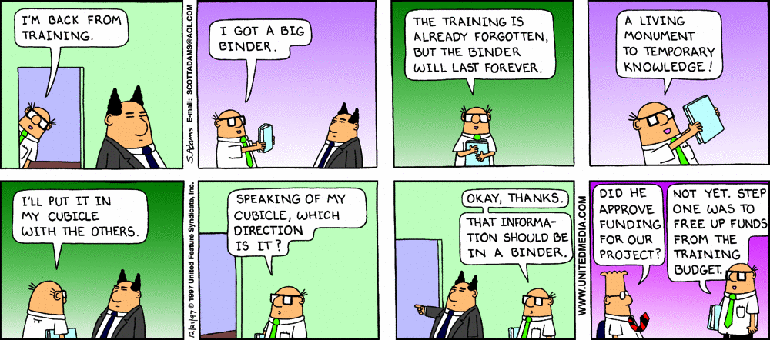
Typical Approach to EBPs = “Train and Hope”

Slide 8
Meta Analysis of Training in EBPs
Training Components | Knowledge | Skill | Use
Didactic workshop | 10% | 5% | 0%
+ Demonstration | 30% | 20% | 0%
+ Practice | 60% | 60% | 5%
Source: Joyce & Showers (2002).

Slide 9
Back to the formula for success…
60%
5%
3%
EBP delivered with fidelity
EBP integrated into routine practice
of potential beneficial outcomes
Source: Fixsen et al. (2005).

Slide 10
Back to the formula for success…
60%
5%
EBP delivered with fidelity
EBP integrated into routine practice
No EBP beneficial outcomes
Youth and families cannot benefit from an EBP they do not receive.
Source: Fixsen et al. (2005).

Slide 11
Meta Analysis of Training in EBPs
Training Components | Knowledge | Skill | Use
Didactic workshop | 10% | 5% | 0%
+ Demonstration | 30% | 20% | 0%
+ Practice | 60% | 60% | 5%
Training followed by regular on-the-job coaching | 95% | 95% | 95%
Source: Joyce & Showers (2002).

Slide 12
Brainstorm Activity 1
How could our agencies approach EBPs differently in the period before training to increase the likelihood of implementation success after training?

Slide 13
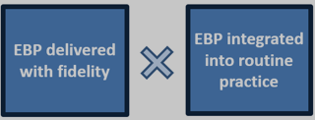
A Different Approach: Exploration Matters
Exploration
Initial Implementation
Full Implementation
Installation
Coaching Plan
Fidelity Assessment
Data System
EBP beneficial outcomes
Stages of Implementation
Source: Fixsen et al. (2005).

Slide 14
A Different Approach: Exploration Matters
During the Exploration Stage, information is gathered about one or more EBPs and questions are considered such as need, fit, and agency capacity to implement. Exploration results in a decision to move forward with an EBP—or not.
Exploration
Source: Fixsen, Ward, & Sims (2014).

Slide 15
A Different Approach: Exploration Matters
Exploration
* Form an implementation team
* Engage key exploration tasks
Source: Fixsen, Ward, & Sims (2014).

Slide 16
Form an Implementation Team
Purpose
An implementation team does the work of implementation through engagement of multiple stakeholders and completion of key stage-based tasks.
Source: Fixsen et al. (2005); Higgins, Weiner, & Young (2012); Metz & Bartley (2020).

Slide 17
Implementation Teams Make a Difference
Approach to Innovation (N = 376 organizations) | 2-year Outcomes
 | % implementation success | # months to achieve
Leader Edict (“just do it”) | 35% | 15
Leader Persuasion (“here’s why you should do it”) | 47% | 21
Implementation Team (“let’s get ready to do it, together”) | 73% | 16
Source: Nutt (2001) cited in Fixsen et al. (2013).

Slide 18
Implementation Teams Make a Difference
Approach to EBP | Long-term Outcomes
 | % implementation success | # years to achieve
Without implementation team in place (hope EBP happens) | 14% | 17
With implementation team in place (ensure EBP happens) | 80% | 3
Source: Fixsen et al. (2005).

Slide 19
Form an Implementation Team
Purpose
Membership
Repurpose a current team?
3-5 members
Some understanding of implementation
Some fluency in the EBPs of interest
Dedicated time
Empowered for decision-making
Source: Fixsen et al. (2005); Higgins, Weiner, & Young (2012); Metz & Bartley (2020).

Slide 20
Form an Implementation Team
Purpose
Membership
Key Tasks - Exploration Matters
Initiative inventory
EBP selection process
Attend to staff readiness
Source: Fixsen et al. (2005); Higgins, Weiner, & Young (2012); Metz & Bartley (2020).

Slide 21
Exploration Task 1:
Complete an Initiative Inventory
The implementation team can review existing agency initiatives, mandates, and resource commitments in order to guide decision making about the capacity and fit of potential new work.
Source: National Implementation Research Network

Slide 22
Exploration Task 1:
Complete an Initiative Inventory
Source: National Implementation Research Network

Slide 23
The implementation team can consider 6 important domains for each potential EBP.
Exploration Task 2:
Engage EBP Selection Process
NEED
SUPPORTS
EVIDENCE
CAPACITY
FIT
(The Initiative Inventory provides insights here.)
USABILITY
Source: Metz & Louison (2018).
Source: Metz & Louison (2018)

Slide 24
Potential EBPs to consider
Source: Metz & Louison (2018).
Source: Metz & Louison (2018)

Slide 25
Exploration Task 3: Attend to Staff Readiness
The implementation team considers staff readiness for new ways of working. This is critical for later implementation success.
Readiness is viewed as a process (not event) and a state (not trait) that fluctuates.
Source: Fixsen, Blase, Horner, Sims, & Sugai (2013).

Slide 26
Brainstorm Activity 2
What might be some strategies that could enhance staff readiness for new ways of working?

Slide 27
Exploration Task 3: Attend to Staff Readiness
The implementation team considers staff readiness.
Readiness is viewed as a process and a state.
Strategies:
Leader communicates the why of EBP implementation
Include staff in the EBP selection process
Normalize ambivalence about new ways of working
Make clear the requirements for EBP delivery with fidelity—“truth in advertising”
Invite staff to self-select into the first group of implementers
Source: Fixsen, Blase, Horner, Sims, & Sugai (2013).

Slide 28
Summary: A Different Approach to EBPs
A staff champion learns about upcoming training in an EBP; asks leader to approve
Leader forms an implementation team (including staff champion)
Team conducts initiative inventory and considers the EBP with Hexagon Tool
Team involves stakeholders and attends to staff readiness
Decision made to move forward with the EBP—or not!

Slide 29
Bottom Line: Exploration Matters
Approach to EBP (N = 6 agencies) | 1-year Outcomes
 | % implementation success | cost ($) per staff
Did not complete exploration | 13% | $924
Did complete exploration | 65% | $365
“…these findings indicate a striking cost savings for sites completing the readiness process and support the thoughtful application of readiness procedures in the early stages of an implementation initiative.” Source: Romney, Israel, & Zlatevski (2014).

Slide 30
Closing Activity
In the chat box, please respond to one question:
What is the most important thing you learned here about exploration matters? Or…
If your agency is currently considering an EBP initiative, what might be a next right step?

Slide 31
References
Bruns, E. J., Kerns, S. E. U., Pullmann, M. D., Hensley, S. W., Letterman, T., & Hoagwood, K. (2016). Research, data, and evidence-based treatment use in state behavioral health systems, 2001-2012. Psychiatric Services, 67(5), 496-503.
Fixsen, D. L., Blase, K., Horner, R., Ward, C., & Sugai, G. (2013). Readiness for change [Scaling-up Brief, No. 3]. Chapel Hill, NC: National Implementation Research Network. Access from https://files.eric.ed.gov/fulltext/ED507442.pdf
Fixsen, D. L., Naoom, S. F., Blase, K. A., Friedman, R. M., & Wallace, F. (2005). Implementation research: A synthesis of the literature. Tampa, FL: University of South Florida. Access from https://nirn.fpg.unc.edu/resources/implementation-research-synthesis-literature
Fixsen, D. L., Ward, C., & Sims, B. (2014). Exploration stage [Scaling-up Brief, No. 4]. Chapel Hill, NC: National Implementation Research Network. Access from https://nirn.fpg.unc.edu/resources/exploration-stage
Higgins, M. C., Weiner, J., & Young, L. (2012). Implementation teams: A new lever for organizational change. Journal of Organizational Behavior, 33, 366-388.
Institute of Medicine (2001). Crossing the quality chasm: A new health system for the 21st century. Washington DC: National Academy Press.
Joyce, B., & Showers, B. (2002). Student achievement through staff development (3rd ed.). Alexandria, VA: Association for Supervision and Curriculum Development.
Metz, A., & Bartley, L. (2020). Implementation teams: A stakeholder view of learning and sustaining change. In B. Albers, A. Shlonsky, & R. Mildon (Eds.), Implementation science 3.0 (pp. 199-225). Cham, Switzerland: Springer.
Metz, A. & Louison, L. (2018). The hexagon tool: Exploring context. Chapel Hill, NC: National Implementation Research Network. Access from https://nirn.fpg.unc.edu/resources/hexagon-exploration-tool
National Implementation Research Network. Initiative inventory. Access from https://nirn.fpg.unc.edu/resources/initiative-inventory
Neal, J. W., Neal, Z. P., Kornbluh, M., Mills, K. J., & Lawlor, J. A. (2015). Brokering the research-practice gap: A typology. American Journal of Community Psychology, 56(3-4), 422-435.
Nutt, P. C. (2001). Contingency approaches applied to the implementation of strategic decisions. International Journal of Business, 6(1), 53‐84.
Stirman, S. W., Gutner, C. A., Langdon, K., & Graham, J. R. (2016). Bridging the gap between research and practice in mental health service settings: An overview of developments in implementation theory and research. Behavior Therapy, 47(6), 920-936.
Romney, S., Israel, N., & Zlatevski, D. (2014). Effect of exploration‐stage implementation variation on the cost effectiveness of an evidence‐based parenting program. Zeitschrift für Psychologie, 222(1), 37-48.

Slide 32
Thank you scott.caldwell@dhs.wisconsin.gov

