Slide 1
Wisconsin Youth Treatment Initiative Lessons Learned and Formula for Success
Jason Cram, Wisconsin Department of Health Services
Janae Goodrich, UW-Madison Population Health Institute
Rachel Amos, UW-Madison Population Health Institute
Notes:
Jason – introductions

Slide 2
Background
Funded by a four-year grant from Substance Abuse and Mental Health Services Administration, October 2017 – September 2021.
Contracted with four clinics across the state to provide evidence-based treatment.
Selected evidence-based practice: Multidimensional Family Therapy (MDFT).
Notes:
PHI

Slide 3
Program Purpose
“The purpose of this program is to provide funding to improve treatment for adolescents and/or transitional aged youth with substance use disorders and/or co-occurring substance use and mental health disorders by assuring youth statewide access to evidence-based assessments, treatment models, and recovery services supported by the strengthening of the existing infrastructure system.”
https://www.samhsa.gov/grants/grant-announcements/ti-17-002
Notes:
PHI

Slide 4
Clinic Locations
Partner sites located in:
Rural and urban areas.
Areas with a low number of providers.
High areas of substance use/abuse.
Partner sites are:
County agency.
Hospital affiliation.
Non-profit private practice.
Notes:
PHI

Slide 5
Population Served
111 youth and young adults served
*Data as of July 2, 2021 – Source: SPARS Reports
Notes:
PHI

Slide 6
Preliminary Outcomes
Six-month follow-up outcomes
*Data as of July 2, 2021
(N = 68)
Source: SPARS Reports
Preliminary youth MDFT behavioral outcomes at discharge
96% lived at home/not in a placement
94% had no drug use other than Marijuana or alcohol
94% had no new arrests
81% used Marijuana/alcohol less than 10 days per month
74% in school or working
*Data as of September 30, 2020, (N = 89), Source: Years 1-3 Evaluation Report
Notes:
PHI

Slide 7
Successes
Structure for family therapy
Strengths of the MDFT model
Positive outcomes for youth and family
Alternative to inpatient treatment
Innovative opportunities for outreach
Notes:
PHI

Slide 8
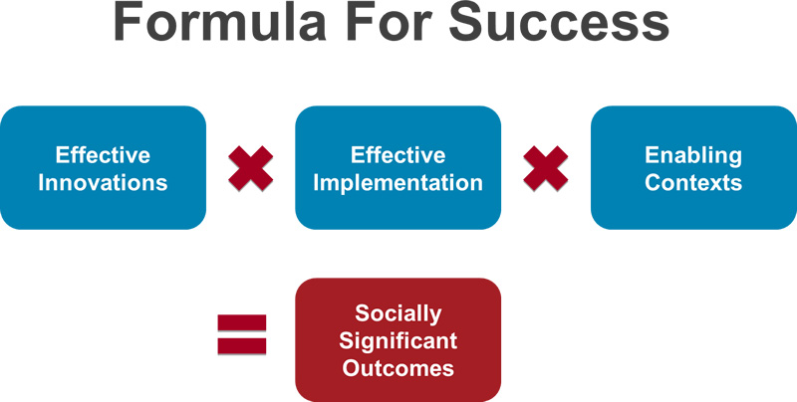
Formula for Success
Notes:
DHS

Slide 9
Challenges to Implementation
Lack of planning grant
Lack of interested and qualified providers
Start-up challenges
Training delays
Staff retention
Notes:
DHS

Slide 10
Challenges to Implementation
Staff recruitment
Training and train-the-trainer models
Development of referral sources
Estimation of target age population
Evidence-based practice alignment with billing structure
Notes:
DHS

Slide 11
Challenges to Implementation
Wisconsin is largely rural with 5.8 million residents; 36% of the population living in 4 of 72 counties; and 44 of 72 counties having a population below 50,000.
Wisconsin does not have Medicaid expansion.
There is little financial incentive for a clinic or clinician to use an evidence-based practice.
Notes:
DHS

Slide 12
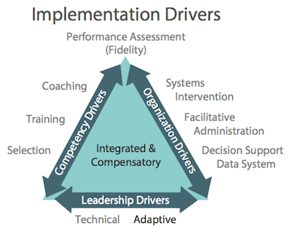
Implementation Drivers
Notes:
DHS

Slide 13
Lessons Learned
Lack of planning grant (leadership drivers)
Utilize implementation science
Apply the lessons learned – implementation teams
Begin planning for future grants
Engage potential vendors before application
Lack of interested and qualified providers (competency drivers)
Address initiative overload early
Engage potential vendors before application
When possible, target specific vendors
Begin sustainability planning immediately
Notes:
DHS

Slide 14
Lessons Learned
Start-up challenges (organization drivers)
Consult with others in implementation of evidence-based practices
Engage evidence-based practices trainers early and often
Anticipate delays
Training delays (organization drivers)
Engage evidence-based practices trainers early and often
Establish a flexible training plan
Plan for multiple training locations and times
Consider virtual training when possible
Notes:
DHS

Slide 15
Lessons Learned
Staff retention (organization and competency and leadership drivers)
Fully understand the training time and costs
Appreciate that practicing an evidence-based practice to fidelity is not for everyone
Focus on workforce development
Increased reimbursement for evidence-based practice delivery
Importance of a local champion
Staff recruitment (competency drivers)
Workforce development
Incentives
Notes:
DHS

Slide 16
Lessons Learned
Training and train-the-trainer models (leadership, competency, and organization drivers)
Centralized trainer
Collaborate with evidence-based practice developer
Build in and budget for redundancy
Development of referral sources (organization driver)
Immediate and continued outreach with local adaptation
Advertising
Forums for presenting model and Q&A
Promote the benefits of evidence-based practices and the long-term cost savings
Notes:
DHS

Slide 17
Lessons Learned
Target age range and geography (organization and leadership drivers)
Work to build consortiums
Explore family and natural support engagement opportunities
Use of video technology or telemedicine where applicable
Financial (organization and leadership drivers)
Promote systems change at state and insurance levels
Promote utilization of Medicaid reimbursement
Notes:
DHS

Slide 18
Data Collection Challenges and Lessons Learned
Challenges
Amount of data collection required
Alignment between data collection requirements
Lessons learned (organization and competency drivers)
Training for staff
Ongoing monitoring and reminders
Dedicated staff time
Local measurement of success
Notes:
PHI

Slide 19
Notes:
DHS

Slide 20
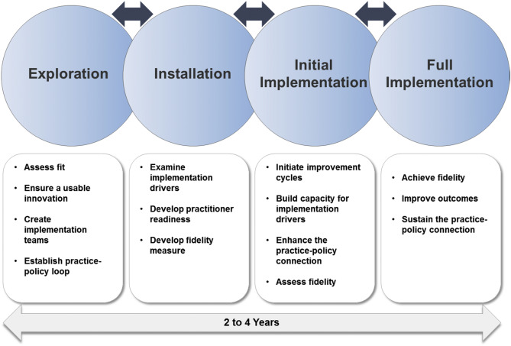
Formula for Implementation
Notes:
DHS

Slide 21
An Eye to the Future
Promote a sustainable system of care that meets the needs of a population through the utilization of evidence-based practices to fidelity.
Sustainability of existing sites
Workforce development
Implementation team
Develop in-house trainers
Decision support data system
Include potential vendors in the planning
Notes:
PHI and DHS
Sustainability of existing sites - PHI
Workforce development - Jason
Implementation team - Jason
Develop in-house trainers - Jason
Decision support data system - PHI
Include potential vendors in the planning - DHS

Slide 22
Contact Information
Jason Cram
Children, Youth, and Families Section Chief
Wisconsin Department of Health Services
jason.cram@dhs.wisconsin.gov
Janae Goodrich
Associate Researcher
University of Wisconsin-Madison Population Health Institute
jgoodrich@wisc.edu
Rachel Amos
Associate Research Specialist
University of Wisconsin-Madison Population Health Institute
reamos@wisc.edu

