Slide 1
Spring 2023 General Meeting
University staff

Slide 2
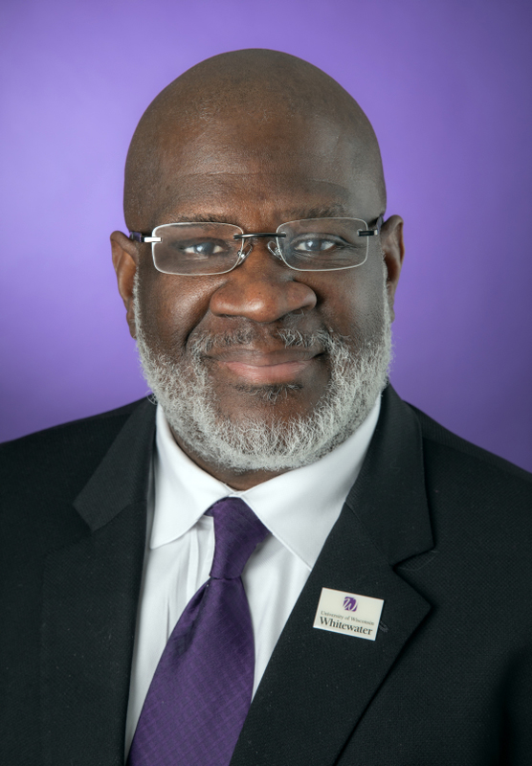
Spring 2023 General Meeting University Staff
CHANCELLOR
Dr. Corey King
Welcome

Slide 3
Spring 2023 General Meeting University Staff
KEPRO
Kelly Rissky
UWW Updates

Slide 4
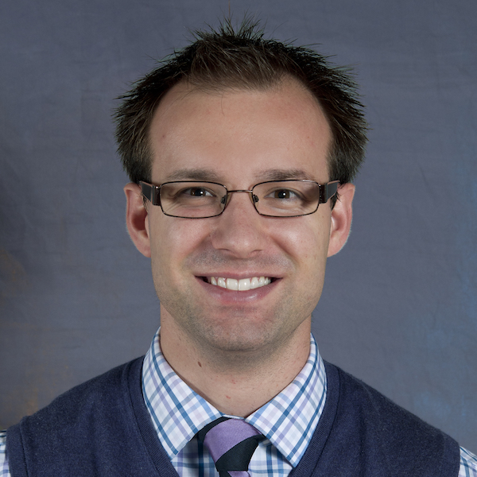
Spring 2023 General Meeting University Staff
STRATEGIC PRIORITIES
Matt Winden
UWW Updates

Slide 5
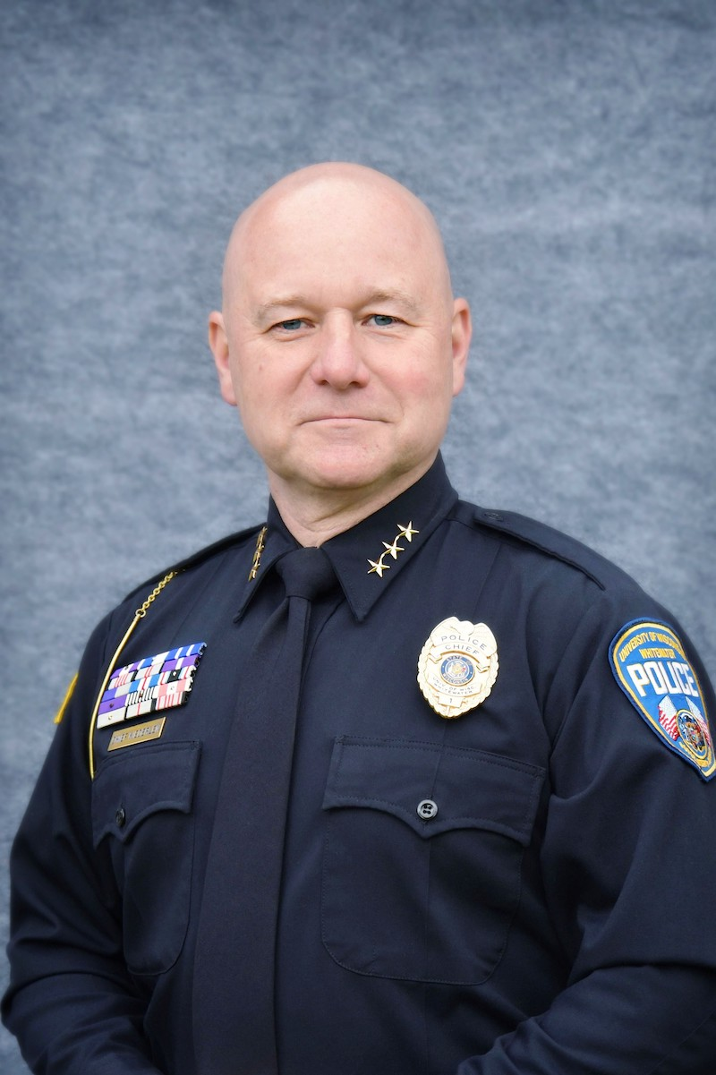
Spring 2023 General Meeting University Staff
PARKING
Chief Matt Kiederlen
UWW Updates

Slide 6
Spring 2023 General Meeting University Staff
Well Wisconsin
Kristi Mulcahey
UWW Updates

Slide 7
Spring 2023 General Meeting University Staff
UWW Updates

Slide 8
Spring 2023 General Meeting University Staff
Annual US Excellence Awards
Employee Recognition
Regent US Excellence Awards
Individual
Program

Slide 9
Spring 2023 General Meeting University Staff
Employee Recognition
& Retirement Dinner
May 9, 2023
UC Hamilton Room
4:30 pm – Open Bar
5:30 pm – Dinner
6:30 pm – Presentation
Employee Recognition

Slide 10
Spring 2023 General Meeting University Staff
April 12, 2023
8:30 am – 3:30 pm | Union South
UWS Training
WHO SHOULD ATTEND?
UW System employees who would like to learn professional skills across a wide variety of valuable topics such as:
Career management
Engagement, inclusion, and diversity
Leadership
Personal development and workplace skills
Relationship building and communication
Well-being
COST - $125
REGISTRATION DUE – 3/28/23
https://hr.wisc.edu/administrative-professionals-conference/

Slide 11
Spring 2023 General Meeting University Staff
Want to get involved?
Here’s how …
JOIN USC
Election process starts in April
Watch your email for nomination requests
2-year terms July 2023-June 2025

Slide 12
Spring 2023 General Meeting University Staff
Want to get involved?
Here’s how …
JOIN A COMMITTEE
UW-W Committees
USC Committees
Search Committees
Interested? Email: usc@uww.edu

Slide 13
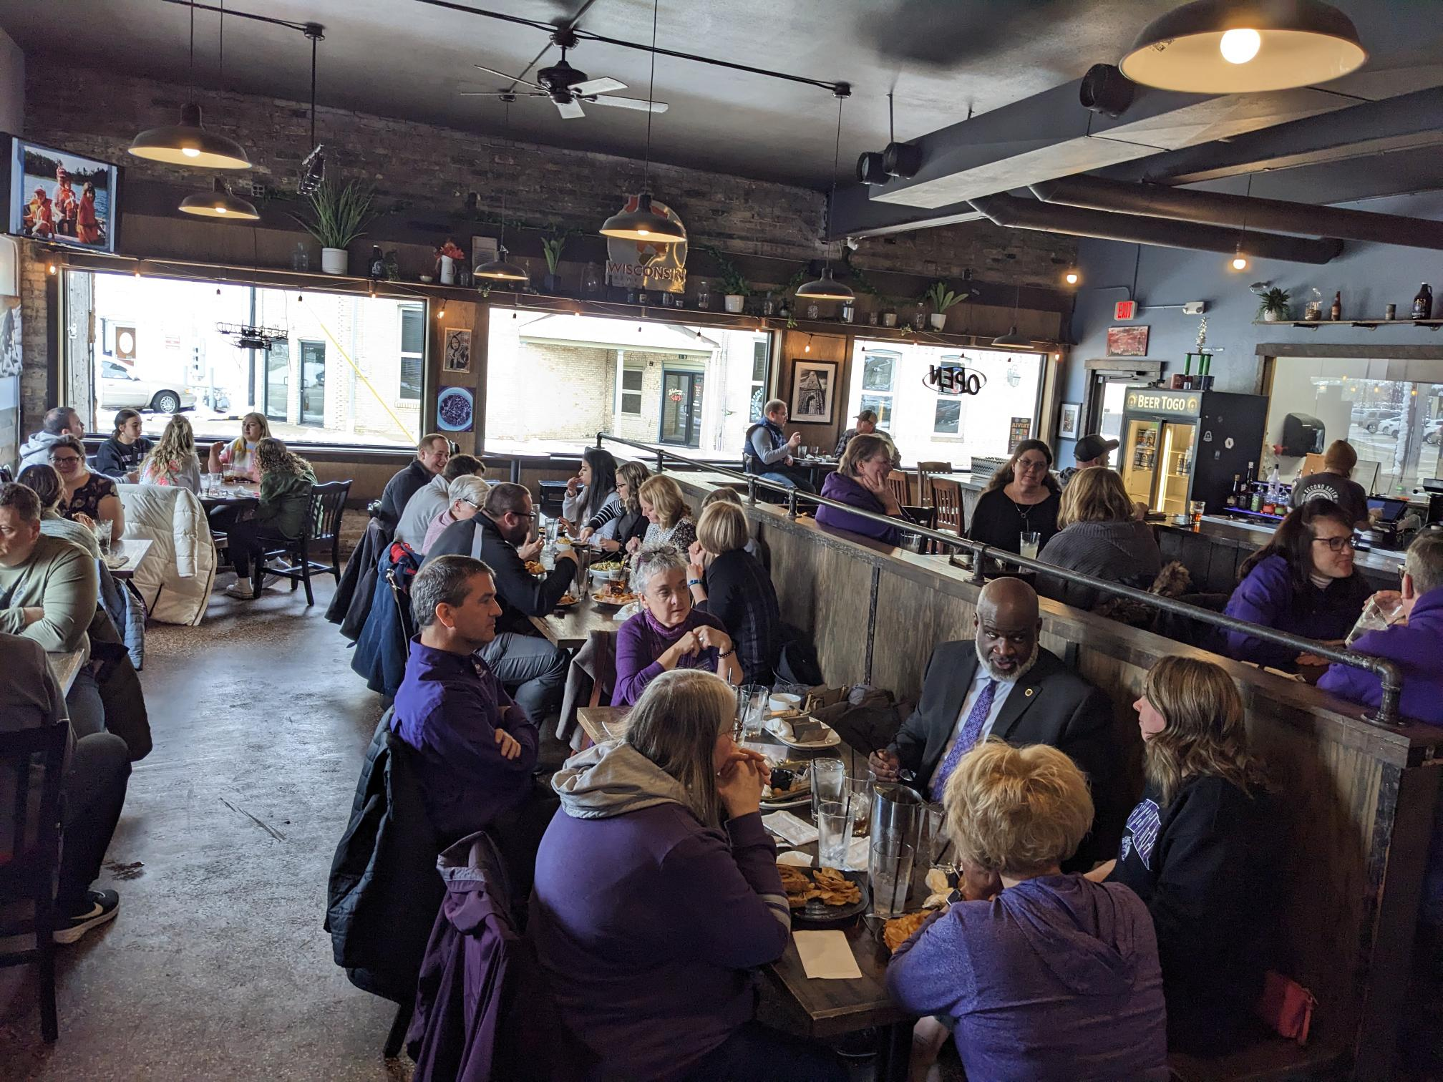
Spring 2023 General Meeting University Staff
Second Salem – March 10, 2023
USC Fundraiser

Slide 14
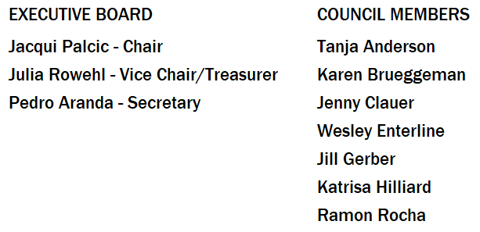
Spring 2023 General Meeting University Staff
Email: usc@uww.edu
Website: uww.edu/usc
Contact USC

